Slide 1
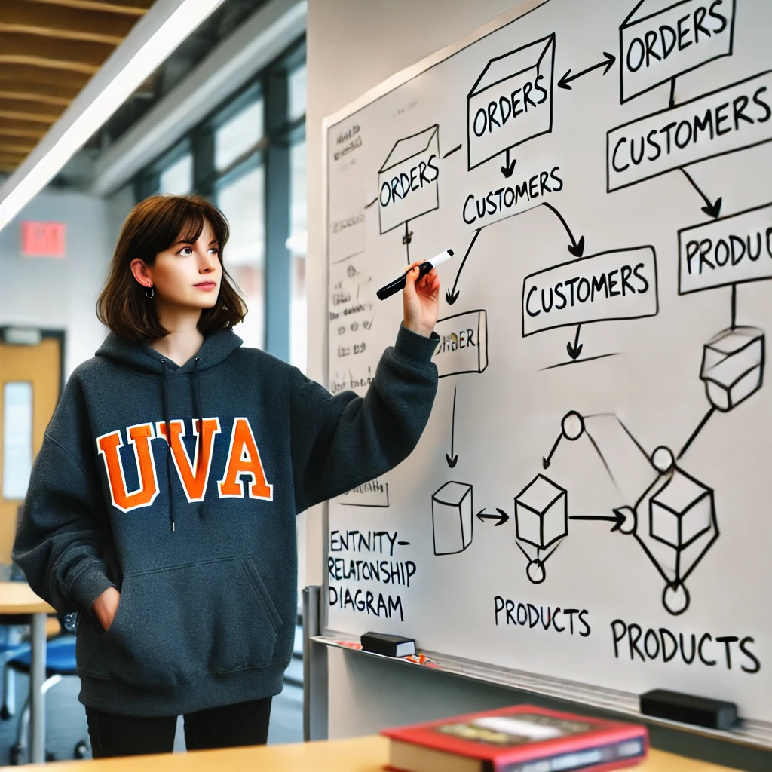
Database Design Practice
Stefano Grazioli

Slide 2
Critical thinking
Next Monday: SQL in-class test
Pledged, Individual, Open book, in RRH 225
Your computer
One column added to LOAN (“purpose”)
No GenAI, code generators, AI, etc.
Team formation
MP4 is individual, but MP5 is done in teams of three

Slide 3
You do the talking
Name
Year, Concentration, Track…
How hard was Smallbank 2?
Things I like about the class
Things than can be improved

Slide 4
Orange Words
Union statement
Nested query
Having command

Slide 5
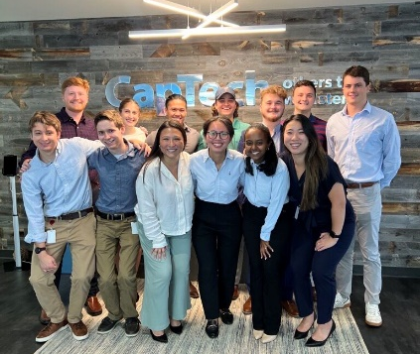
Your next project as an IT consultant
Welcome... to your next job (MP#4)
Notes:
Real consulting company, but the project is fictional.

Slide 6
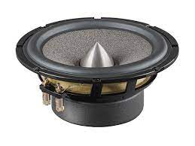
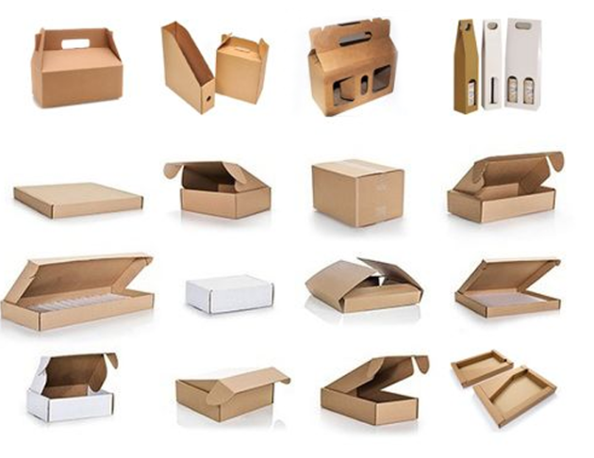
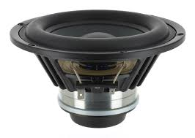
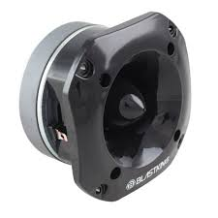
DigiSonos and UBC go invoiceless
B2B

Slide 7
How does invoiceless work?
Info flow in orange
Goods flow in blue
1. Purchase order
2a. Goods
2b. Packing ‘slip’ or ‘list’
3. Returned goods
4.Payment
5. Reconciliation

Slide 8
You will consult with one department and focus on one step of the overall process
1. Purchase order
2a. Goods
2b. Packing ‘slip’ or ‘list’
3. Returned goods
Purchasing Dept.
Receiving Dept.
Accounts payable Dept.
Sales Dept.
Shipping Dept.
Accounts receivable Dept.
4.Payment
5. Reconciliation

Slide 9
Website has all the details
The department you are supporting (e.g. ‘sales’) sent you a memo
Mandatory tool is MySQLWorkbench (there is a video)

Slide 10
WINIT
What is new in IT

Slide 11
Practice for MP4
This is design, not math.
Focus on providing places for storing the data that your users need to do their job

Slide 12
Attributes
ACME keeps track of its customers. Each customer has a customerID, name, address, and phone number.

Slide 13
Multi-Valued Attributes
ACME keeps track of its customers. Each customer has a customerID, name, address, and phone number. However, they often have several different addresses where they may take delivery.

Slide 14
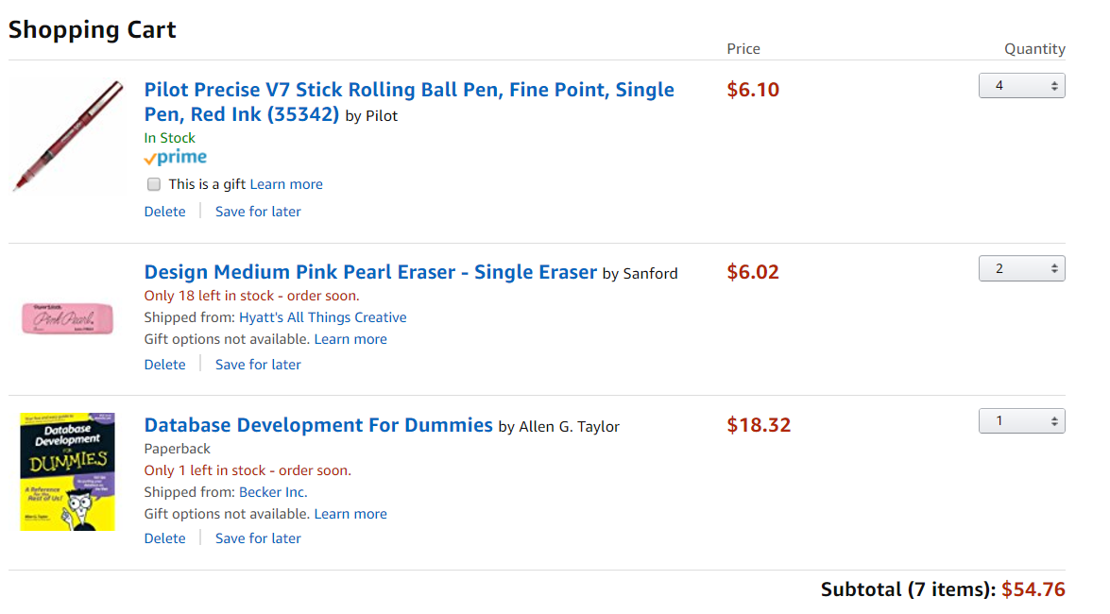
Order: one header, three line items
Common part (“Order Header” or “Order”)
Order
Rose Ct. 224, Atlanta GA
Ordered items (“Line items”)
Geniuses
for Geniuses

Slide 15
Relationships
Orders include many products and the ordered quantities. Orders have a number and a date. Products have a SKU, a name, and a MSRP (i.e., fixed/non-negotiable) price.
MSRP = Manufacturer’s Suggested Retail Price

Slide 17
Tables
Acme employs 207 employees. We keep track of their names, social security numbers, and employee_id.

Slide 18
Multiple Tables
Each product must be inspected by one ACME employee before sale.

