Slide 1

More practice with business data modeling (MP4 and MP5)
Stefano Grazioli

Slide 2
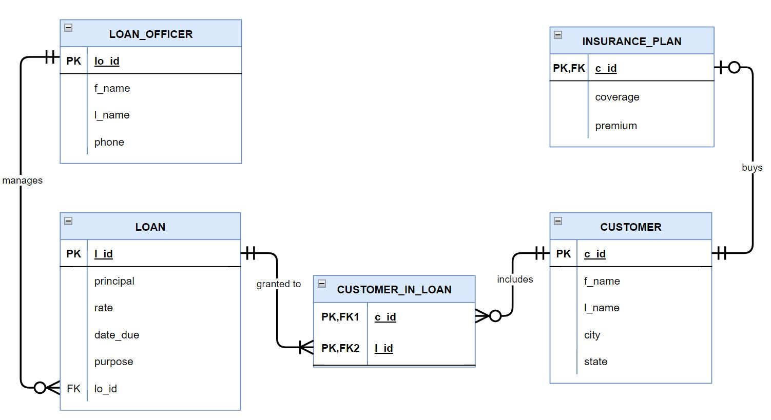
Critical thinking
Monday Test will be on SmallBankDB

Slide 3
Common mistakes in SQL
When renaming columns with AS, use “” to insert spaces between words
Understand why in many cases GETDATE() is better than a fixed date
Read the question carefully: e.g., sorting ASC/DESC
If a question asks “How many...?",
you need to use COUNT(*)

Slide 4
You do the talking
Name
Year, Concentration, Track…
Am I more confident with SQL?
Things I like about the class
Things than can be improved

Slide 5
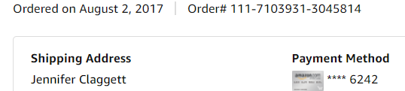
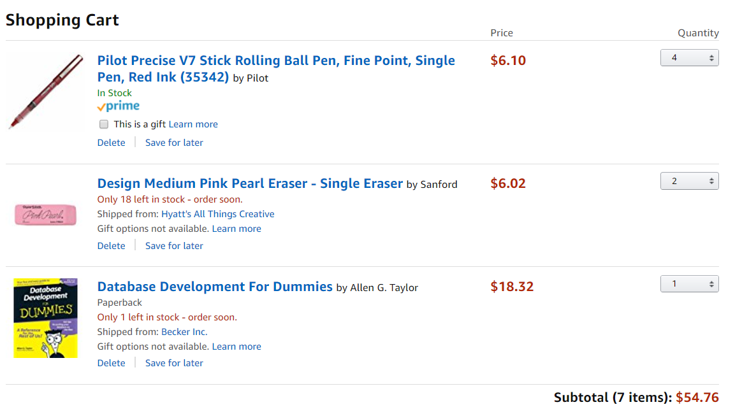
From last time….
Common part (“Header”)
Order
Rose Ct. 224, Atlanta GA
Ordered items (“Line items”)
Geniuses
for
Geniuses

Slide 6
You do the modeling
Orders include many products and the ordered quantities. Orders have a number and a date. Products have a SKU, a name, and a MSRP (i.e., fixed/non-negotiable) price.
MSRP = Manufacturer’s Suggested Retail Price

Slide 7

How does this change my database design?
Orders include many products and the ordered quantities. Orders have a number and a date. Products have a SKU, a name, and a MSRP (i.e., fixed/non-negotiable) price. MSRP changes in time. Prices of items are negotiated order by order.

Slide 8
How does this change my database design?
The salesperson may also apply a discount to the whole order. Since that’s a lot of discretionary power, ACME wants to know which salesperson sold each order.

Slide 9
WINIT
What is new in IT

Slide 10


Shipments
3 (of 4)
2 (of 2)
0 (of 1)
Customer
A ‘shipment’

Slide 11
The printout that summarizes the shipment info is often called a “Packing list” (or “slip”)
Packing List Date Shipped: August 4, 2022 Shipment ID# 523423 (OrderNo 111-71039310-3045814)
PRODUCT | ORDERED | SHIPPED
Pilot Red Pens | 4 | 3
Pink Eraser | 2 | 2
Database for Geniuses | 1 | 0
Common part (“Header”)
Shipped items in the box (“Line items”)

Slide 12
Packing list/Shipment- Line Item – Product is another common pattern
ACME fulfills each order by means of one or more shipments. Each shipment may either include all or only a portion of the quantities ordered.
3 (of 4)
2 (of 2)
Customer
0 (of 1)
A ‘shipment’

Slide 13
DB design principles (MP4)
If it is a process (e.g., a decision) do not represent it.
  But you might need to keep track that it happened, or who did it
If it can be calculated, do not represent it
  Unless explicitly asked

Slide 14
Separating process and data can be tricky.
Customers pay us (electronically) as soon as they receive the goods we ship to them, as detailed in the packing slip. We keep track of these payments.

Slide 15
Separating process and data can be tricky
Orders at ACME that receive a discount larger than 50% must be approved by a manager.

Slide 16
Relationships (Advanced)
From Before: Acme employs 207 employees. We keep track of their names, social security numbers, and employee_id.
Now add: Managers manage employees. Managers are employees too.

