Slide 1
Comparing normalized and denormalized DBs
Which is best?

Slide 2
Critical thinking
Questions on MP6 (ad Campaigns)?
Starting the second part of the course: Business Intelligence
Reporting
Visualization
Simple math decision making

Slide 3
You do the talking
Name, major…
Do you feel you are learning the skill?
Things you like about the class
Things that can be improved

Slide 4
Orange words
View

Slide 5
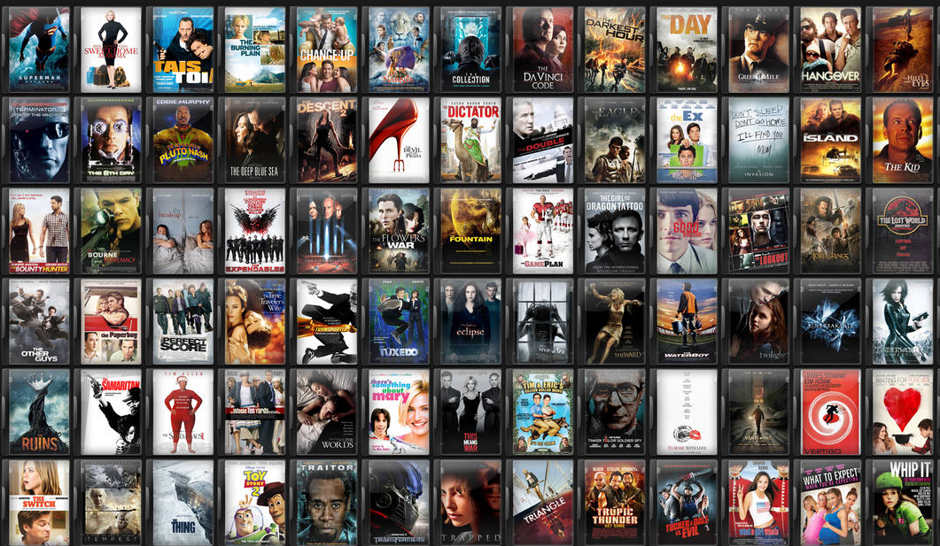
You are in charge of the user experience at Netflix/Prime
How would you organize the movies for the users?
Notes:
Netflix has 3500~4000 movies

Slide 6
The way data is organized makes certain operations easier, and others more difficult.

Slide 7
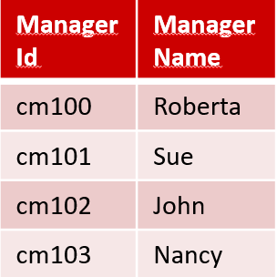
Why managers at Pressly might prefer looking at denormalized data?
Normalized vs. Denormalized data
Ad Campaign ID | Type Id | Budget in millions
111 | 1 | $ 5
111 | 2 | $ 5
222 | 1 | $ 6
222 | 3 | $ 3
222 | 5 | $ 10
333 | 3 | $ 8
333 | 4 | $ 2
444 | 6 | $ 10
555 | 3 | $ 10
AdCampaign ID | Name | Start | Duration (days) | ManagerId | Manager Name | TypeId | Media | Range | Budget in millions
111 | SummerFun | 6/6/22 | 12 | cm100 | Roberta | 1 | TV | Local | $ 5
111 | SummerFun | 6/6/22 | 12 | cm100 | Roberta | 2 | TV | National | $ 5
222 | SummerZing | 6/8/22 | 30 | cm101 | Sue | 1 | TV | Local | $ 6
222 | SummerZing | 6/8/22 | 30 | cm101 | Sue | 3 | Social | Local | $ 3
222 | SummerZing | 6/8/22 | 30 | cm101 | Sue | 5 | Web | Local | $ 1
333 | FunBall | 6/9/22 | 12 | cm102 | John | 3 | Social | Local | $ 8
333 | FunBall | 6/9/22 | 12 | cm102 | John | 4 | Social | National | $ 2
444 | FallStyle | 6/9/22 | 5 | cm103 | Nancy | 6 | Web | National | $ 10
555 | FallColors | 6/9/22 | 3 | cm100 | Roberta | 3 | Social | Local | $ 10
TypeId | Media | Range
1 | TV | Local
2 | TV | National
3 | Social | Local
5 | Web | Local
4 | Social | National
6 | Web | National
AdCampaignID | Name | Start | Duration (days) | ManagerID (FK)
111 | SummerFun | 6/6/22 | 12 | cm100
222 | SummerZing | 6/8/22 | 30 | cm101
333 | FunBall | 6/9/22 | 12 | cm102
444 | FallStyle | 6/9/22 | 5 | cm103
555 | FallColors | 6/9/22 | 3 | cm100

Slide 8
Which DB is faster?
Normalized vs. Denormalized data
Ad Campaign ID | Type Id | Budget in millions
111 | 1 | $ 5
111 | 2 | $ 5
222 | 1 | $ 6
222 | 3 | $ 3
222 | 5 | $ 10
333 | 3 | $ 8
333 | 4 | $ 2
444 | 6 | $ 10
555 | 3 | $ 10
AdCampaign ID | Name | Start | Duration (days) | ManagerId | Manager Name | TypeId | Media | Range | Budget in millions
111 | SummerFun | 6/6/22 | 12 | cm100 | Roberta | 1 | TV | Local | $ 5
111 | SummerFun | 6/6/22 | 12 | cm100 | Roberta | 2 | TV | National | $ 5
222 | SummerZing | 6/8/22 | 30 | cm101 | Sue | 1 | TV | Local | $ 6
222 | SummerZing | 6/8/22 | 30 | cm101 | Sue | 3 | Social | Local | $ 3
222 | SummerZing | 6/8/22 | 30 | cm101 | Sue | 5 | Web | Local | $ 1
333 | FunBall | 6/9/22 | 12 | cm102 | John | 3 | Social | Local | $ 8
333 | FunBall | 6/9/22 | 12 | cm102 | John | 4 | Social | National | $ 2
444 | FallStyle | 6/9/22 | 5 | cm103 | Nancy | 6 | Web | National | $ 10
555 | FallColors | 6/9/22 | 3 | cm100 | Roberta | 3 | Social | Local | $ 10
TypeId | Media | Range
1 | TV | Local
2 | TV | National
3 | Social | Local
5 | Web | Local
4 | Social | National
6 | Web | National
AdCampaignID | Name | Start | Duration (days) | ManagerID (FK)
111 | SummerFun | 6/6/22 | 12 | cm100
222 | SummerZing | 6/8/22 | 30 | cm101
333 | FunBall | 6/9/22 | 12 | cm102
444 | FallStyle | 6/9/22 | 5 | cm103
555 | FallColors | 6/9/22 | 3 | cm100
How many managers do we have?

Slide 9
Which DB is faster?
Normalized vs. Denormalized data
Ad Campaign ID | Type Id | Budget in millions
111 | 1 | $ 5
111 | 2 | $ 5
222 | 1 | $ 6
222 | 3 | $ 3
222 | 5 | $ 10
333 | 3 | $ 8
333 | 4 | $ 2
444 | 6 | $ 10
555 | 3 | $ 10
AdCampaign ID | Name | Start | Duration (days) | ManagerId | Manager Name | TypeId | Media | Range | Budget in millions
111 | SummerFun | 6/6/22 | 12 | cm100 | Roberta | 1 | TV | Local | $ 5
111 | SummerFun | 6/6/22 | 12 | cm100 | Roberta | 2 | TV | National | $ 5
222 | SummerZing | 6/8/22 | 30 | cm101 | Sue | 1 | TV | Local | $ 6
222 | SummerZing | 6/8/22 | 30 | cm101 | Sue | 3 | Social | Local | $ 3
222 | SummerZing | 6/8/22 | 30 | cm101 | Sue | 5 | Web | Local | $ 1
333 | FunBall | 6/9/22 | 12 | cm102 | John | 3 | Social | Local | $ 8
333 | FunBall | 6/9/22 | 12 | cm102 | John | 4 | Social | National | $ 2
444 | FallStyle | 6/9/22 | 5 | cm103 | Nancy | 6 | Web | National | $ 10
555 | FallColors | 6/9/22 | 3 | cm100 | Roberta | 3 | Social | Local | $ 10
TypeId | Media | Range
1 | TV | Local
2 | TV | National
3 | Social | Local
5 | Web | Local
4 | Social | National
6 | Web | National
AdCampaignID | Name | Start | Duration (days) | ManagerID (FK)
111 | SummerFun | 6/6/22 | 12 | cm100
222 | SummerZing | 6/8/22 | 30 | cm101
333 | FunBall | 6/9/22 | 12 | cm102
444 | FallStyle | 6/9/22 | 5 | cm103
555 | FallColors | 6/9/22 | 3 | cm100
Change ‘SummerZing’ into ‘SummerFlash’

Slide 10
Which DB is faster?
Normalized vs. Denormalized data
Ad Campaign ID | Type Id | Budget in millions
111 | 1 | $ 5
111 | 2 | $ 5
222 | 1 | $ 6
222 | 3 | $ 3
222 | 5 | $ 10
333 | 3 | $ 8
333 | 4 | $ 2
444 | 6 | $ 10
555 | 3 | $ 10
AdCampaign ID | Name | Start | Duration (days) | ManagerId | Manager Name | TypeId | Media | Range | Budget in millions
111 | SummerFun | 6/6/22 | 12 | cm100 | Roberta | 1 | TV | Local | $ 5
111 | SummerFun | 6/6/22 | 12 | cm100 | Roberta | 2 | TV | National | $ 5
222 | SummerZing | 6/8/22 | 30 | cm101 | Sue | 1 | TV | Local | $ 6
222 | SummerZing | 6/8/22 | 30 | cm101 | Sue | 3 | Social | Local | $ 3
222 | SummerZing | 6/8/22 | 30 | cm101 | Sue | 5 | Web | Local | $ 1
333 | FunBall | 6/9/22 | 12 | cm102 | John | 3 | Social | Local | $ 8
333 | FunBall | 6/9/22 | 12 | cm102 | John | 4 | Social | National | $ 2
444 | FallStyle | 6/9/22 | 5 | cm103 | Nancy | 6 | Web | National | $ 10
555 | FallColors | 6/9/22 | 3 | cm100 | Roberta | 3 | Social | Local | $ 10
TypeId | Media | Range
1 | TV | Local
2 | TV | National
3 | Social | Local
5 | Web | Local
4 | Social | National
6 | Web | National
AdCampaignID | Name | Start | Duration (days) | ManagerID (FK)
111 | SummerFun | 6/6/22 | 12 | cm100
222 | SummerZing | 6/8/22 | 30 | cm101
333 | FunBall | 6/9/22 | 12 | cm102
444 | FallStyle | 6/9/22 | 5 | cm103
555 | FallColors | 6/9/22 | 3 | cm100
Assign to FallColors an additional Type 4 campaign with a $2 mil. budget

Slide 11
Which DB is faster?
Normalized vs. Denormalized data
Ad Campaign ID | Type Id | Budget in millions
111 | 1 | $ 5
111 | 2 | $ 5
222 | 1 | $ 6
222 | 3 | $ 3
222 | 5 | $ 10
333 | 3 | $ 8
333 | 4 | $ 2
444 | 6 | $ 10
555 | 3 | $ 10
AdCampaign ID | Name | Start | Duration (days) | ManagerId | Manager Name | TypeId | Media | Range | Budget in millions
111 | SummerFun | 6/6/22 | 12 | cm100 | Roberta | 1 | TV | Local | $ 5
111 | SummerFun | 6/6/22 | 12 | cm100 | Roberta | 2 | TV | National | $ 5
222 | SummerZing | 6/8/22 | 30 | cm101 | Sue | 1 | TV | Local | $ 6
222 | SummerZing | 6/8/22 | 30 | cm101 | Sue | 3 | Social | Local | $ 3
222 | SummerZing | 6/8/22 | 30 | cm101 | Sue | 5 | Web | Local | $ 1
333 | FunBall | 6/9/22 | 12 | cm102 | John | 3 | Social | Local | $ 8
333 | FunBall | 6/9/22 | 12 | cm102 | John | 4 | Social | National | $ 2
444 | FallStyle | 6/9/22 | 5 | cm103 | Nancy | 6 | Web | National | $ 10
555 | FallColors | 6/9/22 | 3 | cm100 | Roberta | 3 | Social | Local | $ 10
TypeId | Media | Range
1 | TV | Local
2 | TV | National
3 | Social | Local
5 | Web | Local
4 | Social | National
6 | Web | National
AdCampaignID | Name | Start | Duration (days) | ManagerID (FK)
111 | SummerFun | 6/6/22 | 12 | cm100
222 | SummerZing | 6/8/22 | 30 | cm101
333 | FunBall | 6/9/22 | 12 | cm102
444 | FallStyle | 6/9/22 | 5 | cm103
555 | FallColors | 6/9/22 | 3 | cm100
What is Roberta total budget?

Slide 12
Which DB is faster?
Normalized vs. Denormalized data
Ad Campaign ID | Type Id | Budget in millions
111 | 1 | $ 5
111 | 2 | $ 5
222 | 1 | $ 6
222 | 3 | $ 3
222 | 5 | $ 10
333 | 3 | $ 8
333 | 4 | $ 2
444 | 6 | $ 10
555 | 3 | $ 10
AdCampaign ID | Name | Start | Duration (days) | ManagerId | Manager Name | TypeId | Media | Range | Budget in millions
111 | SummerFun | 6/6/22 | 12 | cm100 | Roberta | 1 | TV | Local | $ 5
111 | SummerFun | 6/6/22 | 12 | cm100 | Roberta | 2 | TV | National | $ 5
222 | SummerZing | 6/8/22 | 30 | cm101 | Sue | 1 | TV | Local | $ 6
222 | SummerZing | 6/8/22 | 30 | cm101 | Sue | 3 | Social | Local | $ 3
222 | SummerZing | 6/8/22 | 30 | cm101 | Sue | 5 | Web | Local | $ 1
333 | FunBall | 6/9/22 | 12 | cm102 | John | 3 | Social | Local | $ 8
333 | FunBall | 6/9/22 | 12 | cm102 | John | 4 | Social | National | $ 2
444 | FallStyle | 6/9/22 | 5 | cm103 | Nancy | 6 | Web | National | $ 10
555 | FallColors | 6/9/22 | 3 | cm100 | Roberta | 3 | Social | Local | $ 10
TypeId | Media | Range
1 | TV | Local
2 | TV | National
3 | Social | Local
5 | Web | Local
4 | Social | National
6 | Web | National
Joins slow you down!
AdCampaignID | Name | Start | Duration (days) | ManagerID (FK)
111 | SummerFun | 6/6/22 | 12 | cm100
222 | SummerZing | 6/8/22 | 30 | cm101
333 | FunBall | 6/9/22 | 12 | cm102
444 | FallStyle | 6/9/22 | 5 | cm103
555 | FallColors | 6/9/22 | 3 | cm100
What is the total budget for national campaigns?

Slide 13
The way data is organized makes certain operations easier, and others more difficult.
Design choices
Normalized
Denormalized

Slide 14
What is New in IT

Slide 15
Two alternative ways to organize your data
Normalized Denormalized
Better data quality: insert, update, delete anomalies
Less data duplication
Faster single-table answers
Fewer joins = faster answers
Required input to stat software
Easier to understand

Slide 16
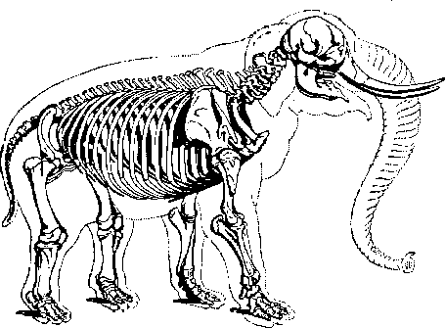
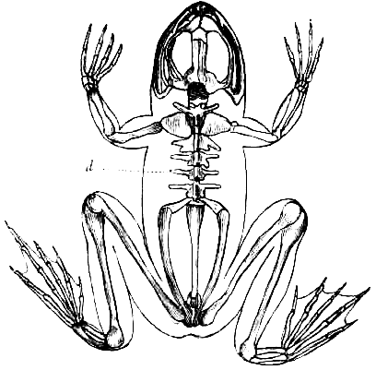
The data model is the skeleton of your database
Good for jumping, not so good for carrying weight
Good for carrying weight, not so good for jumping
Which is the best skeleton?

Slide 17
There is no ‘best’ DB design. The best design depends on what you need to do.
Normalized: good if you do a lot of fast, short single-row operations. Fewer errors (anomalies): Good for transactions
Denormalized: good for avoiding doing lots of joins that slow down your system if you have lots of data: Good for analysis

Slide 18
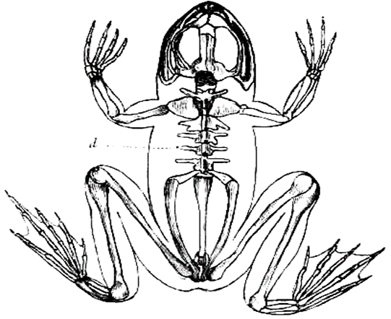
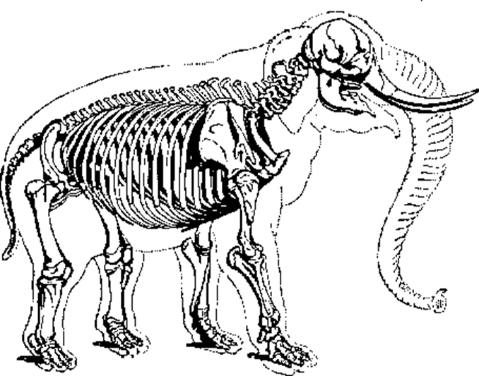
Interview question: are there different types of DBs? Why? Which one would you pick?
Likely best choice
Needs of the business
Operations, Transactions
Normalized Relational DB + SQL
Analysis
Reporting, Business intelligence (simple math)
Analytics (complex math)
Data Warehouse (DW): denormalized RelationalDB + SQL + Visualization tool
DW or a Data Lake + SQL + specialized tools (e.g., SAS, SPSS, python, visualization)
Comm 3220 so far
A Data Lake is a database of non relational data

