Slide 1
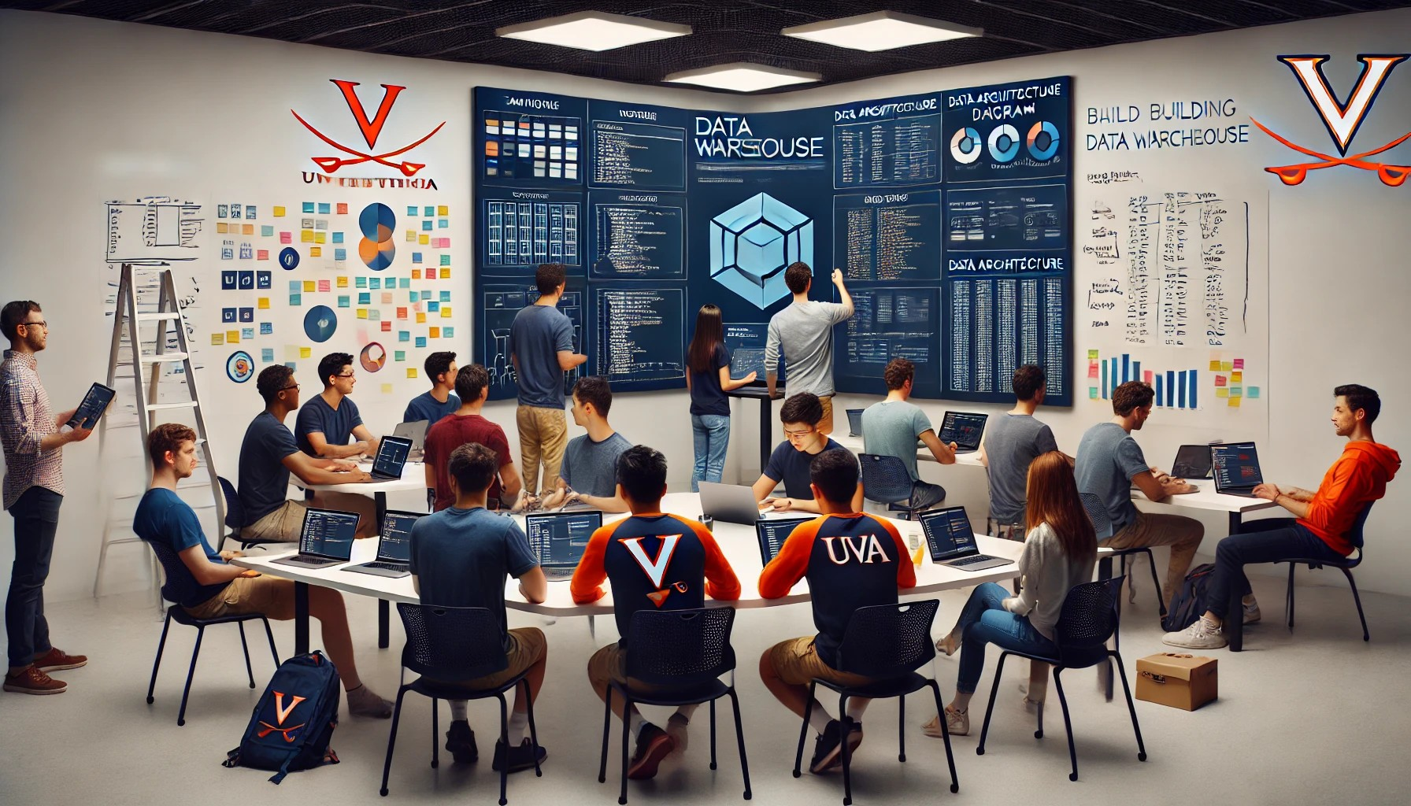


Building a DW
The ‘REI_not’ case

Slide 2
Critical Thinking
MPs on Wed
Participation assessment
Do you feel you might be able to build a small DB if asked?
  Interview the business
  Draw ERD
  Create tables and views using SQL

Slide 3
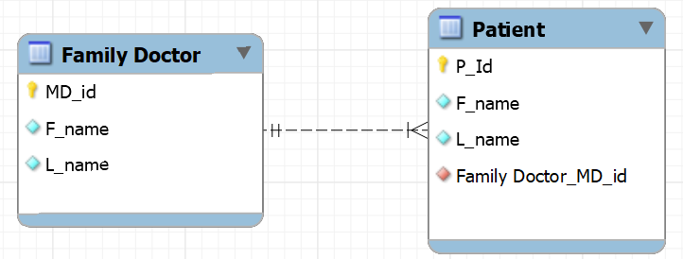
Creating and deleting tables with FKs
TABLE CREATION
Must create Doctor first – why?
TABLE DELETION
Must delete Patient first – why?

Slide 4


Slide 5
Orange words (close laptops)
Pro/cons of normalized DBs
Pro/cons of denormalized DBs
Which one is better?

Slide 6
You Do The Talking
Name
Concentrations, etc…
How hard was MP6 (Pressly)?
Things that I like about the class
Things that can be improved

Slide 7
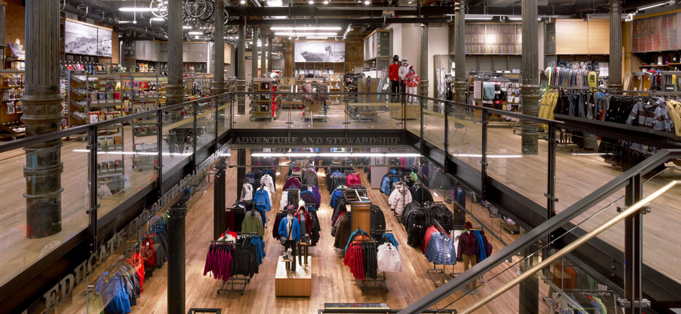

Richmond
flagship store

Slide 8
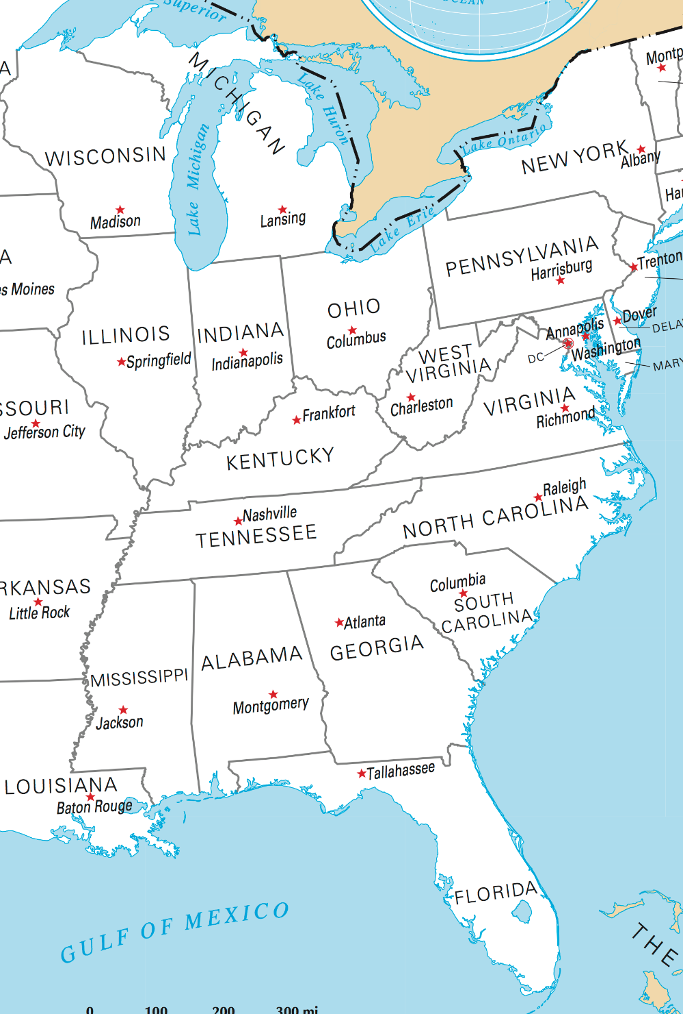

The REI_not retail company
$30mil+ camping supplies start up
Three locations
Six main products:
Tents (2), Backpacks (1), Hiking boots (2), and Hiking socks (1)

Slide 9
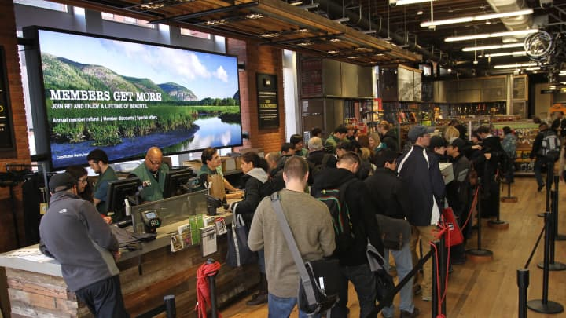
Interviews and documents led to a narrative to build a DB
“Customers buy goods at the store. We look up their membership numbers, and then record items, prices, and date.”
“Only members can buy.
If a customer is not a member,
we issue a free membership.”
“We constantly update
our inventory levels based on
sales.”
“We keep track of suppliers
and products categories.

Slide 10
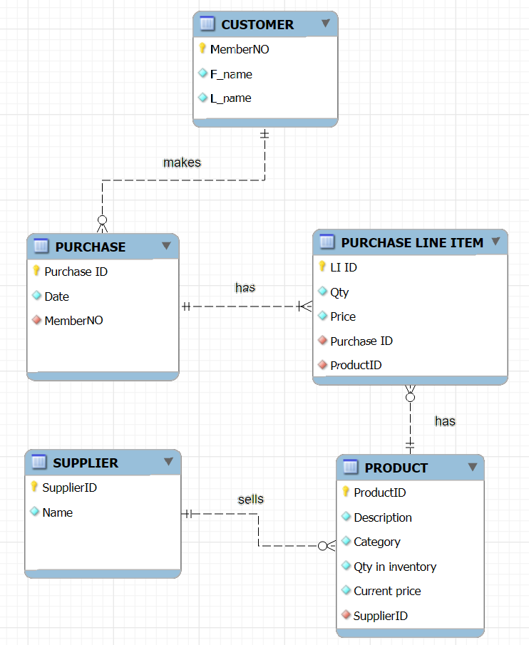

Draft design for a
store DB
City: Richmond/Charleston/Atlanta
Size in Square feet
Csystem: cashier, self, hybrid
Layout: modern or traditional

Slide 11
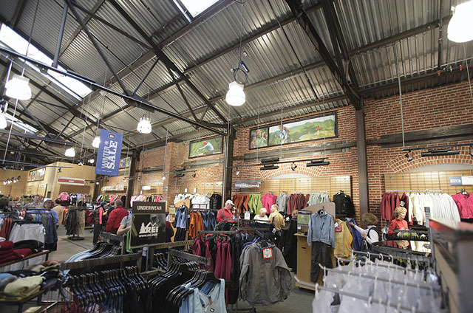


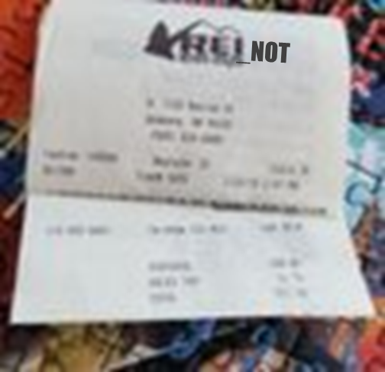
Sample operational queries
Is Stephen Strange
a member?
Create a new customer
What is the price of a
“Galaxy” tent?
Dr. Strange’s buys a Galaxy
tent and 10 hiking socks.
Decrease inventory based on Dr. Strange’s purchase

Slide 12

BI at REI_not: Current state
The company built the Richmond DB first, and then copied it for the Atlanta and Charleston stores.
Richmond Store
Local DB
Store 1
Atlanta Store
Local DB
Store 2
Local DB
Store 3
Charleston
Store

Slide 13
WHAT IS NEW IN IT?

Slide 14
Problems at REI_not: reporting and analytics are broken
What is going on?

Slide 15


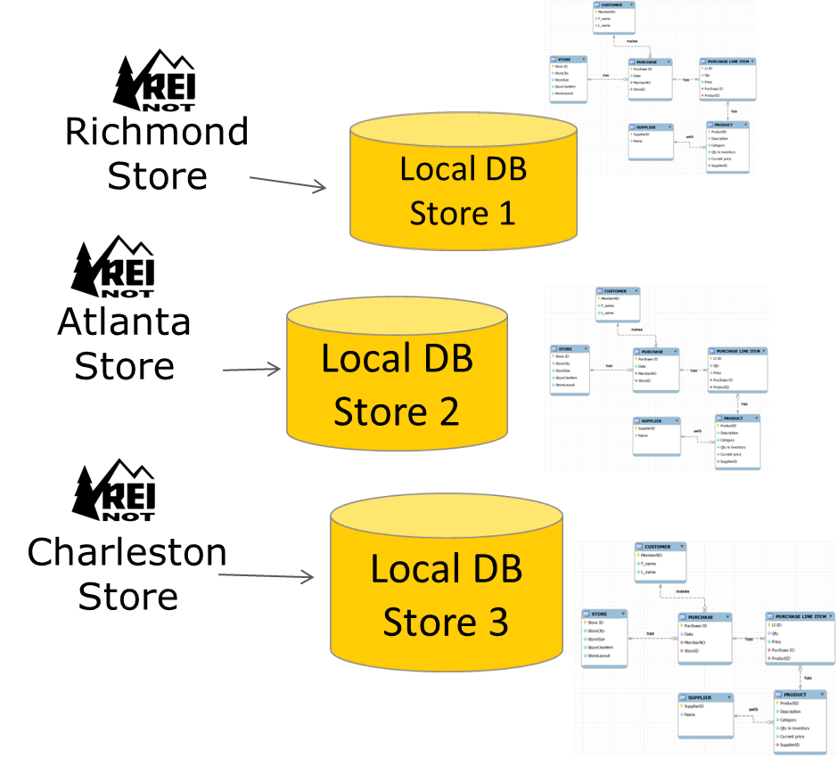
Sample questions from HQ
Revenue by store for the
year?
Revenue by product
in Q3?
Tent sales by store?
Revenue by store layout (traditional vs modern)
Sales by store by month

Slide 16
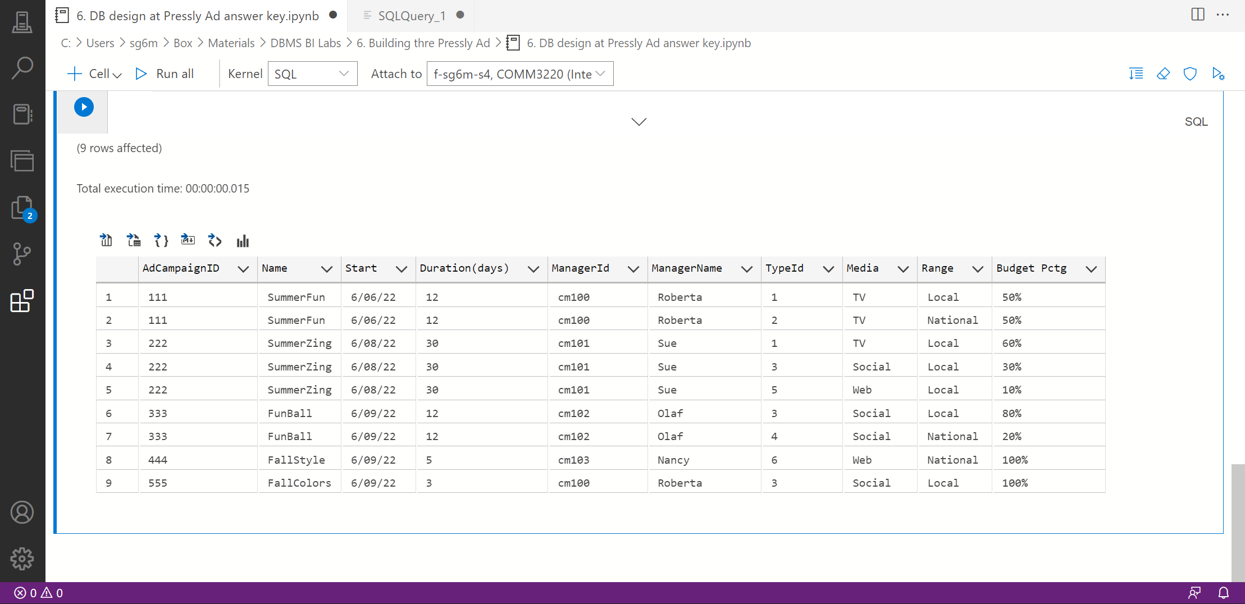

REI_not analysts use ADS to produce Excel files with single-store answers and email them to HQ
Save results as Excel

Slide 17




BI at REI_not: Current state
Richmond Store
Local DB
Store 1
Reports, visualizations…
Atlanta Store
Local DB
Store 2
Local DB
Store 3
Charleston
Store
Managers &
Decision makers

Slide 18
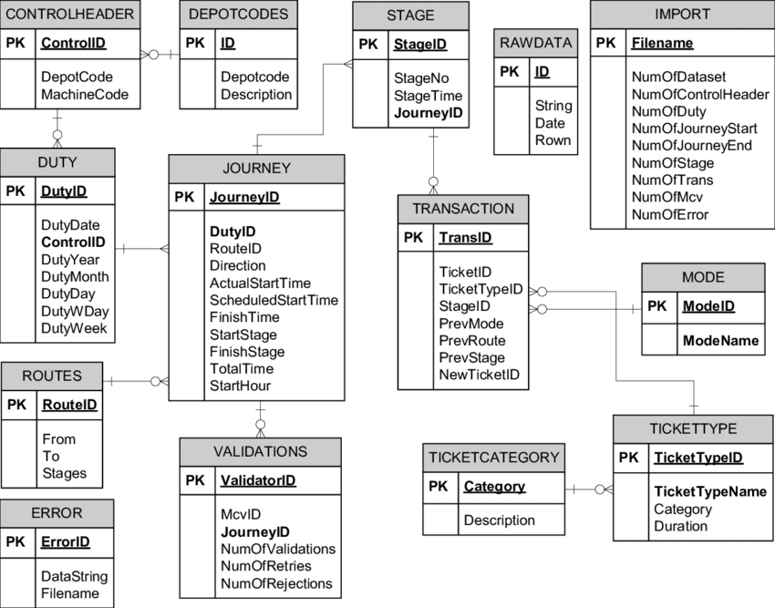

BI at REI_not: Future state (MP7)
Richmond Store
Local DB
Store 1
Reports, visualizations…
Data Warehouse for the whole REI_not
BI/Analytics technologies
ETL technologies
Atlanta Store
Extract
Transform
(i.e., clean)
Load
Query
Report
Analyze
Visualize
Local DB
Store 2
Charleston
Store
Local DB
Store 3
Managers &
Decision makers
NORMALIZED, 3NF, OPERATIONS
DENORMALIZED, BUSINESS INTELLIGENCE, DECISION MAKING

Slide 20
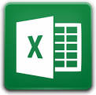

Which one is the best tool?
EXCEL | A DATABASE
Readily available | Needs management and $$
Easier to use. Flexible | Requires knowledge of SQL, more rigid
Charts and Pivot Tables | No Charts, no Pivot Tables
VLOOKUP to relate different ‘tables’ | FKs to relate tables
Sharing via email | Sharing with very many concurrent users
Max 1 million rows, performance degrades way before that | Million rows without performance degradation
Limited data quality (‘integrity’) tools | Many data integrity tools: PKs, FKs, uniqueness, cascading, datatypes, not null, defaults
Manual save | Immediate save
Weak security (passwords) | Strong security (passwords + encryption + permissions)
Better for exploratory analysis, small data | Better for systematic reporting, security, large amounts of data

