Slide 1
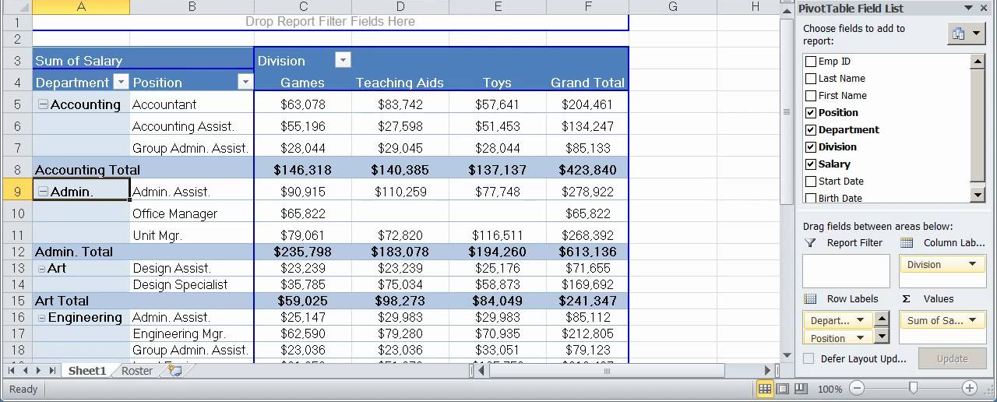
Pivot Tables
are Business Intelligence tools

Slide 2
Critical Thinking
Date auction
Regrading MP6
John/Olaf: add two points if right, no deduction otherwise
‘Not null’: no deduction
Big_Table Format: no deductions for
missing/adding spaces.

Slide 3
You Do The Talking
Name
College, major…
Feeling that you are learning the skill?
Amount of work in this course?
Things that I like about the class
Things that can be improved

Slide 4
Orange words
Dimension in a DW

Slide 5





MP7 REI_not (and interview talking points)
More transactional…
…more analytical
STORE1
DATA
REI_not Richmond
BI Reports for decision making
Data Warehouse
at the REI_not HQ
BI/Analytics technologies
ETL technologies
Query
Report
Analyze
Visualize
Extract
Transform
(i.e., clean)
Load
STORE2
DATA
REI_not
Atlanta
STORE3
DATA
REI_not CEO
REI_not Charleston
YOU: BI & analytics consultants/analysts,
Notes:
Data warehousing includes two parts – getting data in, and getting data out. Getting data in is the hard part – it includes taking data from source systems, transforming the data, and loading it into an integrated data store. Getting data in is 80 % of time and resources, and 50% of unexpected costs.
Getting data out is the fun part – it include the BI tools that casual and power users use to access the data warehouse data. When users use the data, they can deliver value to the organization.
The data store in the middle can be an enterprise data warehouse, a data warehouse with dependent data marts, independent data marts, or a federated database environment. Typically, the independent data mart approach is least effective.

Slide 6

Spot the differences

Slide 7

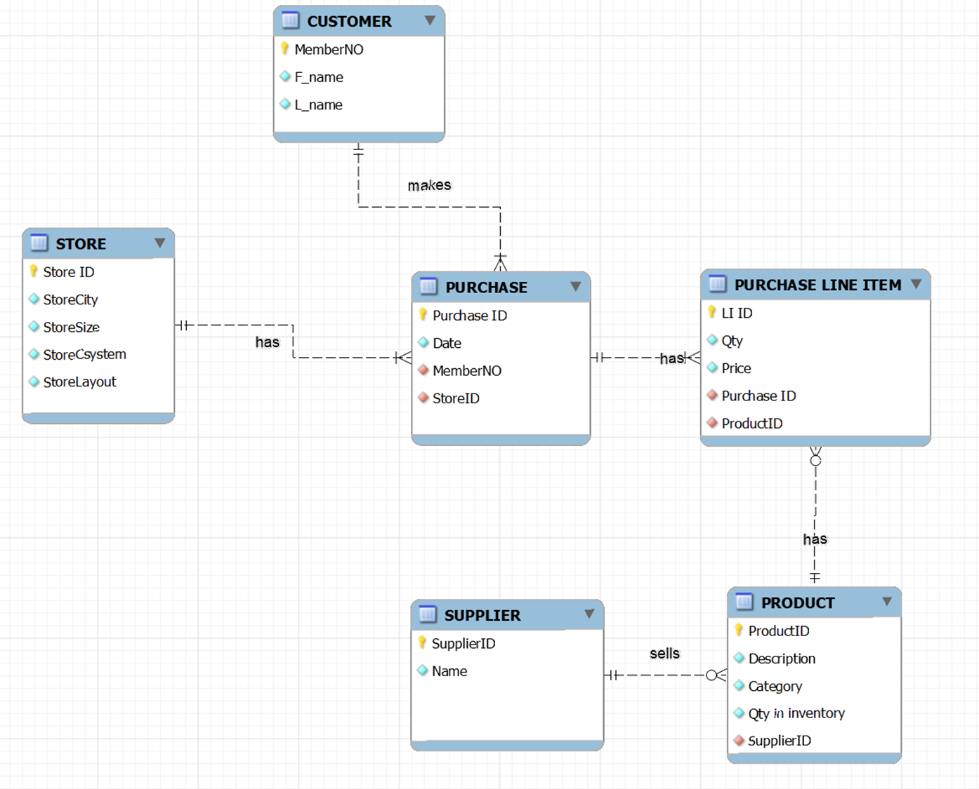
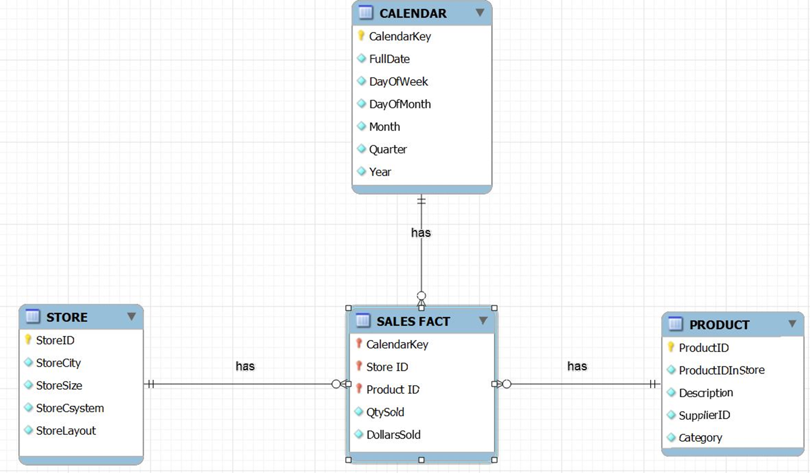
‘Same’ data, two designs: operational and analytical databases (DW) at REI_not
REI_not Operations
REI_not
Data Warehouse

Slide 8

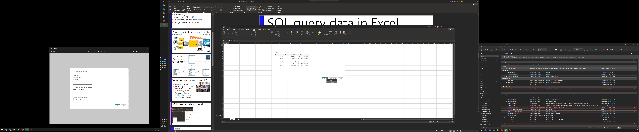
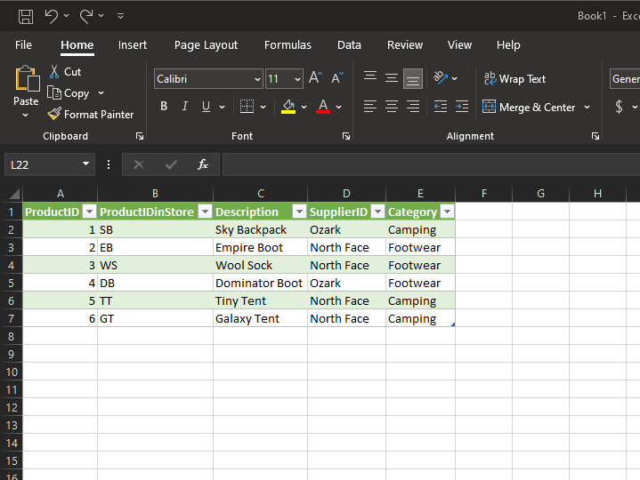
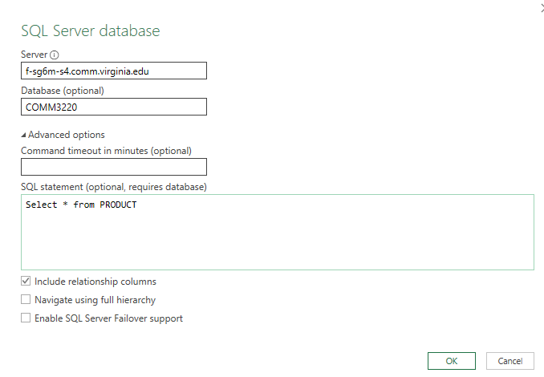
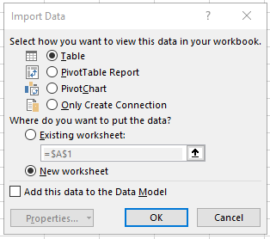

Many people do not know how to use Excel to view SQL query data from a database
1
2
3
4
7
5
6
Computer may ask for your DATABASE userId and Password
8

Slide 9
MP8
BI at ACME Global
Another promotion, another project…

Slide 10


Welcome to ACME Global!
Your career is unstoppable!
Now you are a BI/Finance consultant at ACME Global, a large company with a global presence.
It is year-end and your boss, the CFO, wants to check the differences between budgeted costs and actual costs. This is called a Variance Analysis.
ACME

Slide 11
MP9 (and interview talking points)
More transactional…
…more analytical
N. America
DATA
Data Warehouse
ACME
S. America
DATA
BI Reports for decision making
Use SQL to integrate the 5 ACME region tables into a single VIEW
BI/Analytics technologies
ETL technologies
Use both SQL and Excel Pivot tables to answer global BI questions
ACME
Extract Actual and Budgeted expenditures
Pacific Rim
DATA
ACME
Europe
DATA
ACME
ACME global leadership
Asia
DATA
ACME
YOU: BI & analytics consultants/analysts,

Slide 12
MP8
Variance analysis demo

Slide 13
Pivot Tables are BI tools
A Pivot Table is a data analysis tool. It is used to "slice and dice" data, and drill up/down.
Pivot tables work by grouping and ungrouping data contained in a larger table according to various dimensions, e.g., time, location, department, product….
Superpower of Pivot Tables that SQL cannot easily do:
the pivot. Pivot tables can easily turn cell contents into column names.

Slide 14
What is New in Information Technology

Slide 15


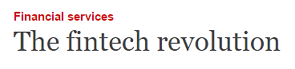


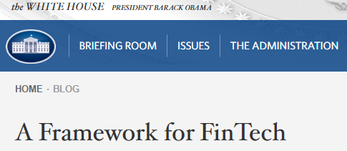



COMM 4230 Finance and IT = Fintech

Slide 16

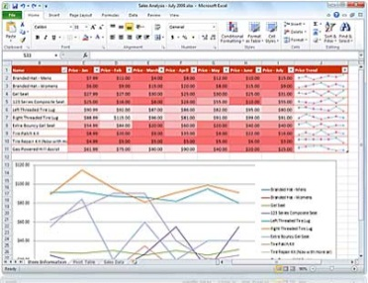



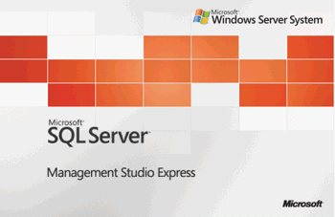

Specific Tools on your CV
Process automation tools
- Visual Basic for Applications,
- Excel Macros,
- VSTO: Visual Studio Tools for Office
Automating Business Intelligence tools:
- Excel-databases
- Azure Data Studio, SQL, SQL Server,
- Pivot Tables
Financial Engineering tools: designing & implementing financial strategies
- Visual Studio,
- Hedge Tournament,
- Advanced Excel

Slide 17


