Slide 1
DW Design
Advanced topics

Slide 2
Critical Thinking
Graded:
MP5 (team)
MP6 (Pressly regraded)
Auction results on Teams
11/4 Sarah Dowd (1 out of 5)
11/6 Lauren Kish (1 out of 4)
11/13 Martha Reavis (1 out of 4)
11/18 Christine Wang (1 out of 1)
11/25 Ethan Johnson & Max Borenstein (2 out of 5)
either 12/2 or 12/4 (TBD) - bid Megan Peck & Bridget Ford (2 out of 2)
either 12/2 or 12/4 (TBD) - random selection Annan Zulfiqar & Lauren Deaver

Slide 3
Common mistakes (MP5)
Identifying – non identifying. red flag: many PKs, especially red PKs. rule: default to non-identifying. only use ‘identifying’ when the chosen PK is not sufficient
Cardinality symbols
Business logic
Words on relationships
Notes:
Employee table with teamId
Order with employee ID and Vendor ID

Slide 4
Orange words
Difference “slice and dice” vs. “drill up/down”
What is a dimension in DW?
What is easy in a Pivot and hard in SQL?

Slide 5
You Do The Talking
Name
College, major…
Feeling learning a skill?
Amount of work in this course?
Things that I like about the class
Things that can be improved

Slide 6
DW granularity
Minimize space, maximize speed (but at a cost)

Slide 7
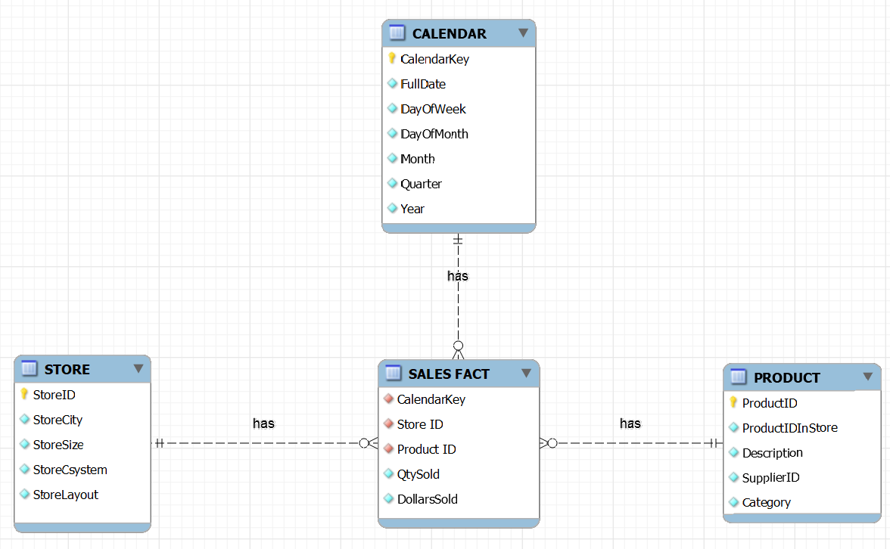
Star Schema DW design for REI_not
Not a perfect translation of the operational ERD: some fields/data might be ignored (e.g. inventory) or simplified (e.g. vendor).

Slide 8
Do all fields in an operational DB get transferred to a DW?
Not a perfect translation of the operational ERD: some fields/data might be ignored (e.g. inventory) or simplified (e.g. vendor).

Slide 9
One table is way bigger than the others… which one?
Not a perfect translation of the operational ERD: some fields/data might be ignored (e.g. inventory) or simplified (e.g. vendor).

Slide 10
Which tables are fairly stable, and which grows continuously?
Not a perfect translation of the operational ERD: some fields/data might be ignored (e.g. inventory) or simplified (e.g. vendor).

Slide 11
Star Schema DW design for REI_not
Can you fit it in EXCEL?
365
Records?
Space in GB?
6
3
Notes:
~6400 records

Slide 12
Star Schema DW design for REI_not
10 years
Can you fit it in EXCEL?
Records?
5,000
250
Notes:
12.5 M records

Slide 13
Granularity: A neat trick
At the REI_not headquarters…
The fact table is becoming too big! We will need to buy a bigger computer for our DW. The budget is $120K. That’s a lot of money I would prefer to spend elsewhere!
10 years
I have an idea. Why don’t we ask the stores to report weekly sales rather than daily sales…
Huh? How would it work?
Every Monday each store would report the ‘qty sold’ and ‘dollars sold’ for each product for the previous week.
Interesting… I can see the potential, BUT also the pitfalls…
250
5,000
Let me think it through, Boss…

Slide 14
Aggregated fact tables have common granularity tradeoffs
Granularity is the scope of the data (by day, by week, by county, by state….)
Granularity tradeoffs:
Space and speed (tricky!)
Costs to gather and store
Analysis and reporting
Fact tables about the same facts with different levels of granularity may coexist in the same DW

Slide 15
Designing a DW
Step 1
Identify the questions and what you need to know to create the answers: the facts. Example: Revenue by store? Revenue by product in Q3 for the whole company? Tent sales by store? Revenue by store layout? …sales, profits, costs, counts...
Step 2
Find out the dimensions along which the facts could be analyzed and their granularity
Example: Time (day, week, quarter), geography (store, state, city…)
Step 3
Draw a Star or Snowflake ERD.

Slide 16
What is New in Information Technology

Slide 17
DW Snowflake Design
An alternative DW design technique

Slide 18
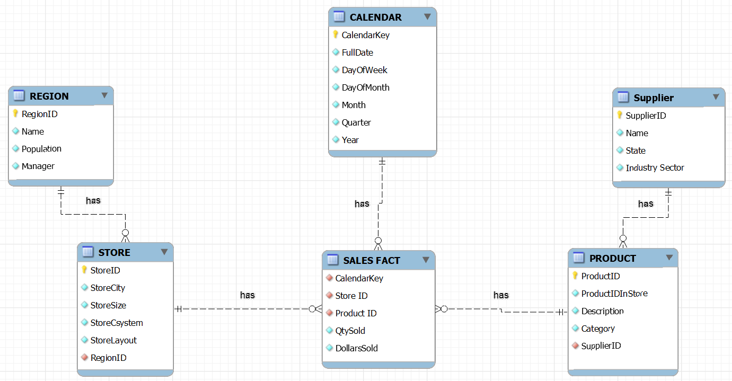
Snowflake Schema
The Snowflake schema design partly normalizes a star schema design

Slide 19
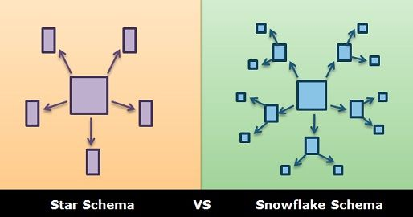
Snowflake schemas
More complex designs
Partly normalized
Typically smaller footprint but slower (more joins)
Not as common in practice (Juckic)
Source: https://techdifferences.com/difference-between-star-and-snowflake-schema.html

Slide 20
Summary: DW Design principles
Not all fields in the operational DB need to be transferred to the DW: only the useful ones
Dimension tables are way smaller (shorter) than the facts table
Dimension tables can be denormalized
Dimension tables are fairly stable, fact tables grow continuously
Typically, DW are updated by appending new data (few/no updates and deletes: mostly inserts)

Slide 21
To recap:
DW design aggregates and denormalize data to facilitate data analysis
fewer joins = speed fewer data = speed

