Slide 1

BI workflows:
Power BI
Stefano Grazioli

Slide 2
Critical Thinking
MP7 REI_not mean: 96
Common errors
  not including a combined PK in the SALES_FACT
  forgetting the calendar FK in the SALES_FACT table
  not formatting the money values.

Slide 3
Orange words
Granularity
Granularity tradeoffs

Slide 4
You Do The Talking
Name
College, major…
Hardest thing so far?
Things that I like about the class
Things that can be improved

Slide 5
BI workflow: quick example
MOVIE DB

Slide 6
Non-standard definitions
Query: a series of steps that produce a PowerBI table from one or more data sources
Model: tables with relations (ERD)
Report: a set of visualizations
Measure: the result of a formula (DAX), think of it as a real or virtual column.

Slide 7



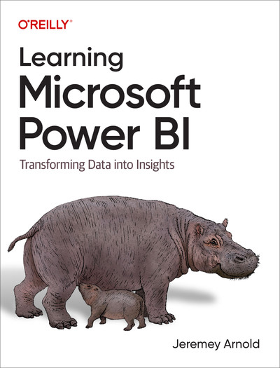


Learning resources
Additional/optional resources to learn Power BI
Power BI reference manual
Linked pics. If UVA is not listed, use your UVA email

Slide 8
What is New in Information Technology

Slide 9
Data wrangling at Nolex Luxury Watches
Mini-Project 9

Slide 10

Luxury watches
Three new stores
  LaGuardia
  DeGaulle
  Fiumicino
CDO wants to know how they are doing: a sales report
The stores sent the BI reports
BUT

Slide 11
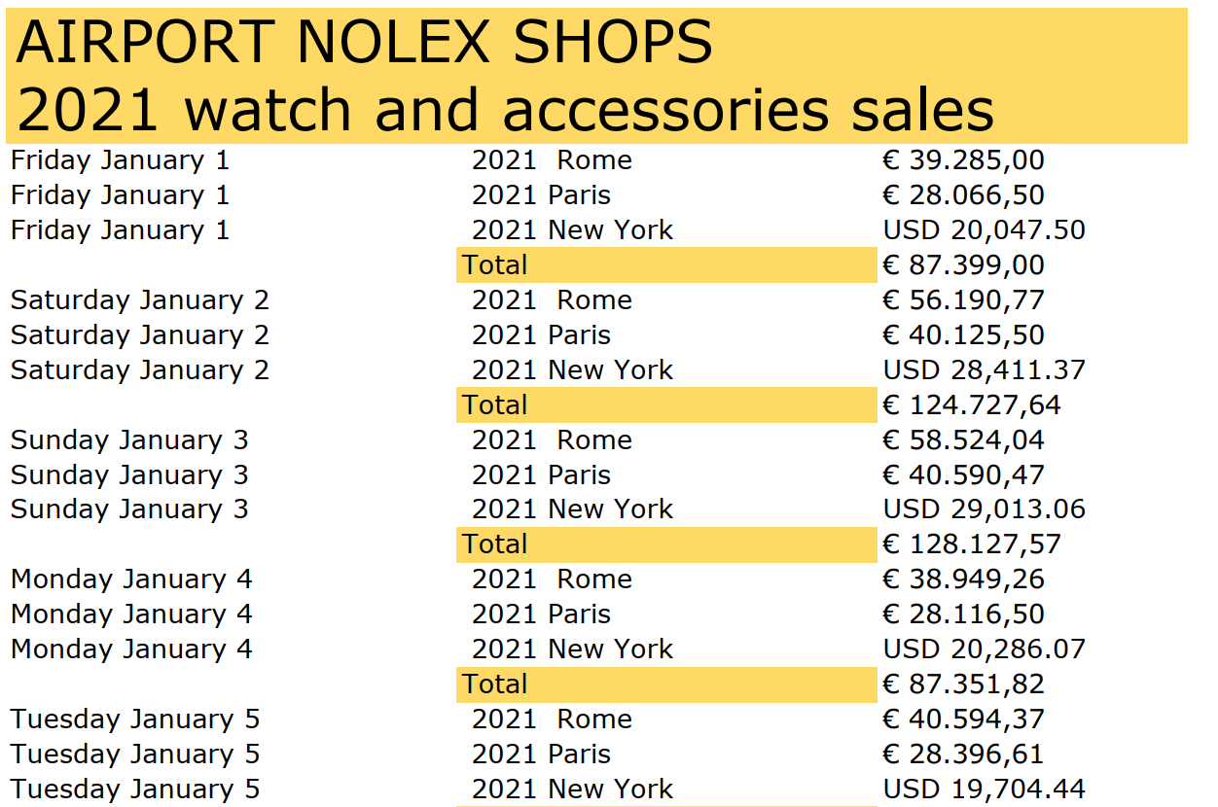
And it is a pdf!

Slide 12
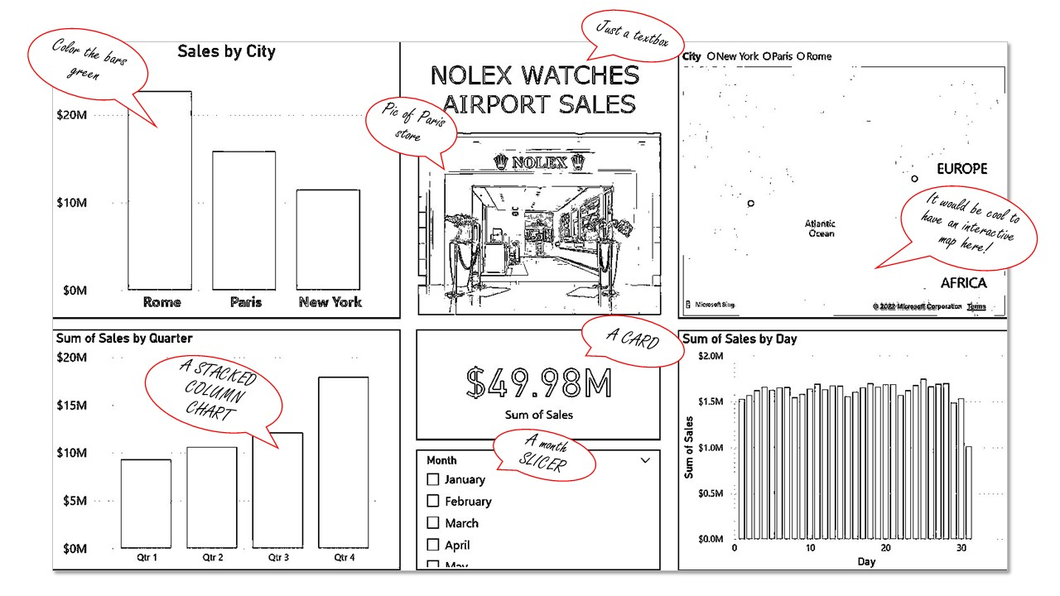

Slide 13

Sometimes Power BI is like a faithful, eager-to-please dog…
… in its desire to help you, it may mess up your work.
Notes:
Source: web

Slide 14
BI workflow: quick example
SMALLBANK DB

Slide 15
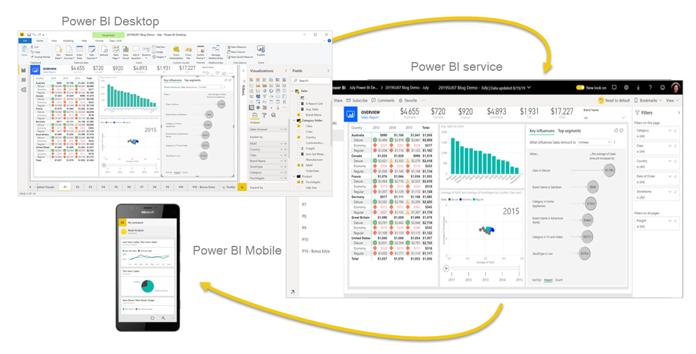
Three ways to consume the results of BI work
Power BI Desktop
Power BI Service
Power BI Mobile

Slide 16
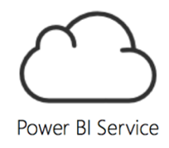
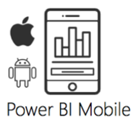


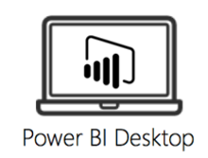
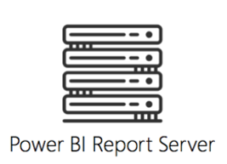


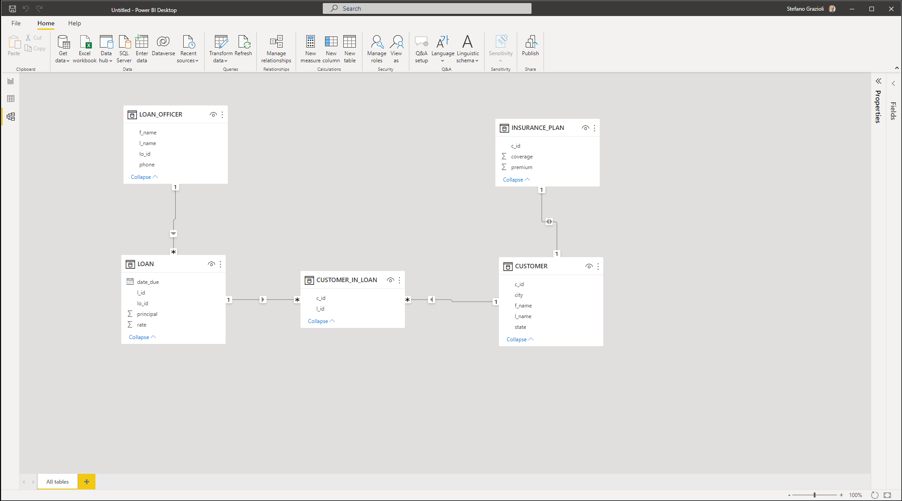

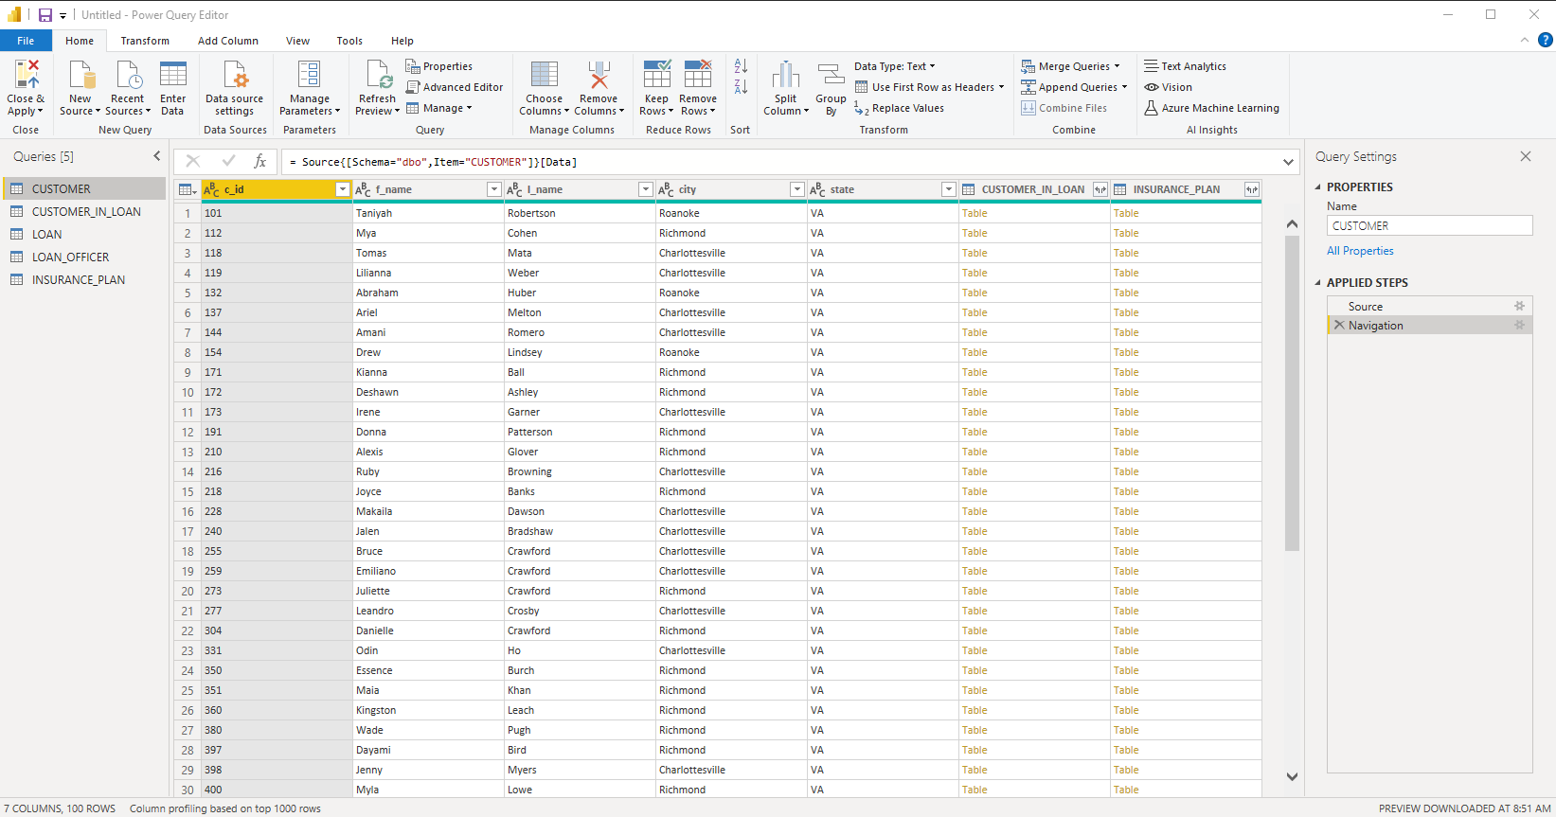

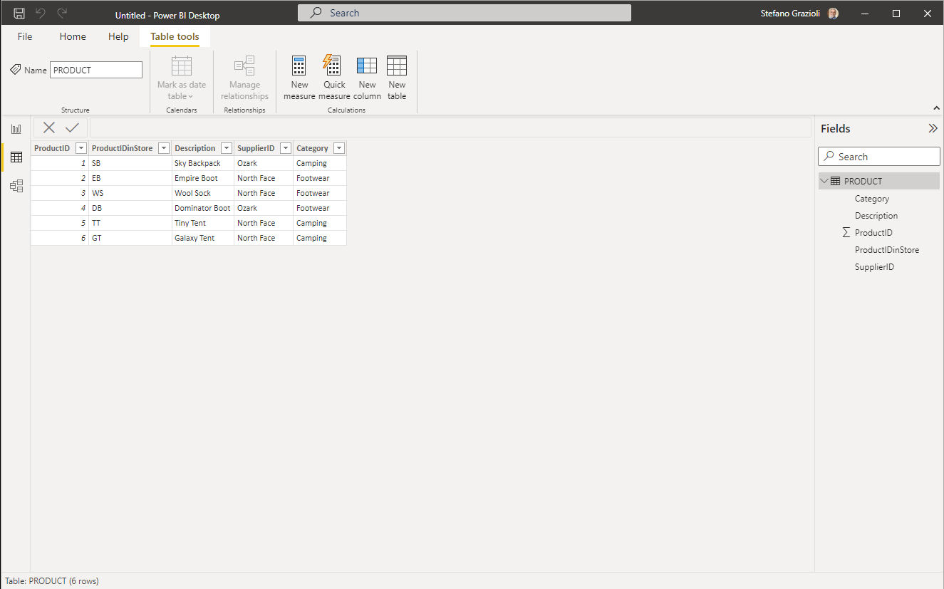
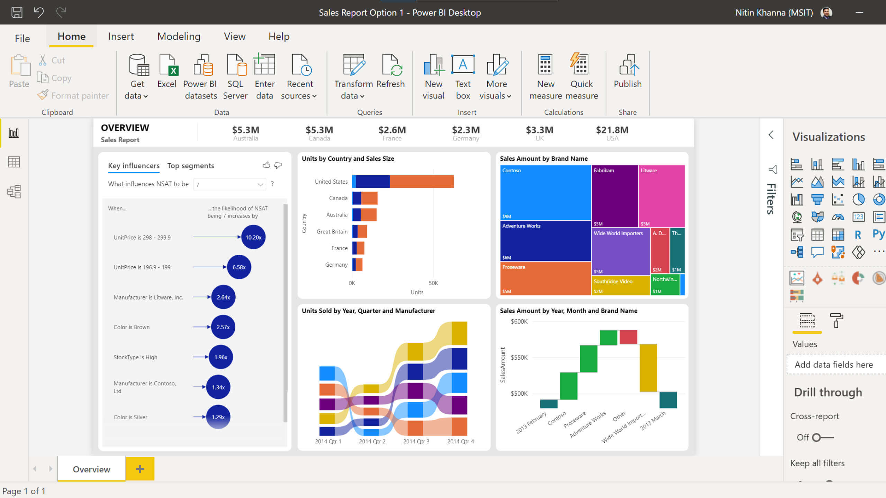



The BI workflow
Extract
Transform (clean)
Load
Model
with relations
Analyze
Publish
Data sources
Raw data
Cleandata
Web Report
Mobile Report
Report
Website
“Model”
…
“Power Query”
extracts and transforms data to be loaded into the “Model”
“Data”
“Report”

Slide 18
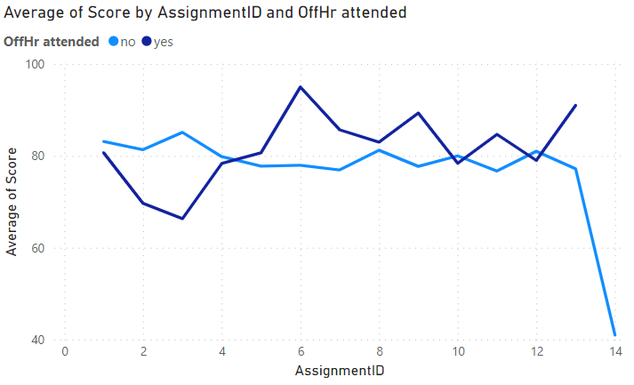
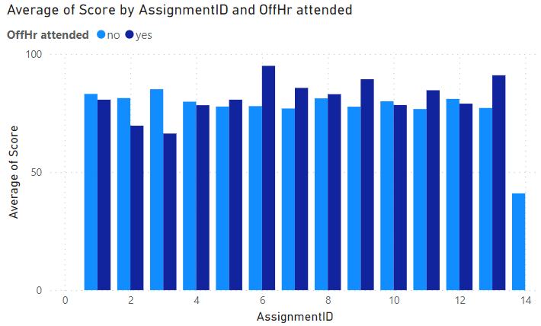
Choosing the right visualization makes interpreting the chart easier
Data source: Jeremey Arnold, 2022

