Slide 1
Power Pivot and techniques to integrate data
Stefano Grazioli

Slide 2
Critical Thinking
How was the second Quiz?
Good questions to Cameron Snapp count as Orange words (if you have not yet done orange words)

Slide 3
You Do The Talking
Name
College, major…
Course goals clear?
Things that I like about the class
Things that can be improve

Slide 4
The most popular Business Intelligence / Analytics tool in the world…
Single source of data
Single source of data

Slide 5
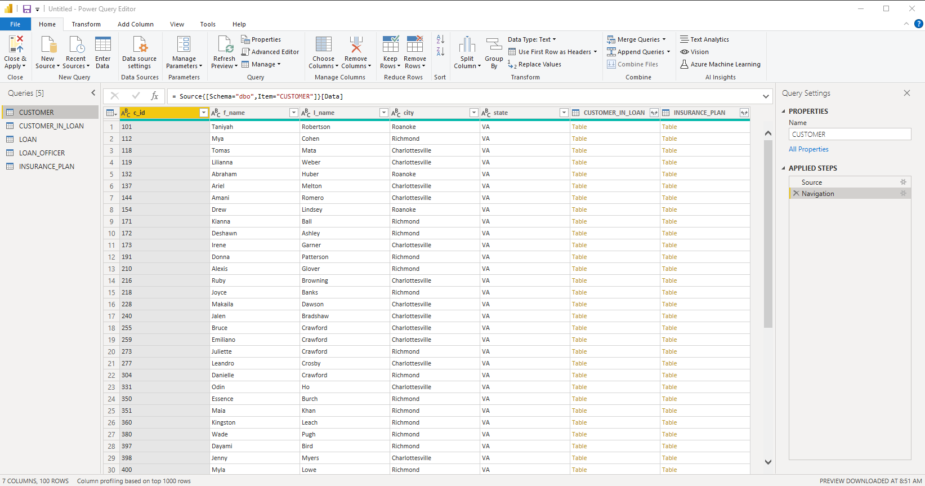
The most popular BI/Analytics tool in the world … just got better!
Power Pivot
(one more entry in your CV)
…
Multiple sources of data
Excel includes “Power Query” to extract and transform data to be loaded into a pivot
Does not require PowerBI

Slide 6
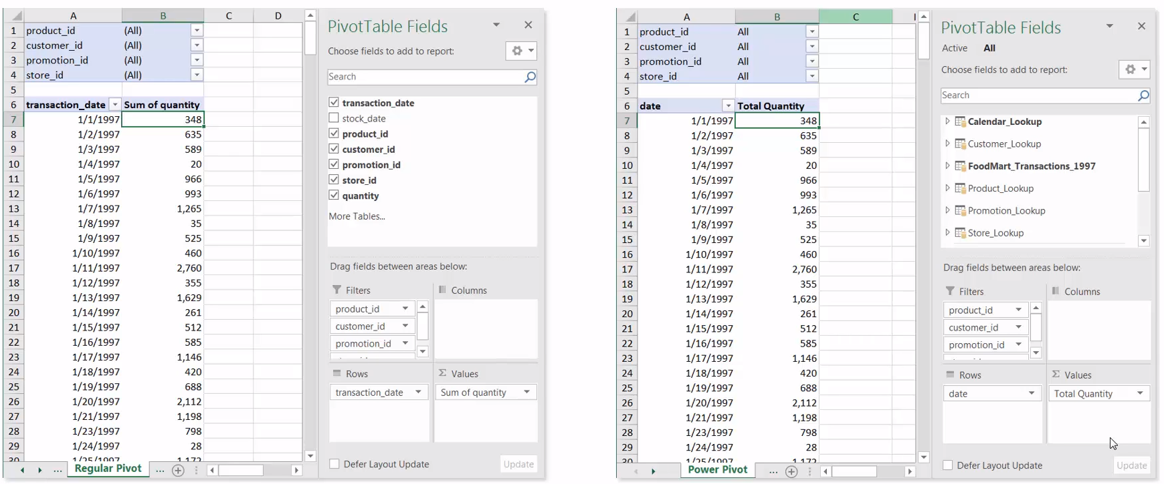
Pivot vs Power Pivot
Source: Excel Maven

Slide 7
Power Pivot
Demos

Slide 8
What do you do if the data you want to analyze with a pivot table is stored in more than one table AND/OR more than one source?
Solution 1: join tables in SQL on the DB and download the data with ADS
Solution 2: join tables in SQL on the DB and create a view with ADS
Solution 3: have Excel run the SQL join and download the data directly into Excel
Solution 4: use PowerBI to do the join automatically
Solution 5: use Power Query and use it to do the join
Solution 6: use Power Pivot.

Slide 9
What is New in Information Technology

Slide 10
What do you do if the data you want to analyze with a pivot table is stored in more than one table AND/OR more than one source?
Solution 1: join tables in SQL on the DB and download the data with ADS
Solution 2: join tables in SQL on the DB and create a view with ADS
Solution 3: have Excel run the SQL join and download the data directly into Excel
Solution 4: use PowerBI to do the join automatically
Solution 5: use Power Query and use it to do the join
Solution 6: use Power Pivot: no SQL, no Power Query

Slide 11
What is New in Information Technology

