Slide 1
Database Management Systems and SQL
Stefano Grazioli

Slide 2

Critical thinking
Going well
EasyMeter ☺
Part II: Business Intelligence begins today

Slide 3
Name, academics…
Comfort with tech and finance
Things I like about the course (so far)
Things that can be improved

Slide 4
Orange words review
What is ‘source code’?
Difference For…next vs. For…each?
Difference For…next vs. Do while …loop?

Slide 5
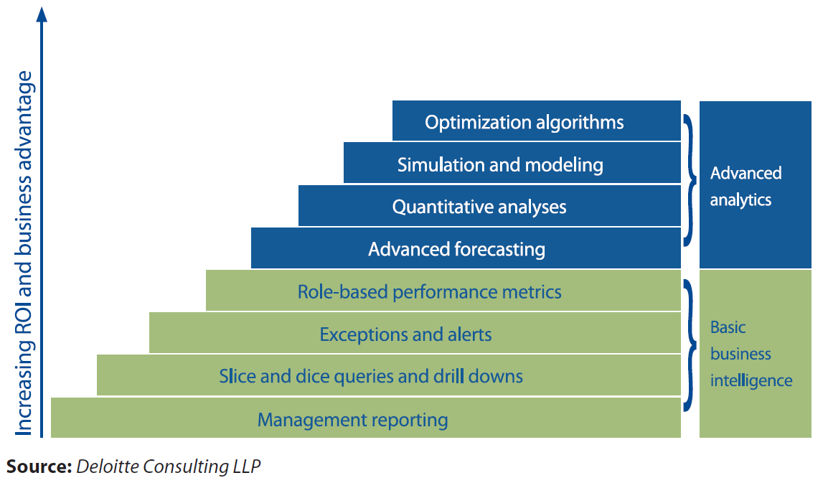
Learning objective: part II
“Business Intelligence refers to the general ability to organize, access and analyze information in order to learn and understand the business.” (Gartner)
Analytics is “the extensive use of data, statistical and quantitative analysis, explanatory and predictive models, and fact-based management to drive decisions and actions” (Davenport and Harris – Competing on Analytics)
Workplace reality is different and blurring
Part III
of the course
Part II
of the course

Slide 6

Congratulations!
You are hired at SmallBank
(now what?)
Homework 06

Slide 7
You are a Business Analyst at SmallBank
Welcome! So glad that you are here and can help us with Business Intelligence! I have so many questions for you…
How many loans above 100K do we have in the database?…
What is the average loan size at the 6% rate?
How many customers do we have in each city?
…
Please access our MS SQL Server and create reports for me.
I am on it, boss!

Slide 8
Congratulations!…Now what?
1. Figure out where is the data
(database, servers, connections…)
2. Understand the data structures, names, and meanings
3. Create SQL queries to get the answers you seek

Slide 9


First, ask about accessing the DB at SmallBank (the DB architecture)
SQL
A program
A file
Pressly AD
You
SQL Server
RDBMS
Notflix
Your computer running Microsoft’s ADS:
AZURE DATA STUDIO
SmallBank DB
Window Server
F-sg6m-s4.comm.virginia.edu
Azure Cloud

Slide 10
Step two: understand the data structures, names, meaning

Slide 11
Tools you need to do the job
A DataBase (DB) is an organized collection of data
A DataBase Management System (DBMS) is a software that provides data-related functionality: search, filter, sort…
A DB client is a program that connects to a DBMS
DataBase
User location
Data center
YOU
‘Client’
program
DBMS
DataBase
file(s)

Slide 12
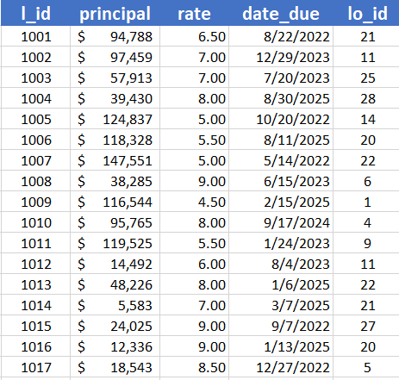
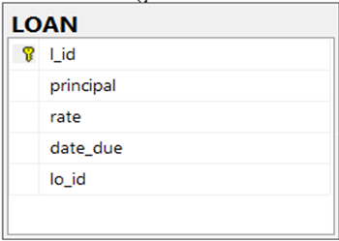
Tables are very commonly used representations in business
Table Name
LOAN
Column or Field
Row or Record
Primary Key
Same as
Data Dictionary
L_id = loan id
Principal = amount borrowed
Rate = interest rate
Lo_id = id of the loan officer
who manages the loan

Slide 13
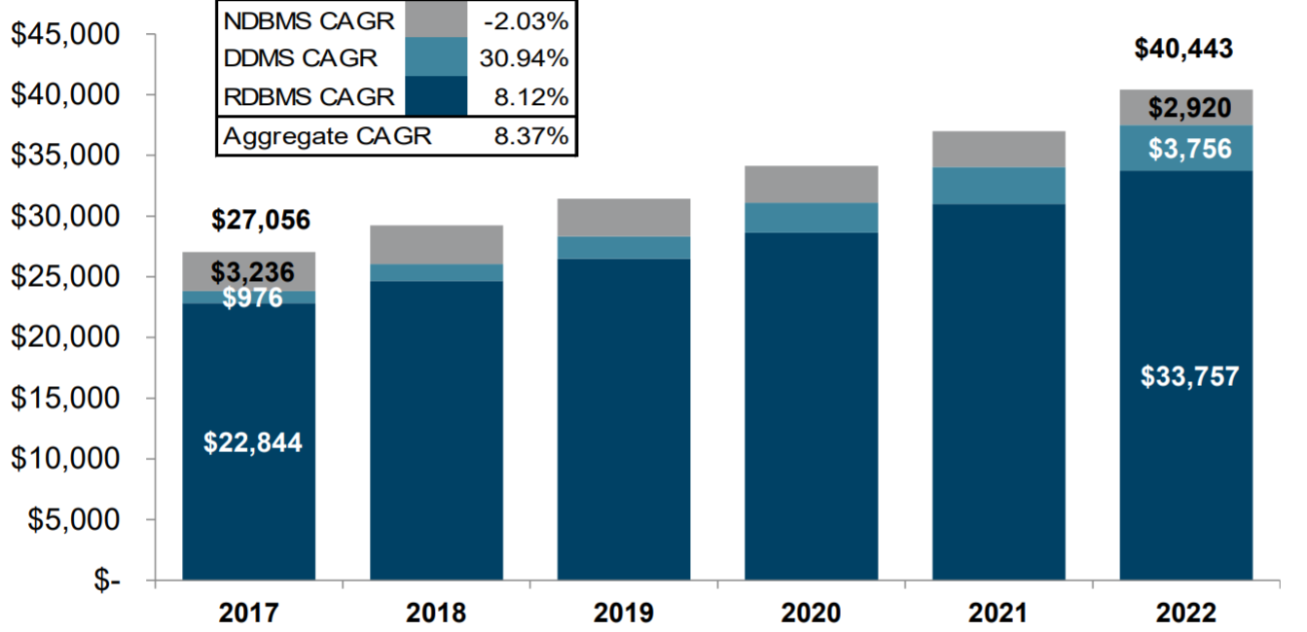
When is a DBMS “relational”?
A DB is relational when it presents data as tables and the tables have defined relationships.
Oracle,
Microsoft,
IBM,
MySQL/Oracle,
SAP/Sybase,
AWS Aurora,
Snowflake,
Teradata,
Google BigQuery
Gartner 2009, 2013 – Chart by IDC, Bernstein 2015, Blair 2019
Notes:
Trends: vendor consolidation – latest Sybase by SAP

Slide 14
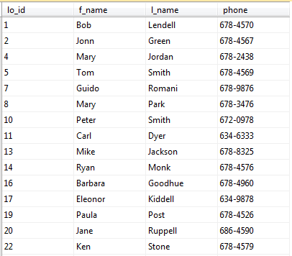
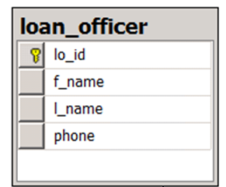
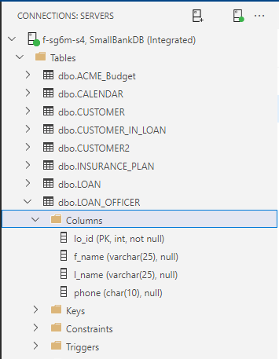
Relational DBMSs present data as tables
ACTUAL TABLE ER DIAGRAM TREE VIEW
LO id
f name
l name
phone

Slide 15
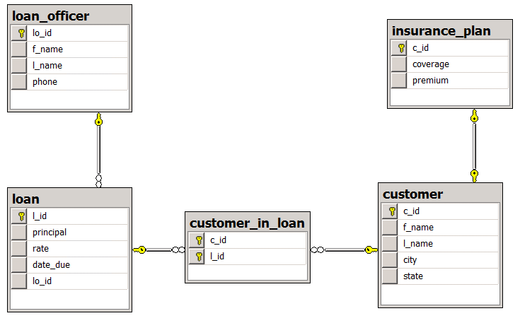
So, at work ask for a DATA MODEL and a DATA DICTIONARY
A map of the DB contents
Data Dictionary
lo_id = the loan officer’s unique id
l_id = the loan unique id
coverage = max. amount covered
premium = amount to pay every year
c_id = the customer’s unique id

Slide 16
Step three: query the DB using SQL

Slide 17

SQL: an example
SELECT *
FROM loan
WHERE principal > 100000
-- SQL is not case sensitive

Slide 18

Azure Data Studio
DEMO

Slide 19
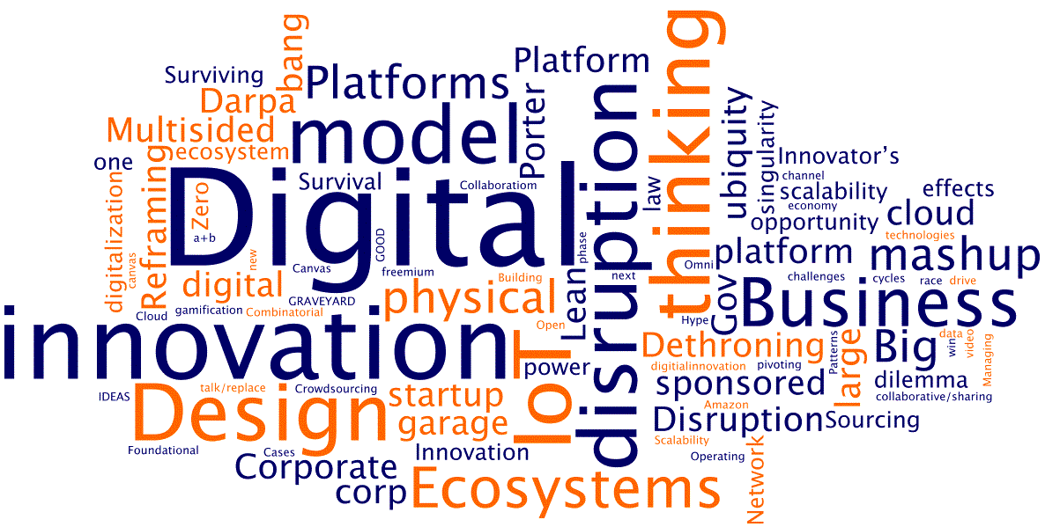
WINIT
What Is New
In Technology?

Slide 20

SQL: a specialized language to manipulate data in tables
SQL - Structured Query Language
SEQUEL – Structured English QUEry Language
Standard to manage data

