Slide 1
Non-queries
Stefano Grazioli

Slide 2
Doing well
Easy meter
No office hours today (teaching at Darden)

Slide 3
Name
Academics
Questions about teams?
Things you like about the class
Things that can be improved

Slide 4
Orange words
Static vs dynamic queries
Object (in object-oriented languages such as VBA)
Object model

Slide 5
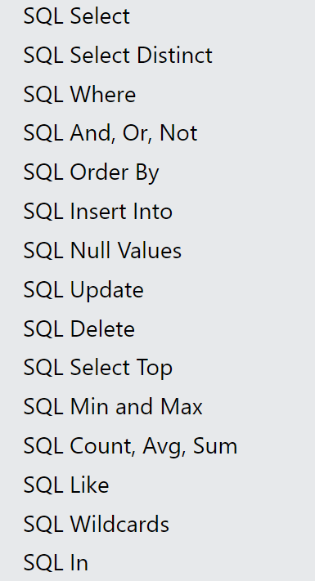
Learning Objectives
SQL “Non queries”
Insert
Delete
Update
Go to https://www.w3schools.com/sql/default.asp
and test the live examples to understand how they work.

Slide 6
Homework
h9

Slide 7
About your customer lists app: the managers now want to be able to change the customer data stored in our database. They say it would save them a lot of time if they could add a customer, or edit a misspelled customer last name or a wrong address right as they speak to the person…
Can you do it?
I am on it, Boss.

Slide 8
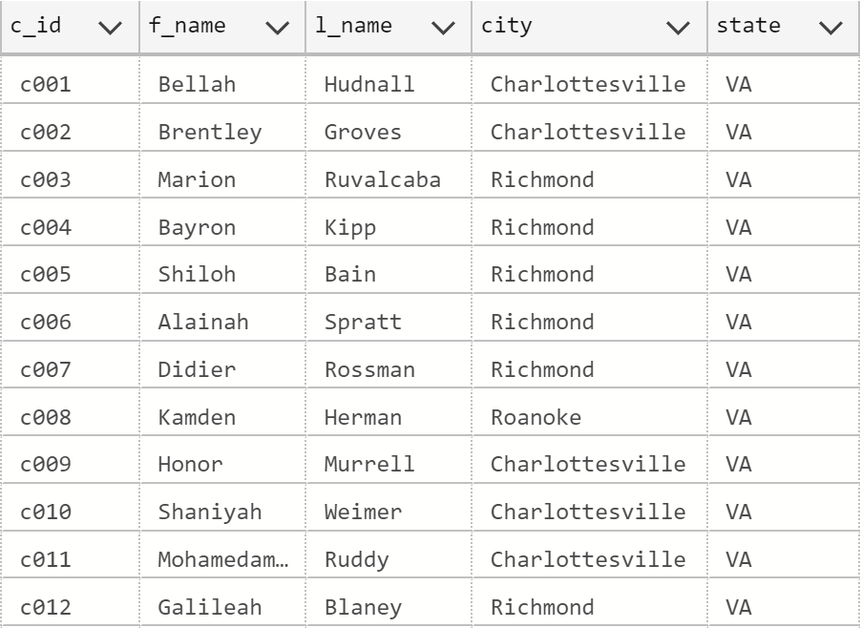
A new customer is enrolled…
‘Customer2’ Table

Slide 9
The SQL
Insert into Customer2 (c_id, f_name, l_name, city, state)
values ('c991', 'Bruce', 'Wayne', 'Gotham', 'NY')
Numbers do not require single quotes

Slide 10
User fills Customer info on screen
Insert into Customer2 (c_id, f_name, l_name, city, state)
values ('c991', 'Bruce', 'Wayne', 'Gotham', 'NY')
User presses ‘Insert row’
System collects info from screen
System creates SQL insert
System Runs non-query
System calls ‘Download Customer’

Slide 11
An old customer leaves…
‘Customer2’ Table

Slide 12
The SQL
Delete from Customer2
where c_id = ‘c008’
Remember to specify the ‘where’!
DEMO

Slide 13
User clicks anywhere in the row to be deleted
User presses ‘Delete selected row’
Delete from Customer2
where c_id = ‘c008’
System collects the selected row number from listobject
System reads c_id column from row that has that row number
System creates and runs a SQL delete
System calls ‘Download Customer’

Slide 14
A customer changes address…
Austin TX

Slide 15
The SQL
Update customer2
set city = ‘Austin’,
state = ‘TX’
where c_id = ‘c005’
Remember to specify the ‘where’
DEMO

Slide 16
User makes changes (except c_id)
User presses ‘Update selected row’
Update customer2
set
f_name = ‘Ariel’,
L_name = ‘Melton’,
city = ‘Austin’,
state = ‘TX’
where c_id = 137
System collects the selected row number from listobject
System reads all columns from row that has that row number
System creates and runs a SQL update that refreshes ALL columns
System calls ‘Download Customer’

