Slide 1
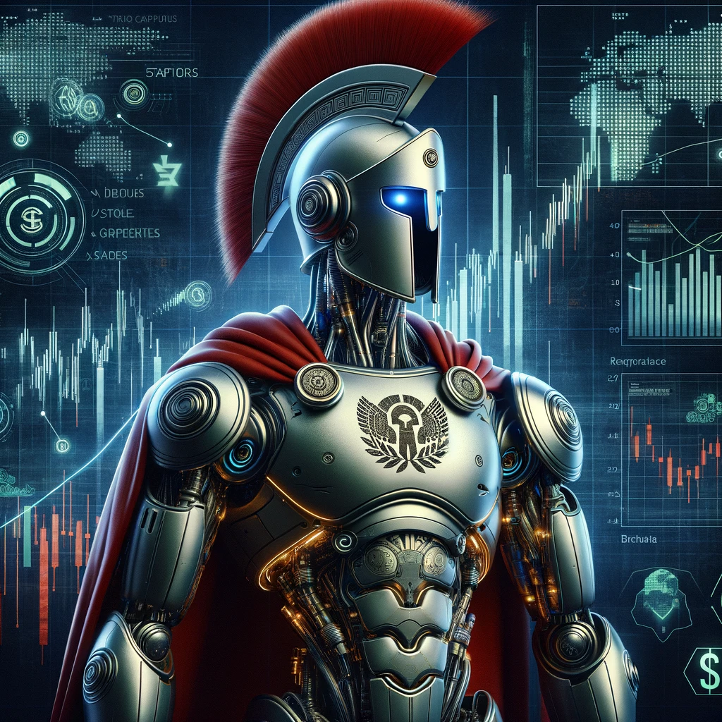

Financial Metrics
Stefano Grazioli

Slide 2
Easy meter
Rulebook posted
Introducing Athens

Slide 3
You do the talking
Name, major…
Clear learning objectives?
Things you like about the class
Things that can be improved
Attitude towards the Tournament

Slide 4
Orange words
Please define the meaning of the column…

Slide 5
Homework
Metrics

Slide 6
What Is New
In Technology?

Slide 7
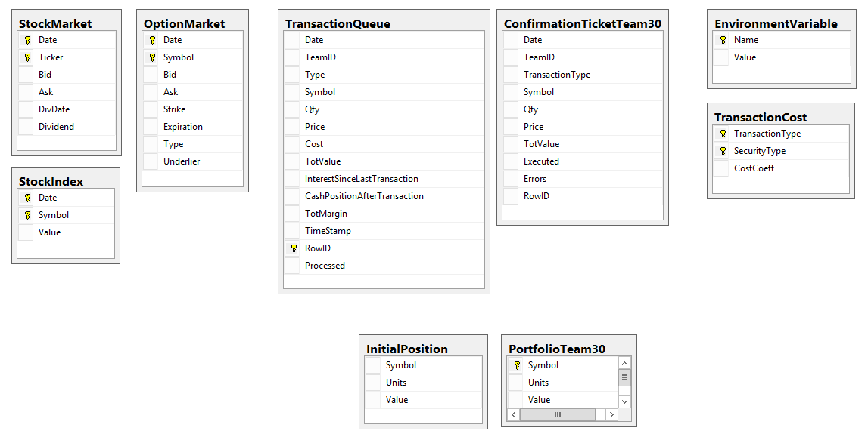
Data model
Alpha / Beta / Gamma Database (Athens - server)
FIXED TABLE NAMES
myDataset
(Spartan Trader - local)
YOU PICK THE NAMES

Slide 8


