Slide 1

Options valuation
Stefano Grazioli

Slide 2
Easy meter
Over 20 teams
Check on the DBs whether you can see your PortfolioTeamXX table

Slide 3
Learning Objective
Understand the financial value of option contracts

Slide 4
What is the value of a call?
European options
On expiration day (easy)
On any other day (not so much)
?

Slide 5


What is the value of a call option?
July 21st
?
Call Option
on Apple
Strike: $150
Expiration: July 21st
Spot price:
1 AAPL share
is $160
Transaction costs not included

Slide 6
What is the value of a call?
July 21st
?
Call Option
on Apple
Strike: $150
Expiration: July 21st
Spot price:
1 AAPL share
is $140
Transaction costs not included

Slide 7
What is the value of a call?
July 21st
?
Call Option
on Apple
Strike: $150
Expiration July 21st
Spot price:
1 AAPL share
is $170
Transaction costs not included

Slide 8
What is the value of a call?
There is a positive correlation between the value of a CALL and the spot price of its underlier
Price of the share goes up
Value of the call option goes up

Slide 9
What is the value of a call?
July 21st
?
Call Option
on Apple
Strike: $150
Expiration July 21st
We just found that this call is worth $20
What happens if we now change the strike?
Spot price:
1 AAPL share
is $170

Slide 10
What is the value of a call?
July 21st
?
Call Option
on Apple
Strike: $140
Expiration: July 21st
Spot price:
1 AAPL share
is $170

Slide 11
What is the value of a call?
There is a negative correlation between the value of a CALL and its strike
Value of the call option
Lower strike

Slide 12
What is the value of a call?
On expiration day, value is certain and dependent on the difference between spot and strike
What about any other day?
?

Slide 13
What is the value of a call?
July 21st
June 21st
?
Call Option
on Apple
Strike: $160
Expiration: July 21st
Spot price:
1 AAPL share
is $160
Expectation:
$170 on July 21st
range 150-200

Slide 14
What is the value of a call?
?
On any other day
value is not deterministic,
because of uncertainty
about the future price of the underlier.

Slide 15
Evaluating call options
The current value of a call Option depends on:
1) the current price of the underlier +
2) the strike price -
3) the underlier volatility +
4) the time to expiration +
5) the risk-free interest rate +
Question:
what is the value
of the option
right now?
Bought a call option on FB for $3.00, x=200
Call Option:
Can buy FB for $200
FB price is $200
a) FB price is $210
b) FB price is $190
?
PAST
NOW
EXPIRATION
Notes:
In essence, as the risk-free rate increases, the present value of the future strike price decreases, making the option to buy at today’s price more valuable. Additionally, the cost of carry affects the overall pricing dynamics, aligning the option’s value more closely with changes in interest rates. From chat gpt

Slide 16
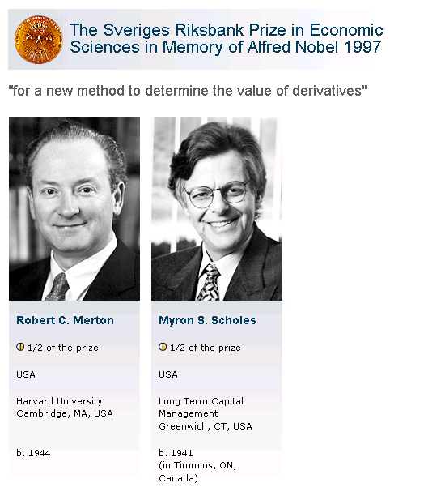
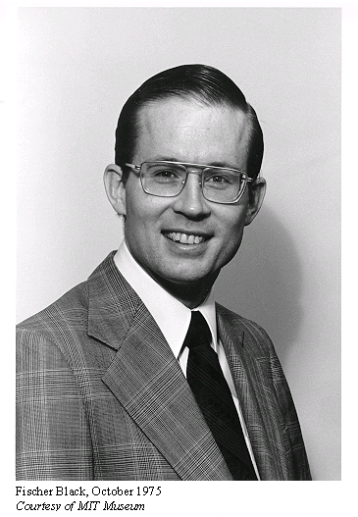
Solving the Option Evaluation Problem

Slide 17
The Black-Scholes Formulas
Price of a Call = S[N(d1)] – Xe^{-rt}[N(d2)]
d1 = {ln(S/X) + (r + σ ²/2)t}
σ√t
d2 = d1 - σ√t
S = current share (mtm) price,
X = option strike price,
t = time to option expiration (in years),
r = riskless rate of interest (per annum),
σ = share volatility (per annum),
N(z) = probability that a standardized normal variable will be less than d. In Excel, this can be calculated using NORMSDIST(z). Delta for a Call = N(d1) Delta for a Put = N(d1) -1

Slide 18
NORMSDIST(z)
z

Slide 19
Why study Black-Scholes?
Their formulas are the foundation for the hedging technique called DELTA HEDGING (next time)
Delta for a Call = N(d1) a positive number, between 0 and 1
Delta for a Put = N(d1)-1 a negative number, between -1 and 0

Slide 20
Double-checked Values
Example:
  S = $ 42, X = $40
  t = 0.5
  r = 0.10 (10% p.a.)
  s = 0.2 (20% p.a.)
Results:
  d1 = 0.7693
  d2 = 0.6278
  N(d1) = 0.7791
  N(d2) = 0.7349
  C = $4.76 and P=$0.81

Slide 21
What is new in IT?

Slide 22
Homework
Demo

Slide 23
Black Scholes was so much fun…
Let’s do it again!

Slide 24
What is the value of a put?
July 21st
?
Put Option
on Apple
Strike: $150
Expiration: July 21st
Spot price:
1 AAPL share
is $140

Slide 25
What is the value of an option?
July 21st
?
Put Option
on Apple
Strike: $150
Expiration: July 21st
Spot price:
1 AAPL share
is $130

Slide 26
What is the value of a put?
There is a negative correlation between the value of a PUT and the spot price of its underlier
Price of the share goes down
Value of the put option goes up

Slide 27
What is the value of a put?
July 21st
?
Put Option
on Apple
Strike: $150
Expiration July 21st
We just found that this put is worth $20
What happens if we now change the strike?
Spot price:
1 AAPL share
is $130

Slide 28
What is the value of a put?
July 21st
?
Put Option
on Apple
Strike: $160
Expiration: July 21st
Spot price:
1 AAPL share
is $130

Slide 29
What is the value of a put?
There is a positive correlation between the value of a PUT and its strike
Value of the put option
Higher
strike

Slide 30
What is the value of a put?
On expiration day, value is certain and dependent on the difference between spot and strike
What about any other day?
?

Slide 31
What is the value of a put?
July 21st
June 21st
?
Put Option
on Apple
Strike: $160
Expiration: July 21st
Spot price:
1 AAPL share
is $160
Expectation:
$150 on July 21st
range 130-170

Slide 32
What is the value of a put?
?
On any other day
value is not deterministic,
because of uncertainty
about the future price of the underlier.

Slide 33
Evaluating PUT options
The current value of a Put Option depends on:
1) the current price of the underlier -
2) the strike price +
3) the underlier volatility +
4) the time to expiration +
5) the risk-free interest rate -
Question:
what is the value
of the option
right now?
Bought a put option on Tesla for $5
x = $190
Put Option:
Can sell Tesla for $190
?
Tesla price is $190
a) TESLA market price is $170
b) TESLA market price is $210
PAST
NOW
EXPIRATION

Slide 34
The Black-Scholes Formulas
Equilibrium price for a Put = –S[N(–d1)] + Xe^{-rt}[N(–d2)]
d1 = {ln(S/X) + (r + σ²/2)t}
σ√t
d2 = d1 - σ√t
S = current spot price,
X = option strike price,
t = time to option expiration (in years),
r = riskless rate of interest (per annum),
σ = spot return volatility (per annum),
N(z) = probability that a standardized normal variable will be less than z. In Excel, this can be calculated using NORMSDIST(d).

Slide 35
BS assumptions | HT assumptions
Unlimited borrowing and lending at a constant risk-free interest rate. | No. Limits to shorting
The stock price follows a geometric Brownian motion with constant drift and volatility. | Yes.
There are no transaction costs. | No.
The stock does not pay a dividend. | No. Some do.
All securities are perfectly divisible (i.e., it is possible to buy a fraction of a share). | No.
There are no restrictions on short selling. | No. Limits to shorting
The model treats only European-style options. | Yes.

