Slide 1
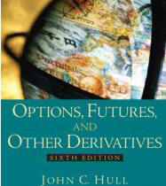
Implied volatility
Stefano Grazioli

Slide 2
Easy meter
Another easy homework
NEW TICKERS on ALPHA
  Do H20 on ALPHA (or other DBs if they have the new tickers)
Learning objective: estimate volatility

Slide 3
Name, major…
Confidence with technology improving?
Things you like about the class
Things that can be improved
Class goals clear?
Any questions you have about the Tournament?

Slide 4
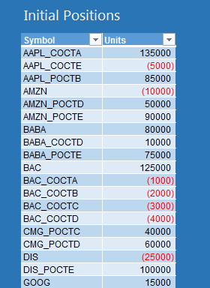
Manual delta hedging
If your position is...
...this is what you need
x Short calls | x * delta long stocks
x Long calls | x * delta short stocks
x Short puts | x * |delta| short stocks
x Long puts | x * |delta| long stocks
x Short stocks | x * 1/|delta| long calls or x * 1/|delta| short puts
x Long stocks | x * 1/delta short calls or x * 1/delta long puts

Slide 5
There is a catch
Delta changes with time....

Slide 6

Delta changes in time
Delta of a Call Option = N(d1)
Delta of a Put Option = N(d1) -1
d1 = {ln(S/X) + (r + σ ²/2) t}
σ√ t
N() is the standard normal cumulative distribution function and it is provided in Excel

Slide 7
Rebalancing your hedge
In the HT, Delta changes with S and t (r, σ are fixed). So, the hedge needs to be periodically readjusted – a practice called rebalancing.
Example:
Yesterday we wanted to hedge 100,000 AAPL long shares and so we shorted 125,000 calls (delta was 0.8). But today the delta is 0.9.
N_{calls} = - 100,000 * 1/0.9
N_{calls} = - 111,111
so, we need to buy back 13,889 calls (=125,000-111,111)
to maintain delta neutrality.

Slide 8
Numeric check: does it work?
We now have 100,000 AAPL & -111,111 Calls on AAPL
Suppose that the AAPL share price increases by $20.
What happens to my portfolio?
Delta = 0.9
so:
Option price change = 0.9 * (+$20) = +$18
Change in Total Portfolio Value = 100,000 * (+$20) + (-111,111) * (+$18) =
= +2,000,000 - 1,999,998 = +$2 i.e., approx. $0
We still have a Delta neutral portfolio (yay!)

Slide 9
Numeric check: does it work?
Suppose that we did not rebalance. We kept 100,000 AAPL &
-125,000 Calls on AAPL
AAPL share price increases by $20.
What happens to my portfolio?
Delta = 0.9
so:
Option price change = 0.9 * (+$20) = +$18
Change in Total Portfolio Value = 100,000 * (+$20) + (-125,000) * (+$18) =
= +2,000,000 – 2,250,000 = -$250,000
I have lost money. This is not a Delta neutral portfolio.

Slide 10
Every how often to rebalance?
Too often = higher transaction costs
Too infrequently = higher risk

Slide 12
Volatility
To compute delta

Slide 13
Volatility is needed to compute delta
Volatility is a measure of the dispersion of the returns of a security over a unit of time
Real world= not constant
HT (and BS model) = constant

Slide 14
Problem: Solving for sigma is too hard!
Price of a Call = S * N(d1) – Xe^{-rt} * N(d2)
d1 = {ln(S/X) + (r + σ ²/2)t}
σ√t
d2 = d1 - σ√t
S = current spot price,
X = option “strike” or “exercise” price,
t = time to option expiration (in years),
r = riskless rate of interest (per annum),
σ = spot return volatility (per annum),
N(z) = probability that a standardized normal variable will be less than d. In Excel, this can be calculated using NORMSDIST(z). Delta for a Call = N(d1) Delta for a Put = N(d1) -1

Slide 15
Iterative technique example
Question: a ten year investment of $1,000 generated an interest of $218.99 What interest rate have I earned?
I know the formula
Interest = 1000 [(1+r)¹⁰ -1]
but I do not know how to invert it

Slide 16
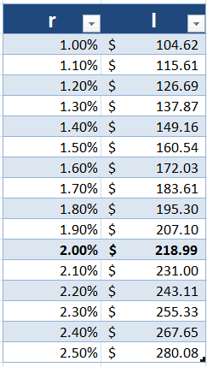
Finding r iteratively
Pick an arbitrary solution value (e.g., r = 1%) and compute the formula: I = 1000 [(1+r)¹⁰ -1]
Try another solution value (e.g., r=1.1%) and compute the formula
If the value of I obtained in step 2 is closer to the target value of I ($218.99), keep increasing the value of r, else reduce it.
Keep on going until you find an r that generates a value of I close enough to the target I=$218.99

Slide 17
Iterative Solutions
Easy to use
BUT
Often only approximations
Not guaranteed to find a solution
Might miss solutions in case there is more than one
y
x
I have found the max!

Slide 18
Implicit volatility method
Assume that BS is true
Find the volatility that will match the observed market price using an iterative technique
DEMO

Slide 19
Excel Tools comparison
Goal seek
if you have one unknown “X” and one known “Y” – as in the example
Goal “Y” is a constant
No constraints (e.g., x > 0)
Solver
if you have more than one unknown “X”s – e.g., suppose that we did not know t and r
Goal “Y” can be a constant, or a min, or a max
Can do constraints on the Xs

