Slide 1
Simulation
A tool to test your strategies

Slide 2
Easy meter
H22: cannot disable functionality to make it work (only change scores and the contents of the APs).
H23 = last graded homework!

Slide 3
Name, Major
Feeling a sense of satisfaction when the homework works?
Feeling better about your knowledge of technology?
Questions about the tournament?

Slide 4
Demo
Simulation

Slide 5
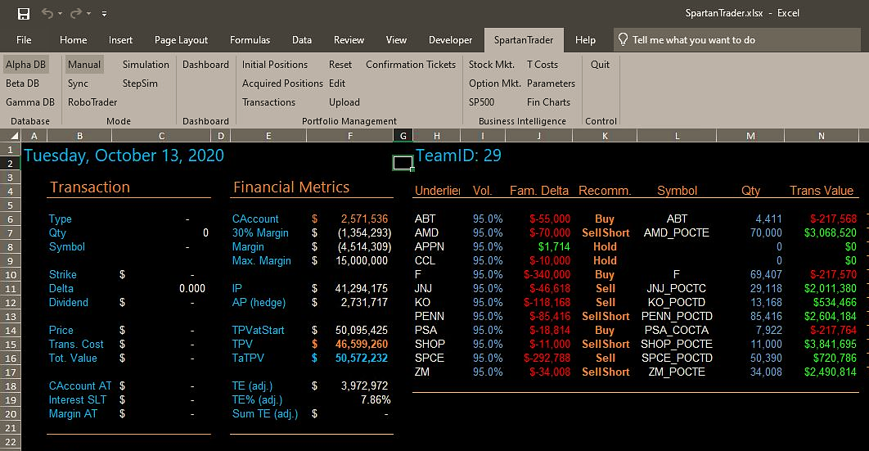

Slide 6
Simulation main processes
Start
Set up: Reset the Spartan Trader to the beginning-of-tournament state
Current date = start date
Daily routine: Show currentDate,
Calc and display financial metrics
Add one day to the current date
Pick the next ticker. Generate and score candidate recommendations
Pick the best recommendation, display and execute it
End of tournament date reached?
More tickers?
No More tickers
End

Slide 7
Spartan Trader MODES
Manual
Does not check for date changes. Does not trade for you. Does not initialize.
Simulation
Does a destructive initialization. Runs trough all available data quickly. Trades for you.
StepSim
Same as Simulation, except that it waits for you before every trade
Sync
Checks continuously for date changes. Does not trade for you. Does not initialize.
RoboTrader
Checks continuously for date changes. Trades for you. Does not initialize.

Slide 9
Tweaking your system
Tweak
Test (simulation)
For best performance

Slide 10
Generating & Scoring Recommendations
Do we hedge today?
N
Should we hedge this family (e.g., AAPL)?
N
Family delta positive or negative?
Sell AAPL stock
Sell AAPL Calls
Sell Short AAPL Calls
Buy AAPL Puts
Buy back AAPL Short Puts
Buy AAPL stock
Buy AAPL Calls
Buy back Short Calls
…..
Base score 700
Base score 600
Base score 200
Base score 400
…..
…..
Base score
400
Base score 500
…..
Loop trough A-E
…..
…..
Is it in IP?
N
Loop trough A-E
Is it in IP?
Is it in IP?
N
Do I have any long stock?
N
N
Do I have available cash?
N
Am I long on it?
N
How many should I buy?
How many should I sell?
How many should I sell short?
Can I afford it?
N
Will I respect max margins?
N
Will I respect the margin?
N
If I do not have enough, I lower the base score with an adjustment
If I cannot sell short enough, I lower the base score with an adjustment
If I cannot buy enough, I lower the base score with an adjustment
Adjust score based on Strike (A-E)
Adjust score based on Strike (A-E)

Slide 11
A strategy is a set of choices
Frequency of recalibration? (HedgingToday)
Family Delta size too large? (NeedToHedge)
Preference among transaction types (Base scores)? (CalcCandidateRecScores)
A-E options preferences? (scoring rules)
Delta threshold? (CalcQtyNeededToHedge)
Family delta target? (CalcQtyNeededToHedge)
Max buy cushion? (MaxPurchasePossible)
Available cash cushion? (AvailableCashIsLow)
Max margin cushion? (TooCloseToMaxMargins)
Max short cushion? (MaxShortWithinConstraints)

