Slide 1
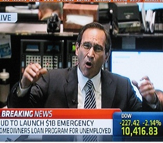
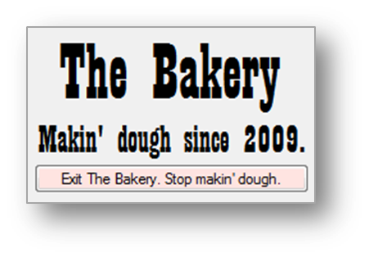
The Robotrader is alive!
The Gobs of Money Machine
No Hedgetation

Slide 2
Perceived difficulty
LAST Homework!
HT Rulebook is available.
Full-length (3 hrs.) test tournaments available starting today. Day and night. Just ask me via Teams.
Can jump on a test tournament at any time no permission required.
Check on Teams for System status.
Help on strategy: outside my door there will be a sign up sheet. Your team may appear only once in the list or it will be deleted.

Slide 3
Confidential Peer Evaluation
May affect your grade
 |  | Name: | Name: | Name:
Overall contribution to team success
Team Work | Quality of work
 | Amount of work
 | Knowledge of the project area
 | Ideas contributed to the project
 | Organization of team work (admin.)
Team Rapport | Leadership
 | Enthusiasm, attitude, initiative
 | Respect for others
 | Dependability, good team player
 | Meeting attendance, punctuality

Slide 4
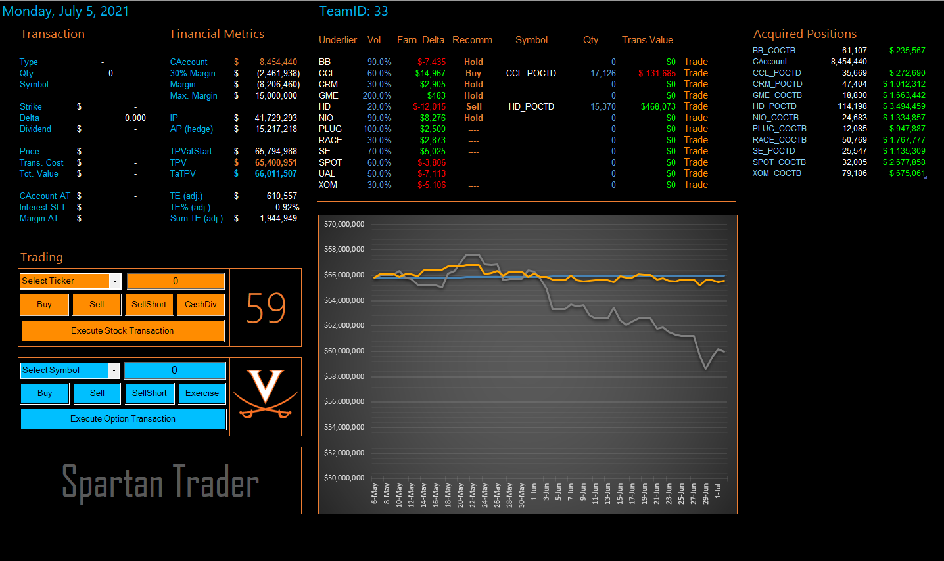

Slide 5
The RoboTrader
Demo 1: chart

Slide 6
The two timers (simplified)
Timer 1 (spy)
Timer 2 (seconds on screen)
Start
Check the date on the DB
New date?
No
Yes
Decrease the seconds by 1
Run daily routine
Set seconds to 59
Less than 0?
Yes
No

Slide 7
The RoboTrader
Demo 2: Robotrade

Slide 9
Main parameters to tweak
Frequency of hedging (HedgingToday)
Family Delta threshold (NeedToHedge)
Alternative actions scoring (CalcCandidateRecScores)
A-E options preferences (scoring rules)
Delta threshold (CalcQtyNeededToHedge)
Family delta target (CalcQtyNeededToHedge)
Available cash cushion (AvailableCashIsLow)
Max buy cushion (MaxPurchasePossible)
Max margin cushion (TooCloseToMaxMargins)
Max short cushion (MaxShortWithinConstraints)

Slide 10
Optional mini-projects
Automatic dividend cashing
Differential thresholds for hedging
Differential family delta targets
Intentional crashes
Edit portfolio on the fly
Bang for the buck
Auto/synch training
July options
Delta for dividend-paying securities
“Extra profits" button
Error viewer
Gamma hedger

Slide 11
Between now and Thursday
Implement H24
Jump on a live HT
Try dividend cashing/paying
Try a full HT
Meet me: sign up
Check the rulebook

