Slide 1
How to do well in the Tournament
Performance improvements

Slide 2
Tournament is in seven days!
Software clinic is open – sign up sheets outside my door – TONS of office hours
HT runs available – check Teams
No morning class next Tue and Thursday (HT day)
No food/alcohol in the labs

Slide 3
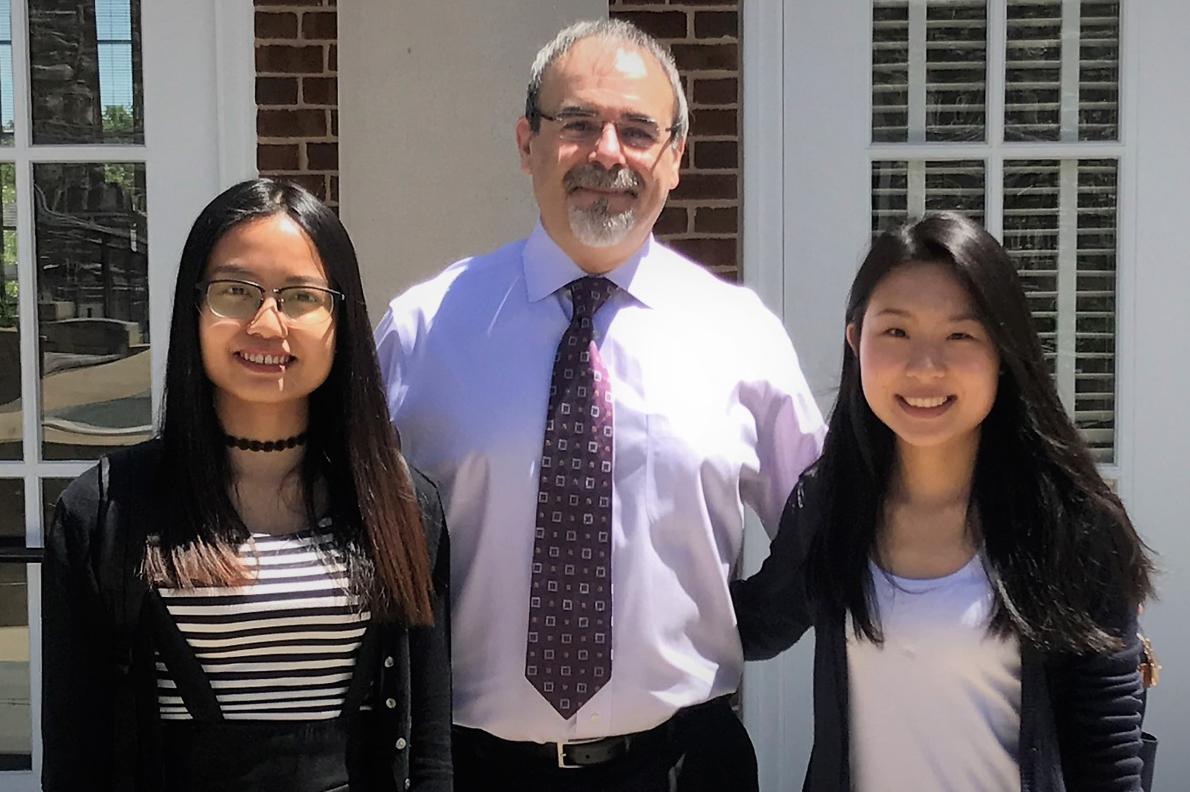
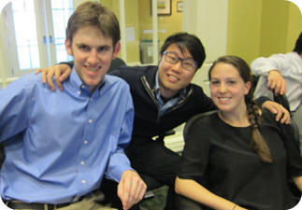
Most of the teams will tweak H24, some will do some optional mini projects, a few will try the dark horses.
OVERALL HT WINNERS 2017
OVERALL HT WINNERS 2013

Slide 4
1. Tweaking

Slide 5
Main parameters to tweak
Frequency of hedging (HedgingToday)
Family Delta threshold (NeedToHedge)
Alternative actions scoring (CalcCandidateRecScores)
A-E options preferences (scoring rules)
Delta threshold (CalcQtyNeededToHedge)
Family delta target (CalcQtyNeededToHedge)
Available cash cushion (AvailableCashIsLow)
Max buy cushion (MaxPurchasePossible)
Max margin cushion (TooCloseToMaxMargins)
Max short cushion (MaxShortWithinConstraints)

Slide 6
2. Miniprojects

Slide 7


Optional mini-projects
Automatic dividend cashing
Differential thresholds for hedging
Differential family delta targets
Intentional crashes
Edit portfolio on the fly
Bang for the buck
Auto/synch training
July options
Delta for dividend-paying securities
“Extra profits" button
Error viewer
Dark horses
Gamma hedger (1 and 2)
Synthetics

Slide 8
The error log
A recommended optional project

Slide 9
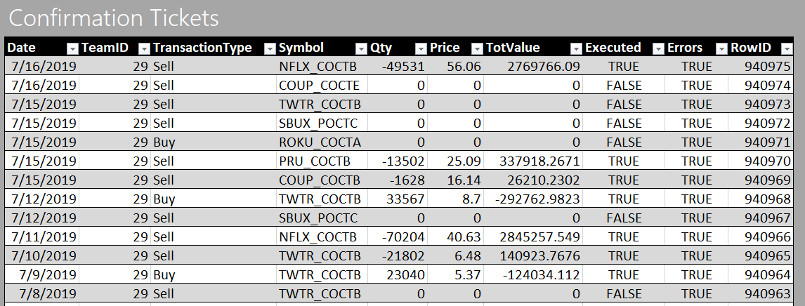
Confirmation tickets
Only produced in the next “day” and only when Athens is running

Slide 10
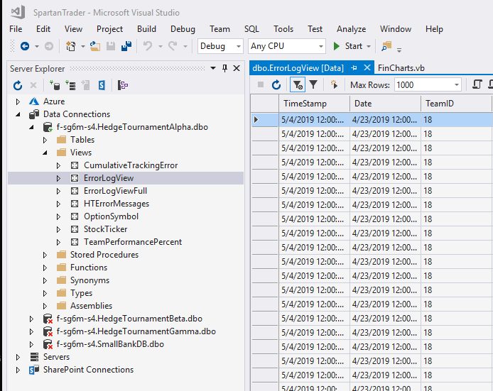
Error log
Each DB has one
Wiped out before each new run

Slide 11
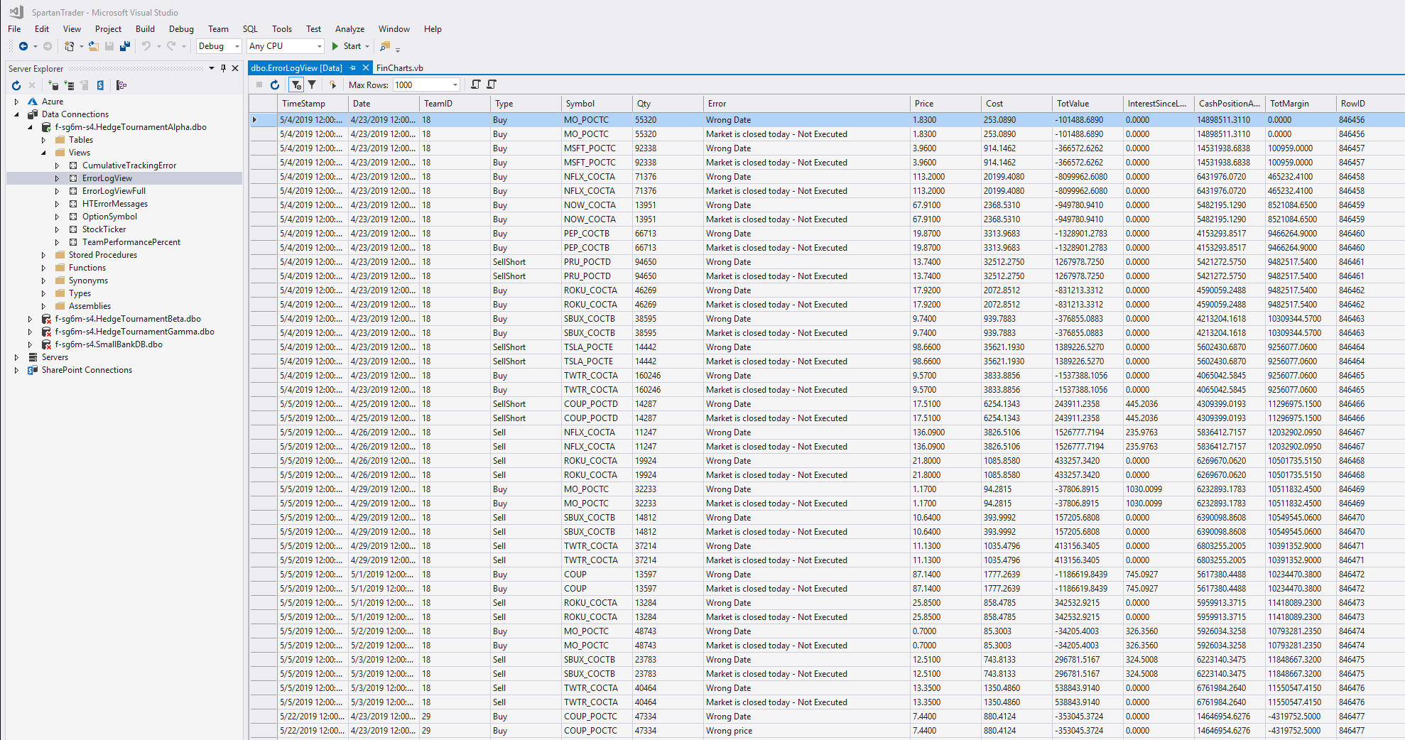

Slide 12
Athens date | Team Date | Tr. Type | Symbol | Qty | Feedback | ROWID
Sunday, May 5, 2019 | Friday, May 3, 2019 | Sell | TWTR_COCTA | 40464 | Wrong Date | 846476
Sunday, May 5, 2019 | Friday, May 3, 2019 | Sell | TWTR_COCTA | 40464 | Market is closed today - Not Executed | 846476
Wednesday, May 22, 2019 | Tuesday, April 23, 2019 | Buy | COUP_POCTC | 47334 | Wrong Date | 846477
Wednesday, May 22, 2019 | Tuesday, April 23, 2019 | Buy | COUP_POCTC | 47334 | Wrong price | 846477
Wednesday, May 22, 2019 | Tuesday, April 23, 2019 | Buy | COUP_POCTC | 47334 | Wrong tot. trans. val. (Excess = -254,344.52) | 846477
Wednesday, May 22, 2019 | Tuesday, April 23, 2019 | Buy | COUP_POCTC | 47334 | Wrong cash position. Excess=179,620.47 | 846477
Wednesday, May 22, 2019 | Tuesday, April 23, 2019 | Buy | COUP_POCTC | 47334 | Transacting twice on the same day - Not Executed | 846477
Wednesday, May 22, 2019 | Tuesday, April 23, 2019 | Buy | MO_POCTC | 32278 | Wrong Date | 846478
Wednesday, May 22, 2019 | Tuesday, April 23, 2019 | Buy | MO_POCTC | 32278 | Wrong price | 846478
Wednesday, May 22, 2019 | Tuesday, April 23, 2019 | Buy | MO_POCTC | 32278 | Wrong tot. trans. val. (Excess = 41,742.72) | 846478
Wednesday, May 22, 2019 | Tuesday, April 23, 2019 | Buy | MO_POCTC | 32278 | Wrong cash position. Excess=-469,512.14 | 846478
Wednesday, May 22, 2019 | Tuesday, April 23, 2019 | Buy | MO_POCTC | 32278 | Transacting twice on the same day - Not Executed | 846478
Wednesday, May 22, 2019 | Tuesday, April 23, 2019 | Buy | MSFT_POCTC | 91466 | Wrong Date | 846479
Wednesday, May 22, 2019 | Tuesday, April 23, 2019 | Buy | MSFT_POCTC | 91466 | Wrong price | 846479
Wednesday, May 22, 2019 | Tuesday, April 23, 2019 | Buy | MSFT_POCTC | 91466 | Wrong tot. trans. val. (Excess = 28,425.35) | 846479
Wednesday, May 22, 2019 | Tuesday, April 23, 2019 | Buy | MSFT_POCTC | 91466 | Wrong cash position. Excess=-515,411.18 | 846479
Wednesday, May 22, 2019 | Tuesday, April 23, 2019 | Buy | MSFT_POCTC | 91466 | Transacting twice on the same day - Not Executed | 846479

Slide 13
Optional project
Write a join that connects your confirmation tickets to the error messages produced by Athens
Create a button to visualize the results of that query

Slide 14
If you see an error during the tournament
Let’s hope you will not need it

Slide 15
Reversing transactions
Something went wrong in a transaction…
Reversing a transaction that was executed
Reversing a transaction that was NOT executed

Slide 16
Reversing a transaction that was executed
You need to execute on the next day a manual reverse transaction
Example
Buy 1,000 Apple → Sell 1,000 Apple
This will get you back to the exact same place because of the T costs.

Slide 17
Reversing a transaction that was NOT executed
No need to execute a reverse transaction. You need to manually modify the Acquired Positions Table.
Example
“Buy 1,000 Apple for $102,000” did not go through.
You need to manually subtract 1,000 Apple from AP and
add back $102,000 to your Capital Account.
This will get you back to the exact same place.

Slide 18
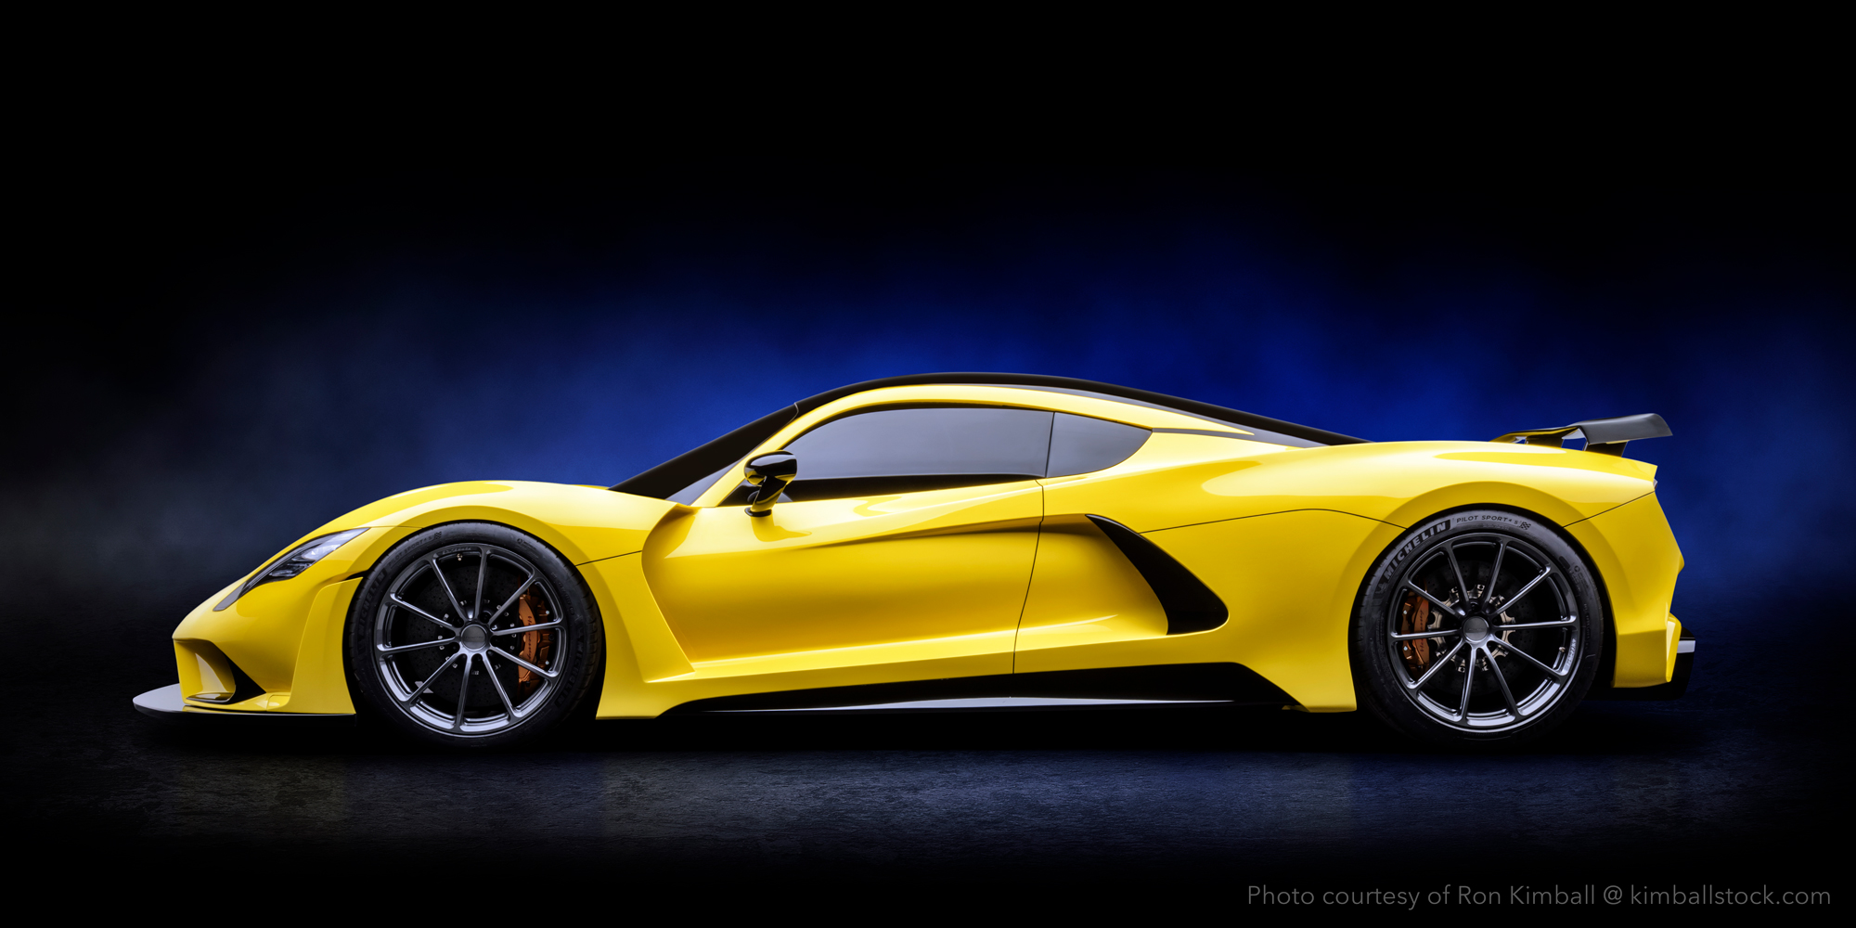
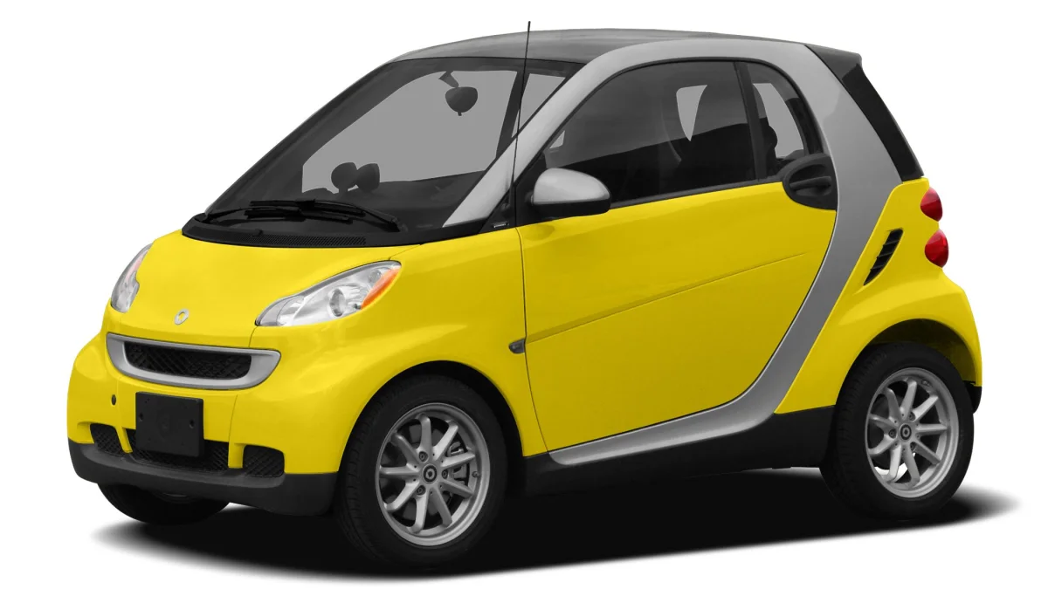
More ideas for performance improvements
Notes:
Hennessey venom F5 – fastest street car – 301 mph
$1.6mil
* About a Bugatti Veyron

Slide 19
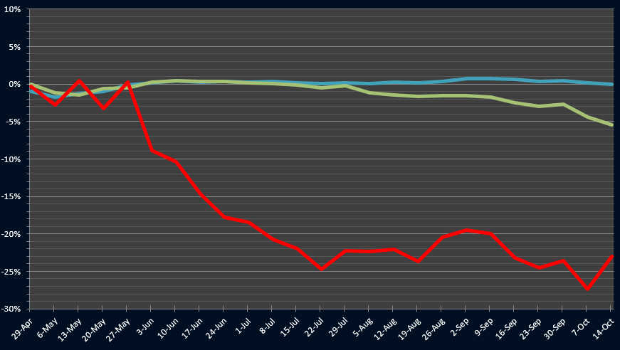
Delta Hedging Weakness
Delta hedging drop

Slide 20
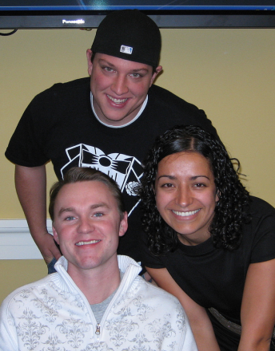
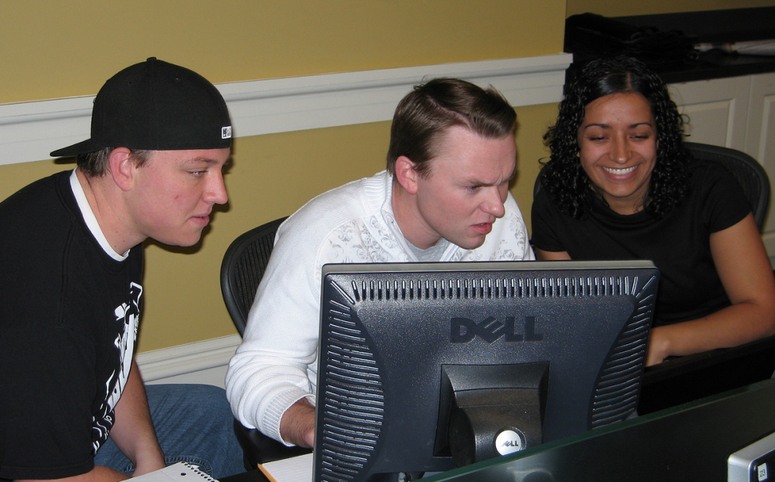
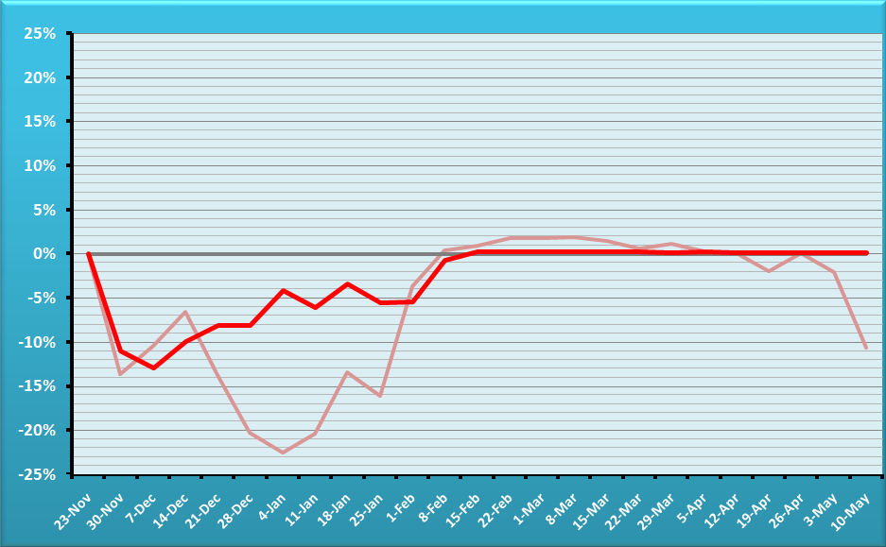
Fall 08 – The Fighters
BUG-FREE
Team
?
AUDITED PERCENT TRACKING ERROR.
Team is in red, reference portfolio semitransparent
OVERALL HT WINNER

Slide 21
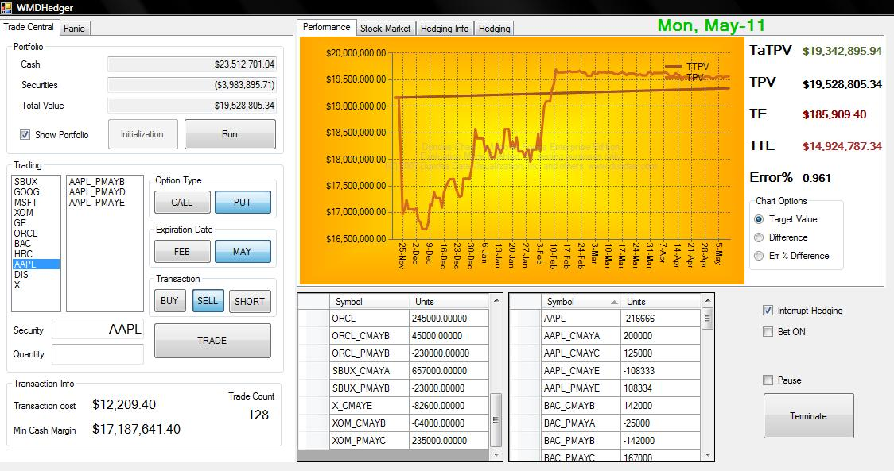

Slide 22
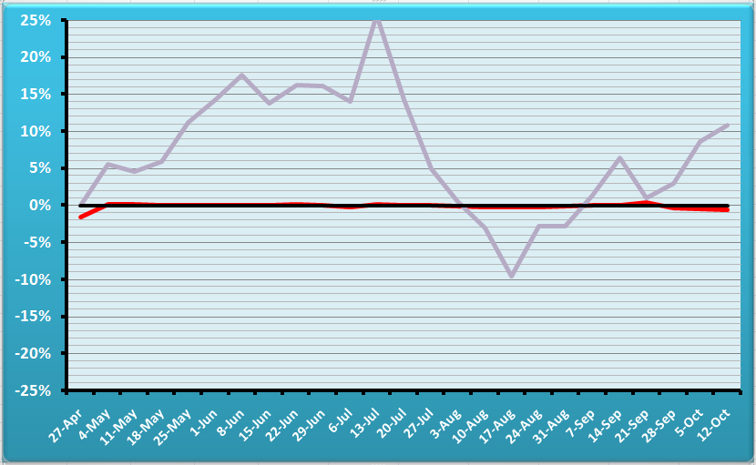
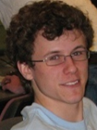
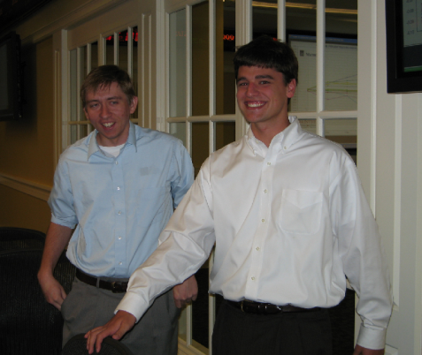
T3 – Gaming The System
PTL (Pardon The Loss)
Mark Paddrik,
Scott Tucker (Ghost) & Michael Ledwith
BUG-FREE
Team
AUDITED PERCENT TRACKING ERROR.
Team is in red, reference portfolio in gray
OVERALL
TOURNAMENT WINNERS

Slide 23
From the rulebook
You cannot trade twice the same ticker or symbol in the same day - i.e., no “money burning.” Both trades will be rejected.

Slide 24
From the rulebook
You may not sell short if you have a long position on the same security.
Example: you can not sellShort 250 GOOG if you hold a long position of 100 GOOG. First you sell the long position, then you go short. You must do so in two separate days.

Slide 25
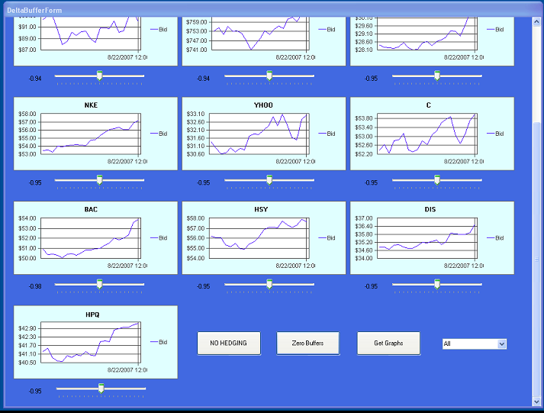
T 14/07
Idea: multiple delta targets

Slide 26
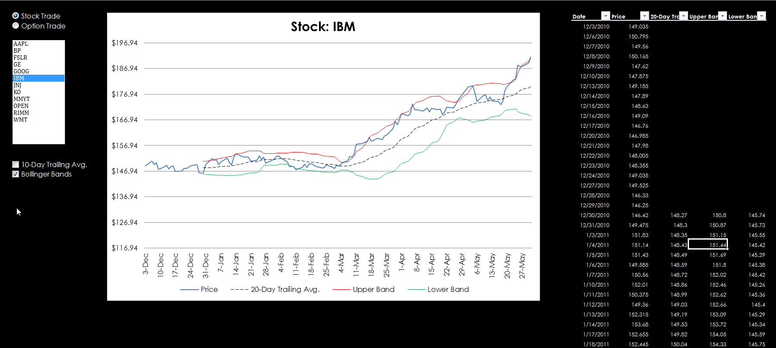

Slide 27
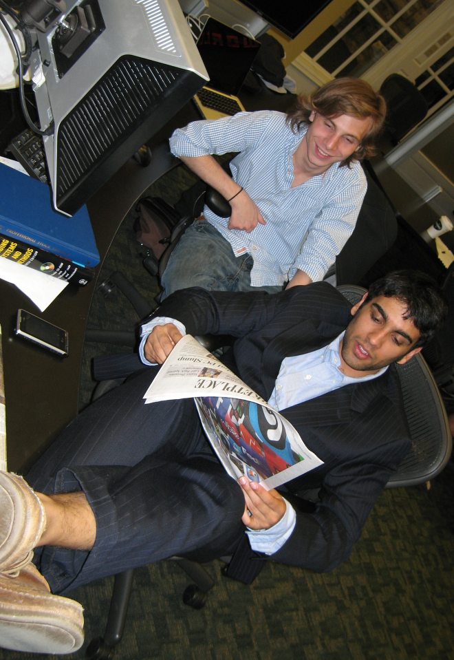
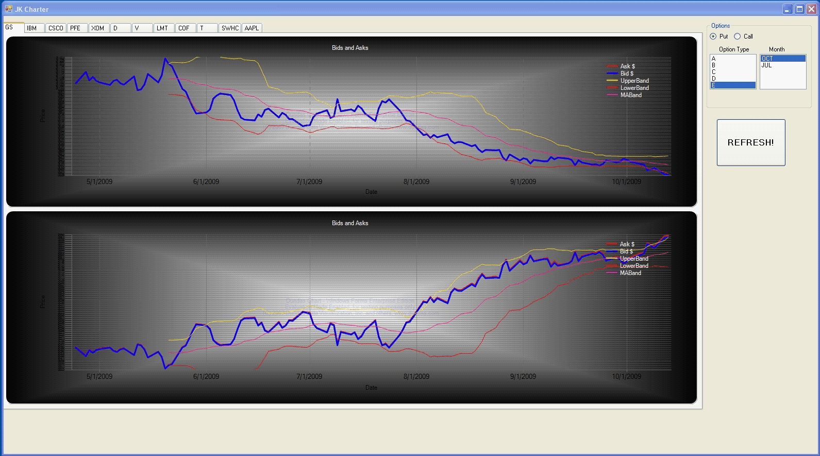
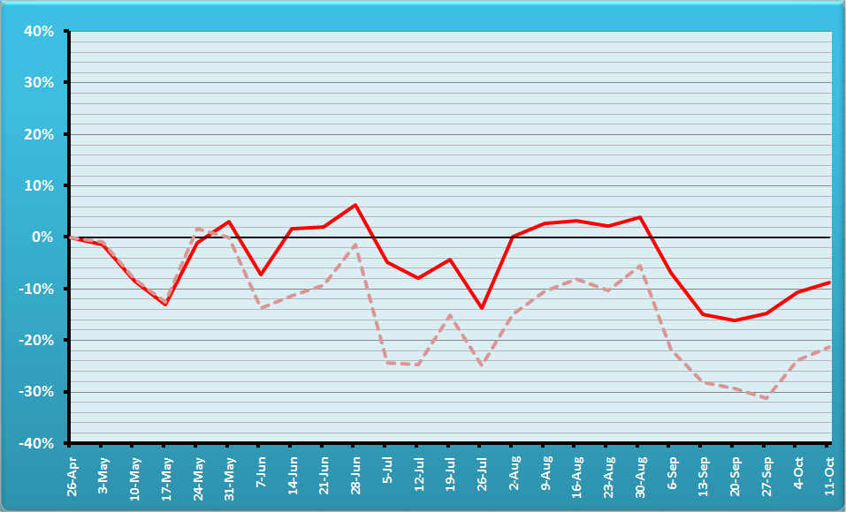
Team 5 – The “Moneymaker”
Jerome Kerviel
Fund Management
AUDITED PERCENT TRACKING ERROR.
Team is in red, reference portfolio semitransparent
Idea: explore new strategies
Notes:
Jérôme Kerviel is a French trader who was convicted in the 2008 Société Générale trading loss for breach of trust, forgery and unauthorized use of the bank's computers, resulting in losses valued at €4.9 billion. (wiki)

Slide 28
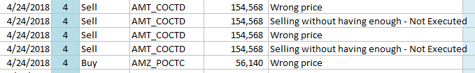
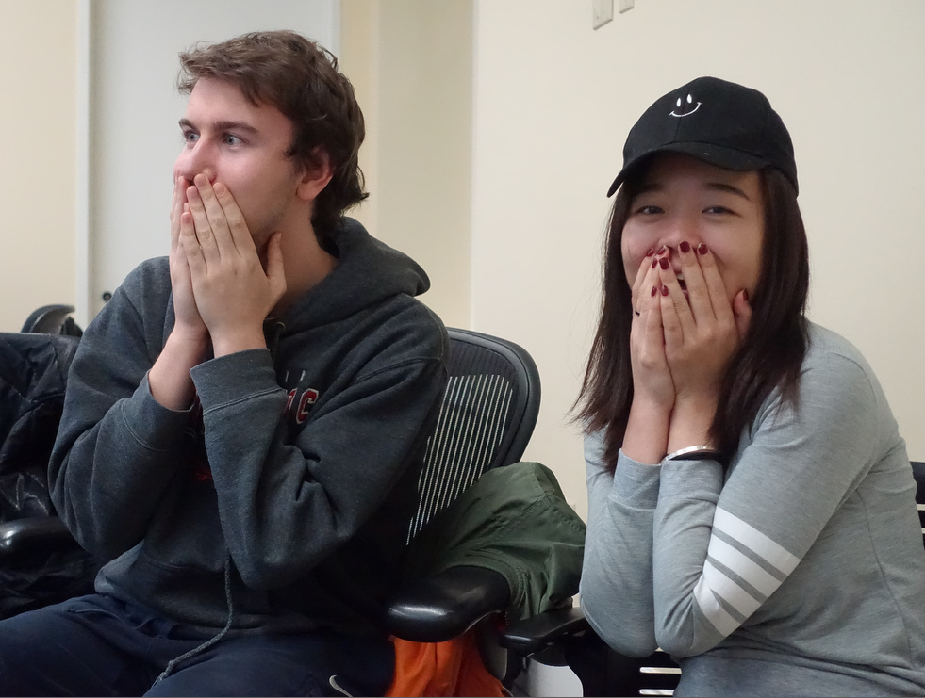
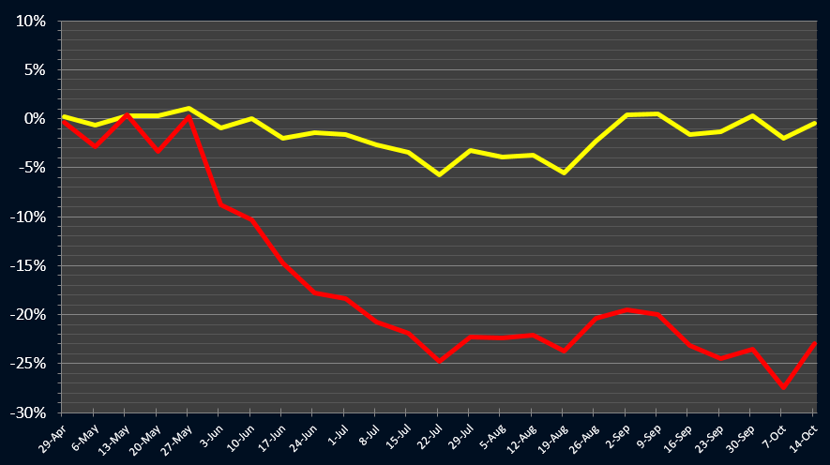

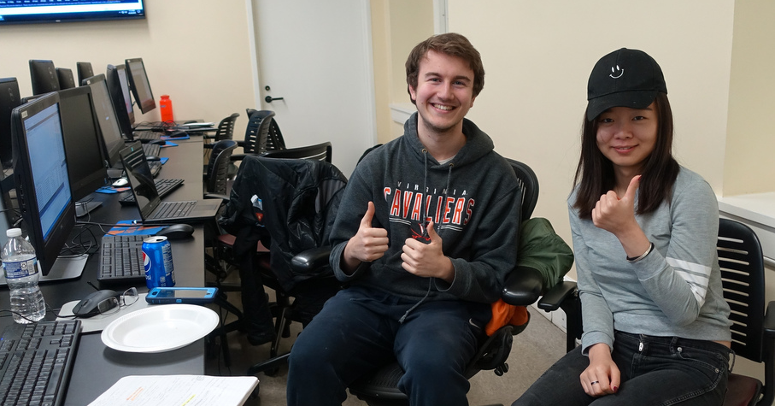
T4 spr18 – The big scare
False start (it might happen to you)
UNDERGRADUATE
RUNNER UP

Slide 30

3. The Dark Horses
Conditional Gamma
Simultaneous Delta Gamma
Synthetics

Slide 31
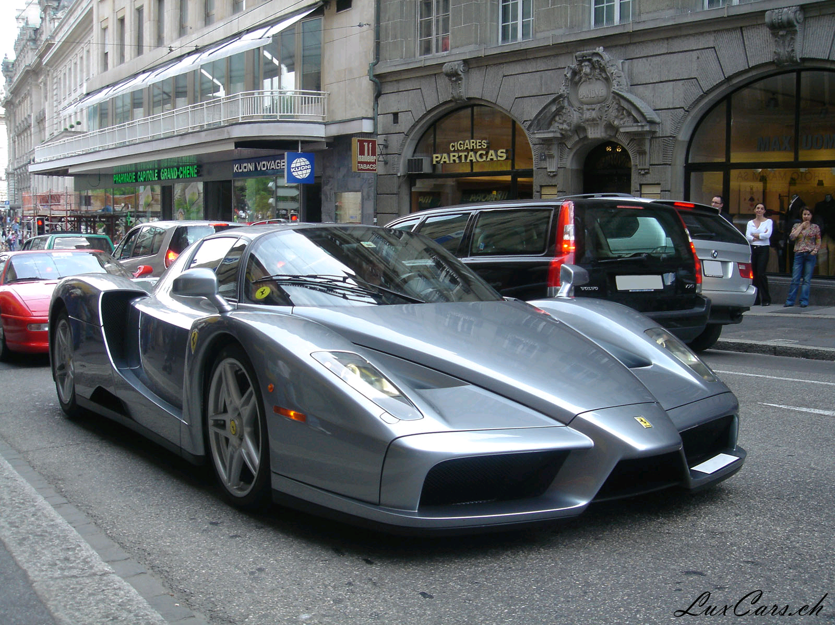
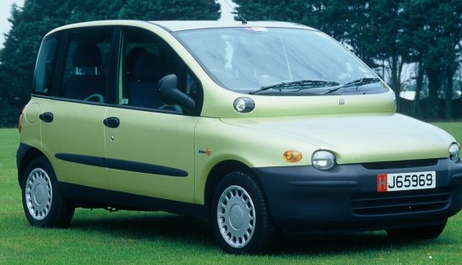
Family Gamma
Family Delta (Δ) measures the change in portfolio value
as the underlier’s price S changes (~speed).
Family Gamma (Γ) measures the rate of change in portfolio value as S changes (~acceleration).

Slide 32
Meaning of Gamma
If Gamma is small (abs.), small changes in S will not affect much Delta (and your portfolio value) ,
so
there is less need to take immediate rebalancing action.
If Gamma is large, small changes in S will affect Delta (and your portfolio value) significantly,
so
there is a stronger need to take immediate rebalancing action.

Slide 33
How to Calculate Gamma
Gamma = N’(d1)
Sσ√ t
N’(d1) = e ^{–(d1)2/2}
√ (2 π)
d1 as in Black Scholes
Gamma
Strike
Stock price S
Notes:
N’ is the prob density function for a standard normal distribution.

Slide 34
Gamma of a Portfolio of Related Securities
Γ_{family} = Σ qty_{i} * γ_{i}

Slide 35
Gamma of a portfolio
During small periods of time t₂-t₁
Δ _{portfolio} = ½ ∗ Γ_{portfolio} ∗ (S₂-S₁)²
Example:
If you do not rebalance, and the underlier price (e.g., GE) drops from $52 to $50, the change of value in a Delta-Neutral Portfolio is approximately
= ½ ∗ Γ ∗ (S₂-S₁)²
= 0.5 * (-10,000) * (52-50)²
= -$20,000
~

Slide 36
Gamma-Neutral Portfolio
More stable than a delta neutral-only.
Cannot use the stock to reach Gamma neutrality because the stock has Gamma = 0
1) Γ_{portfolio} <> 0
2) Γ_{portfolio} + Γ_{x} qty_{x} = 0
3) qty_{x} = -Γ_{portfolio} / Γ_{x}
Warning: Acquiring qty_{x} will disturb Delta neutrality. You will need to rebalance.

Slide 37

Delta Gamma Delta
It’s a financial strategy, not a sorority.
Find out what you need to achieve Delta neutrality.
Find out what you need to achieve Gamma neutrality.
Find out what you need to re-achieve Delta neutrality. Stock is ideal because it will not affect Gamma.

Slide 38
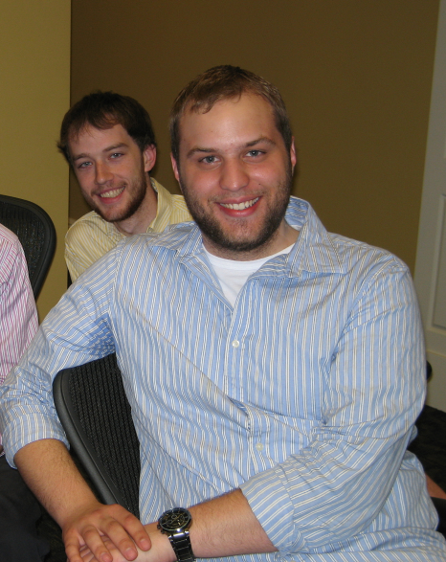
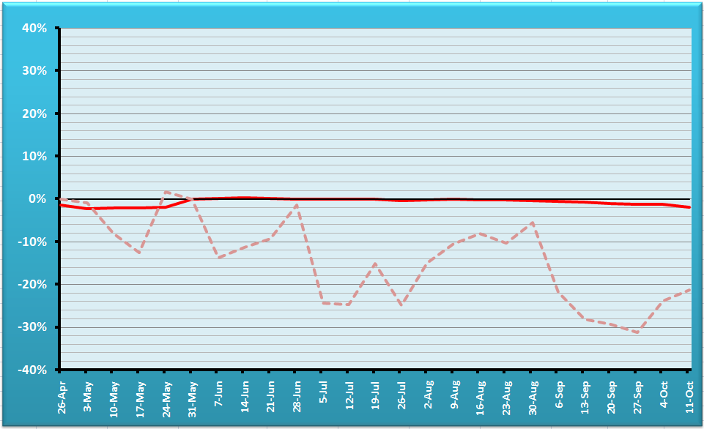
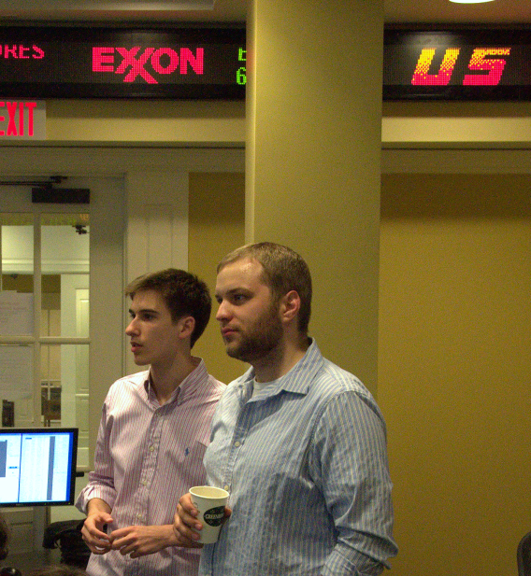
T8 Conditional Gamma
OVERALL HT WINNERS
Bug-free
Team
AUDITED PERCENT TRACKING ERROR.
Team is in red, reference portfolio semitransparent

Slide 39
Simultaneous Delta Gamma
Δ_{portfolio} + δ_{x1} qty_{x1} + δ_{x2} qty_{x2} = 0
Γ_{portfolio} + γ_{x1} qty_{x1} + γ_{x2} qty_{x2} = 0
All known except qty x1 and qty x2
{

Slide 40
Syntetics

Slide 41
Offset the Position with a
Synthetic Security
Profit & Loss
Perfect hedge, but costly.
Synthetic Short position
Long position
to hedge
Stock price
Total Payoff

Slide 42
Put-Call Parity
For European Ps and Cs that have the same strike K, and expire by the same time t:
P + S = C + K e^{-rt}
We can solve for S, P, or C, effectively synthesizing a security with a combination of the other two and some interest-earning cash.
Example: S = C + Ke^{-rt} – P and
- S = - C - Ke^{-rt} + P

Slide 43
Theta, Vega, and Rho
Conceptually similar to Delta
Theta = change in portfolio value when time changes
Vega = change in portfolio value when the volatility changes
Rho = change in portfolio value when the rate of interest changes

Slide 44
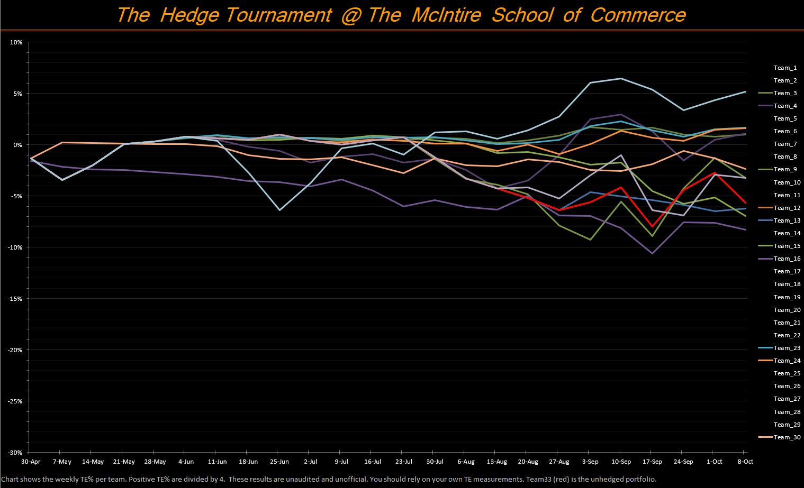
On tournament day…

Slide 45

Tip for success
The few mins before and after the beginning of the tournament are critical
Test!
Make sure you know what
to do in case of a malfunction

Slide 46
Past performances
May not be indicative of future performances

Slide 47
Transactions per Team 2020
Total transactions = 18,720
Mean transactions per team = 516

Slide 48
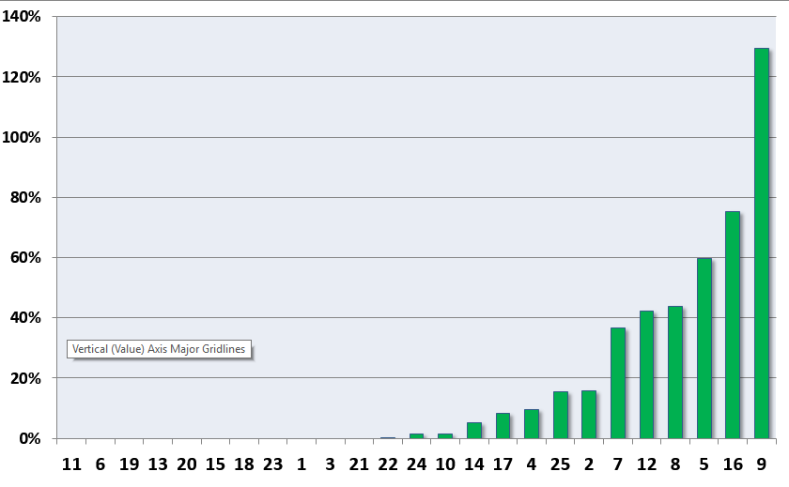
% Errors per Transaction (2016)
Zero bug teams

Slide 49
Cumulative Tracking Error: 2022

Slide 50
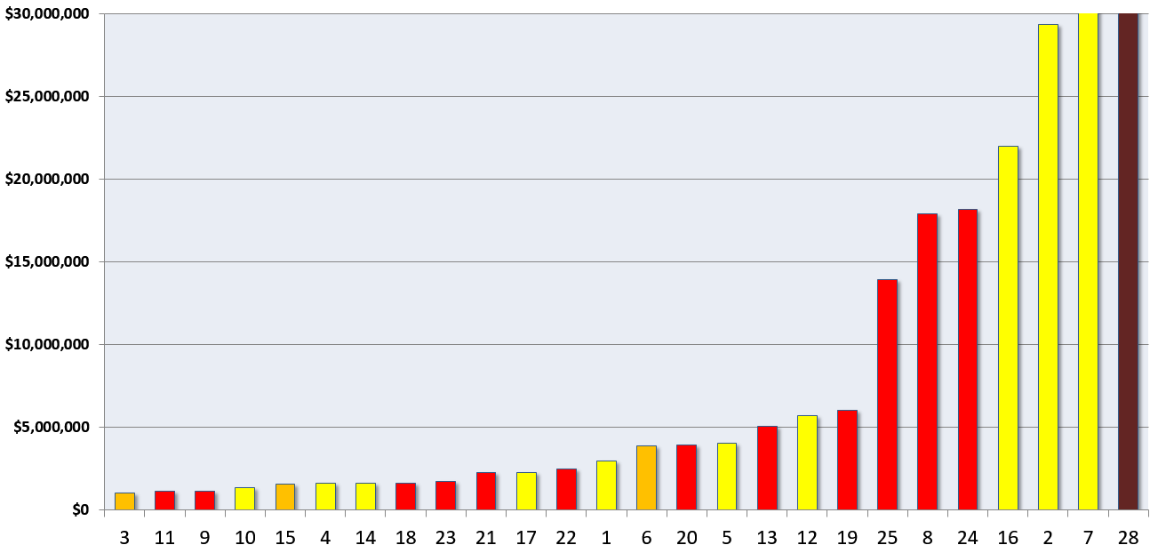
Cumulative Tracking Error 2016
Notes:
Orange: MSA
Red: MSComm
Yellow: UG

