Slide 1

Loops
Introduction to Visual Basic

Slide 2

Labs update
WINIT instructions in the ‘grading policies’
Bug bounty
“Trusted locations”
EasyMeter ☺

Slide 3
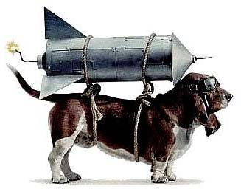

VS is an IDE
Visual Studio
Excel
Requirements:
What needs to be done
VS is an IDE: an Integrated Development Environment
Coding
Compiling
Source code file in a computer language
Runnable code:
.exe, .dll
(i.e., a program)
C#, VBA, C++, python…

Slide 4
Learning Objectives
Loops
  For … Next
  Do While
Conditionals
  If … Then
  Select Case
Procedures
  Subs
  Functions
Objects
  Properties
  Methods

Slide 5
Name, academics…
Comfort with coding
Comfort with finance
Learning goals
Hardest thing so far

Slide 6
Orange words
Difference Sub and Function?

Slide 7
Homework
H4 - Fin Cal Part II

Slide 8
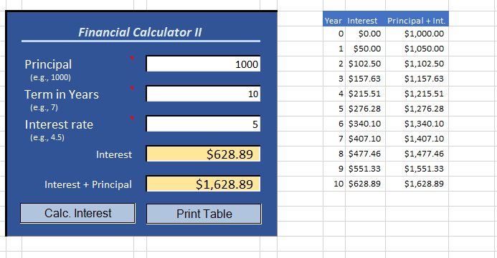
The competency curse
Hey, I really liked your financial calculator! Could you add to it a table that shows interest and principal from year zero to the end?

Slide 9
Activity Diagram (part II)
Simple Financial Calculator
User inputs principal, years, and interest rate
User presses “print table” button
Principal, Year, or Rate is missing
Alert the user
Print and format table header
i > number of years
Format data and autofit the columns
i <= number of years
Print the i^{th} row of data (and
increase i by 1)

Slide 10
Implementing a For…Next loop
Print and format table header
i > 10
Format data and autofit the columns
i <= 10
Print the i^{th} row of data and increase i
For i As Integer = 0 To 10
‘ Code to Print the i^{th} row of data…
‘ …
Next

Slide 11
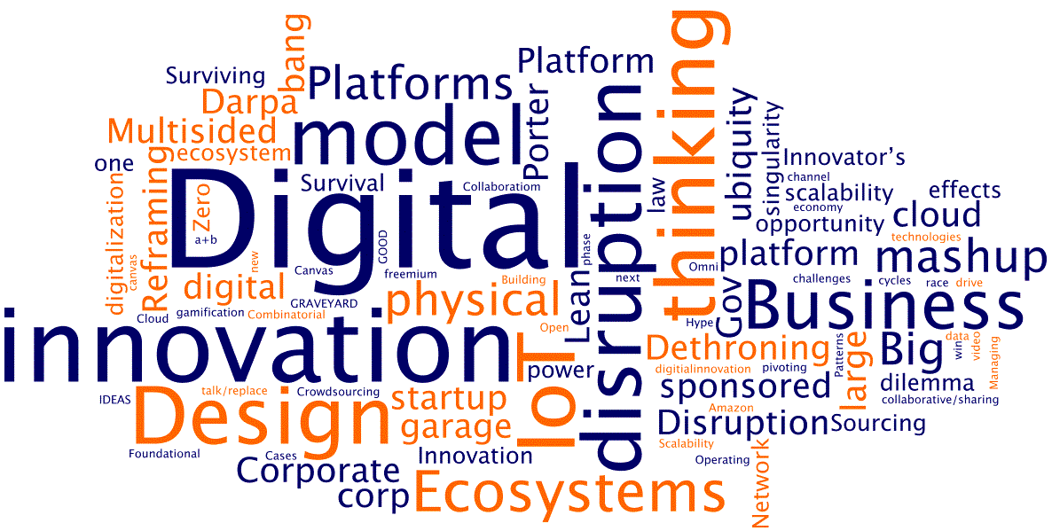
WINIT
What Is New
In Technology?

Slide 12
Loops
Loops are control structures that repeat sets of instructions until a certain condition is met

Slide 13
Four types of loops
You know how many times you need to repeat certain actions: For... Next
You want certain actions to be applied to all items in a set:
For ... Each
Do certain actions if a test is true – begin with the test:
Do While <test> ... Loop
Do certain actions if a test is true – begin with the actions:
Do ... Loop While <test>
Refill the guests
until there is coffee
Fill with coffee the six cups on the table
Fill with coffee all the cups on the table
If there is coffee,
refill the guests

Slide 14
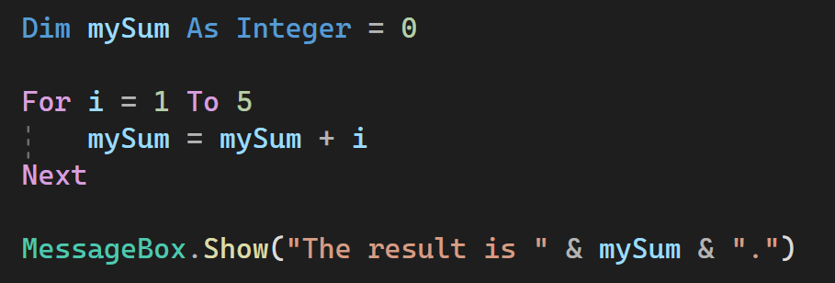
Loops – For … Next

Slide 15
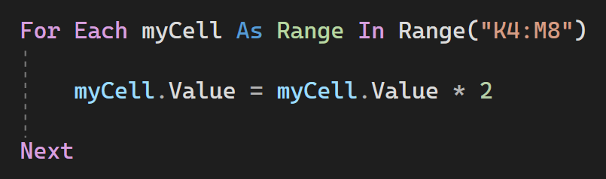
Loops – For Each

Slide 16
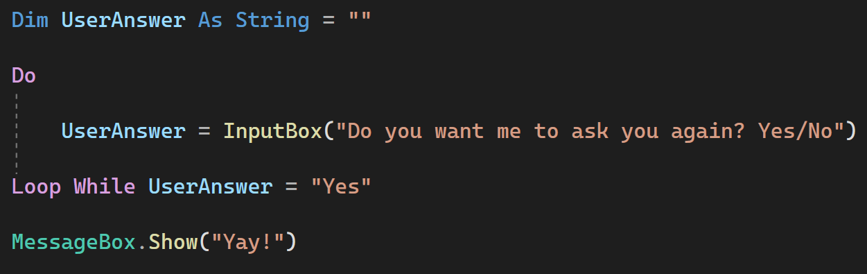
Loops – Do ... Loop While

Slide 17
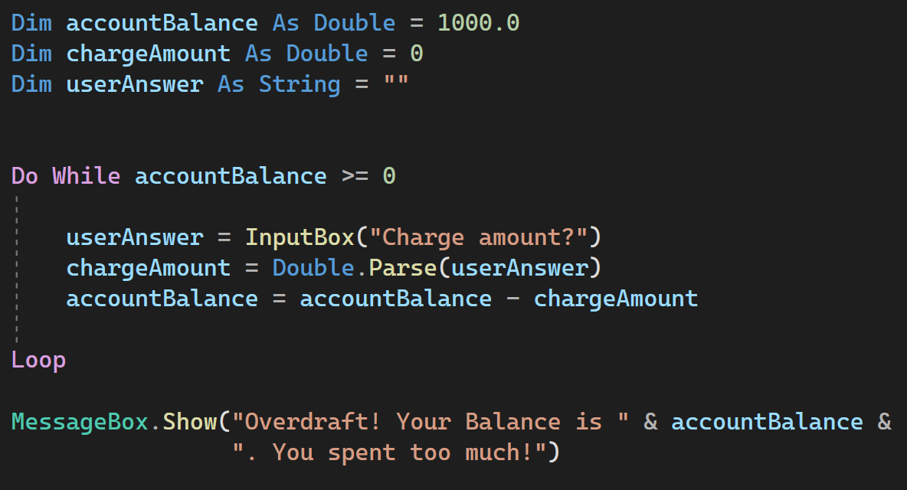
Loops – Do While ... Loop

Slide 18
Suggestions
Give yourself plenty of time
Website resources, Teams, and Google are your friends
Contact me.

