Slide 1
Subs & Functions
Stefano Grazioli

Slide 2

Critical thinking
Going well
Teams?
EasyMeter ☺

Slide 3
You Do The Talking
Name, academics
Learning objectives
Comfort with coding
Comfort with finance

Slide 4

WINIT
What Is New
In Technology?

Slide 5
Key concepts (orange words)
Activity diagram
Variable
Variable type

Slide 6
Learning Objectives
Loops
  For … Next
  Do While
Conditionals
  If … Then
  Select Case
Procedures
  Subs
  Functions
Objects
  Properties
  Methods

Slide 7
Procedures:
Functions and Subs
Simplify!
Reuse!

Slide 8
Program “A”
Program “B”
Line of code
Longer line of code
Longer line of code
Line
Line
Longer line of code
Longer line of code
Longer line of code
Line
Line
Line
Longer line of code
Much longer line of code
Much longer line of code
Longer line of code
Line
Line
Line
Longer line of code
Longer line of code
Longer line of code
Line
Line
Longer line of code
Much longer line of code
Longer line of code
Line
Line
Longer line of code
Longer line of code
Longer line of code
Line
Line
Much longer line of code
Longer line of code
Line
Line
Line
Longer line of code
Much longer line of code
Longer line of code
Line
Longer line of code
Much longer line of code
Longer line of code
Line
Line
Line
Line
Longer line of code
Much longer line of code Line
Line
Line
Longer line of code
Much longer line of code
Line
Line
Longer line of code
Longer line of code
Longer line of code
Line
Line
Longer line of code
Much longer line of cod
Much longer line of code
Longer line of code
Line
Line
Longer line of code
Much longer line of code
Line of code
Longer line of code
Longer line of code
Line
Call SUB “C”
Line
Longer line of code
Much longer line of code
Much longer line of code
Longer line of code
Line
Line
Call SUB “C”
Longer line of code
Much longer line of code
Longer line of code
Line
Call SUB “C”
Much longer line of code
Longer line of code
Line
Line
Line
Longer line of code
Much longer line of code
Longer line of code
Line
Longer line of code
Much longer line of code
Longer line of code
Line
Line
Line
Line
Longer line of code
Much longer line of code Line
Line
Line
Longer line of code
Much longer line of code
Line
Call SUB “C”
Longer line of code
Much longer line of cod
Much longer line of code
Longer line of code
Line
Line
Longer line of code
Much longer line of code
SUB “C”
Line
Longer line of code
Longer line of code
Longer line of code
Line
Line
55 lines of code
20% less writing
No reinventing
Fewer errors
Single location for changes
69 lines of code

Slide 9
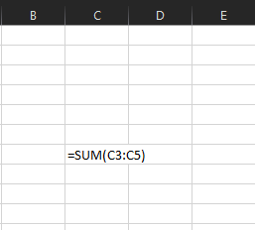
Functions are programs that return values
Example built-in function
Keyword
Argument

Slide 10
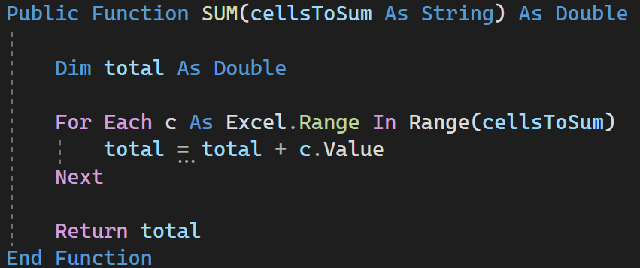

Implementing SUM
Security: private vs. public
Function name
Argument
Type of info returned
Example use of the function in a larger program

Slide 11
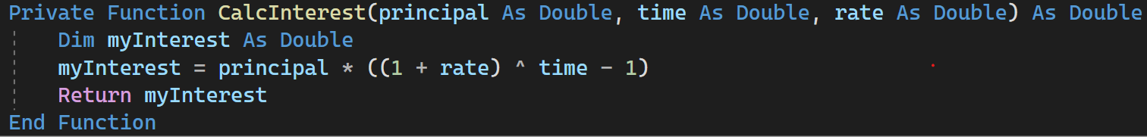
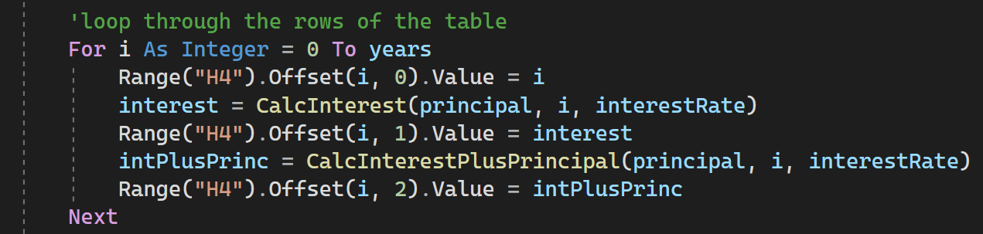
You can create your own functions
Security: private vs. public
Arguments, with arbitrary names
Arbitrary
name
Keyword
Example of use inside a larger program

Slide 12
Binding parameters

Slide 13
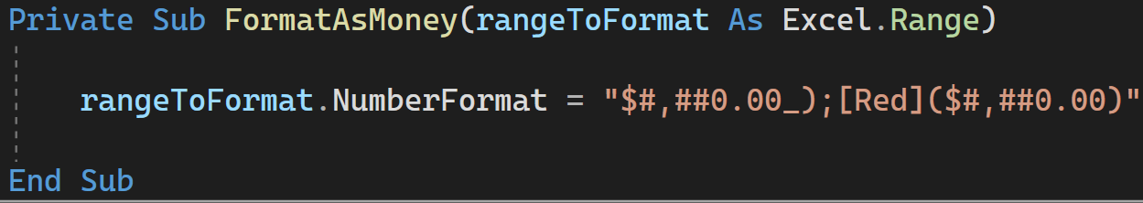
Subs do not return values
Security: private vs. public
Argument, with arbitrary name
Keyword
Arbitrary
name
Example of use inside a larger program

Slide 14
Variables and Parameters
Variables have a lifecycle / scope
Parameters are a special type of variable: used as input to subs and functions, do not need a DIM
Find the vars and params in here
Private Sub Button1_Click …
Dim inputFromUser As String
inputFromUser = InputBox("Please enter your
name")
ShowConfirmation(inputFromUser)
End Sub
Private Sub ShowConfirmation(someText As String)
Range("A1").Value = "You entered: " + someText
End Sub

Slide 15
WINIT
What Is New
In Technology?

