Slide 1

Financial Analytics
Stefano Grazioli

Slide 2
Easy meter

Slide 3

Financial Analytics
Financial analytics is the application of quantitative methods to financial problems:
QF, Financial Engineering are synonyms.
We focus on the IT
aspect of financial
analytics.
Learning by doing:
the Hedge Tournament

Slide 4

Tournament objective
Given an illiquid portfolio of stocks and options, plus some cash,
invest the cash
to minimize the risk of losses.

Slide 5
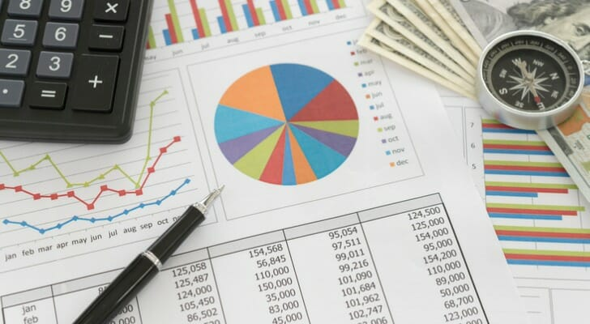
Your portfolio
Cash (Capital account)
Stocks and Options
Initial Positions (IP, illiquid)
and
Acquired position (AP, liquid)
Long/short positions

Slide 6
You do the talking
Name, major…
Comfort with VBA, Excel
Do you have a team?
Things you like about the class
Things that can be improved

Slide 7
Orange words
Pivot table
Dataset

Slide 8
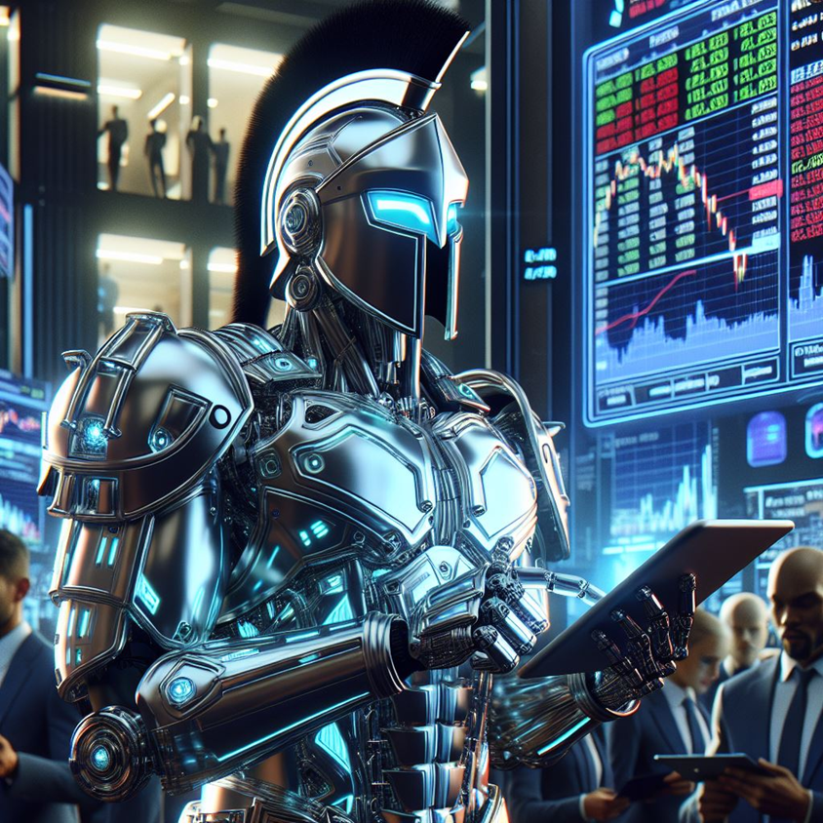
The Spartan Trader
Robotrader /
algo-trader
homework

Slide 9
Spartan Trader functionality
Access
data
Compute
metrics
Trade
securities
Recommend
actions

Slide 10
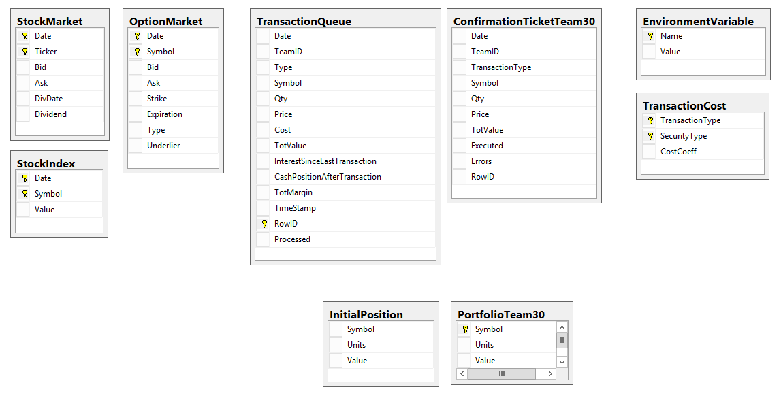
HT datamodel
Automate the access to these tables for H13
Automate the access to these tables for H14

Slide 11
The Datamodel is the same in the three DBs, but data may be different
SERVER: f-sg6m-s4.comm.virginia.edu
Microsoft RDBMS sql server
Hedge
Tournament
ALPHA
Hedge
Tournament
BETA
Hedge
Tournament
GAMMA
Each database has a full instance of the tournament. Each has all the tables. Different instances = potentially different data

Slide 12
Homework H13
All column names in all tables are to be considered orange words.

Slide 13
Homework H14
(already? We just saw H13…)
All column names in all tables are to be considered orange words.

Slide 14
Stocks and Options FUNdamentals

Slide 15
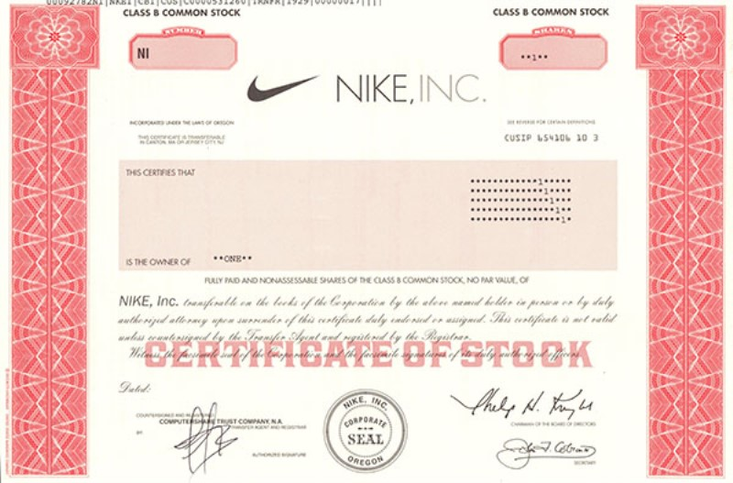
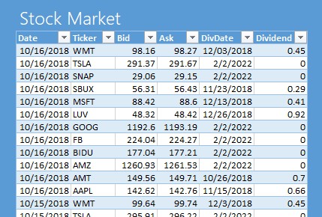
Stocks/Shares
A share of a corporation is a security that represents fractional ownership of the corporation.
Owners of shares - “Shareholders/Stockholders” - may receive dividends, proceeds from liquidation of assets, and may vote on important decisions affecting the corporation.
Shares are bought and sold on stock exchanges by market makers (also known as specialists) and other players. Bid / Ask
Notes:
M maker (e.g. NASDAQ) = firm that buys and sells on its own account. MMs compete among themselves. Electronic market.
Specialist (e.g. NYSE) = monopolist who runs an auction posting bids and asks from the market participants

Slide 16
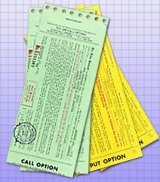
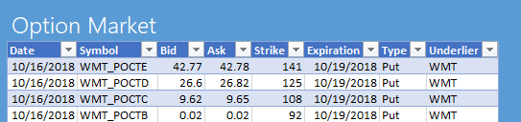
Options are derivatives
An option is a contract giving the buyer the right, but not the obligation, to either buy or sell an underlying asset (e.g., a stock) at a specific price on or before a specified date.
Once created, it may be sold and bought on the market. We do not write options. We buy/sell/sell short them.
Notes:
R. McDonald Fundamentals of Derivatives Markets – chpt 4
Why use derivatives: 1) to hedge; 2) speculate; 3) avoid trans. Costs 4) to arbitrage regulations

Slide 17
Nomenclature
underlier
Put Option
can sell 1 TESLA stock
@ $350.00
on 20 May 2025
Bid: $ 20.00
Ask: $ 20.20
TESLA Stock
Bid: $ 350.00
Ask: $ 350.50
Dividend: $ 0
strike price
expiration:
European vs. American

Slide 18
Example Scenario
You just inherited 1,000,000 Apple shares.
@ $250 -> $250,000,000.
You are pretty happy.
But you are also worried. What if the price drops to $200?
You need some kind of insurance against that.
Somebody is willing to commit to buying your Apple shares at $250
(if you want), two years from now.
But she wants $1 per share. Now.
You decide that it is a good deal. So, you buy 1,000,000 contracts that give you the right to sell your shares at $250 two years from now.
You have bought 1,000,000 put options.

Slide 19
Put Options
A put option gives its holder the right but not the obligation to sell the underlying security at a given price on (or before) a given date.
Think (loosely) “buying insurance”

Slide 20
Alternative WINIT
Just an Idea; If you do not want to pick an event, you might pick a company and tell us about it.
https://thefinancialtechnologyreport.com/the-top-100-financial-technology-companies-of-2024/

Slide 21
Another Scenario
You are an executive at Netflix.
You make $1,000,000 a year.
You are pretty happy.
The Board wants to make sure that you will do your best to keep the price of the Netflix stock up.
Rather than giving you a well-deserved raise, they offer to you a deal. They promise that in three years they will give you the chance to buy 100,000 shares at $1,000 each.
Right now the share is valued at $980.
If the company does well, the share price could go as up as $1,100.
So you think: “In three years I could just get my 100,000 @ $1,000 and then immediately sell them back to the market for $1,100....”
You conclude that an extra $10,000,000 in your pocket is a good thing.
You have been given 100,000 call options.

Slide 22
Call Options
A call option gives its holder the right but not the obligation to buy the underlying security at a given price on or by a given date
Think “deposit to buy later at a fixed price"

Slide 23
Nomenclature
underlier
Call Option
can buy 1 TESLA stock
@ $750.00
on 20 May 2025
Bid: $ 20.00
Ask: $ 20.50
TESLA Stock
Bid: $ 760.00
Ask: $ 760.50
Dividend: $ 0
strike price
expiration:
European vs. American

Slide 24
American vs. European Options
In the HT we use European options only. Why?
Models and theory built on European options
American always at least as expensive
Not optimal to exercise early an American on a non-dividend paying stock (if assumptions hold)
Always possible to trade a European option before expiration.
Source: R. McDonald – Fundamentals of derivative markets

Slide 26
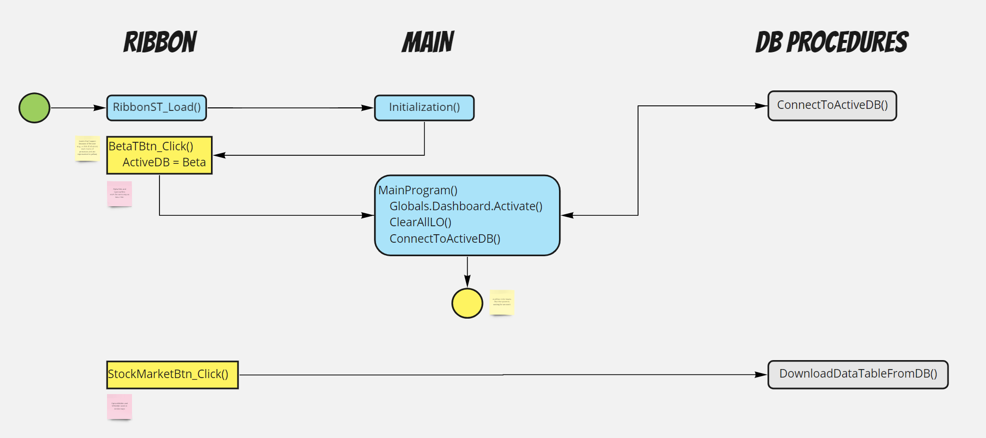

Slide 27
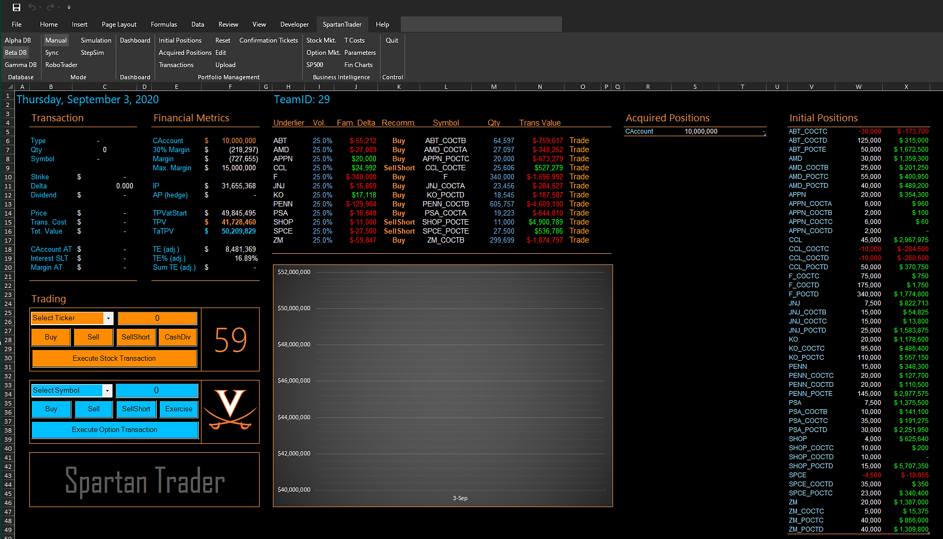

Slide 28
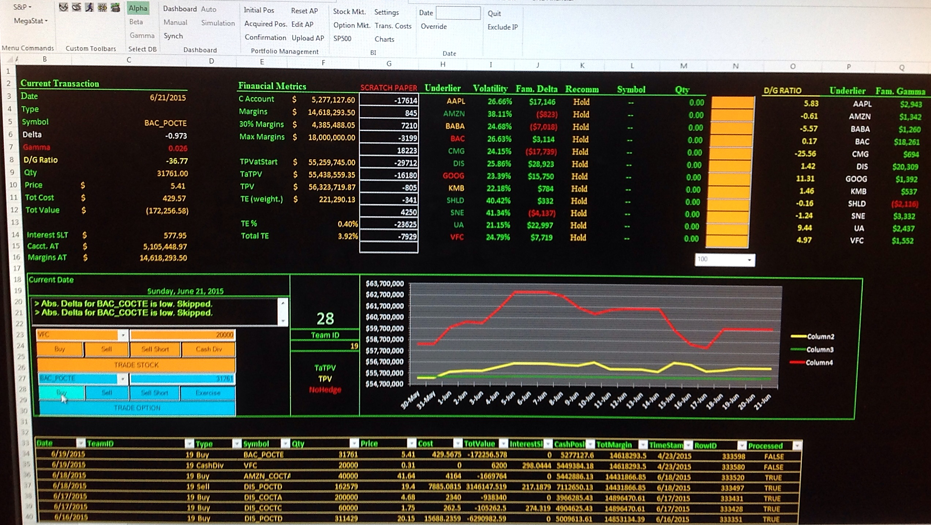

Slide 29
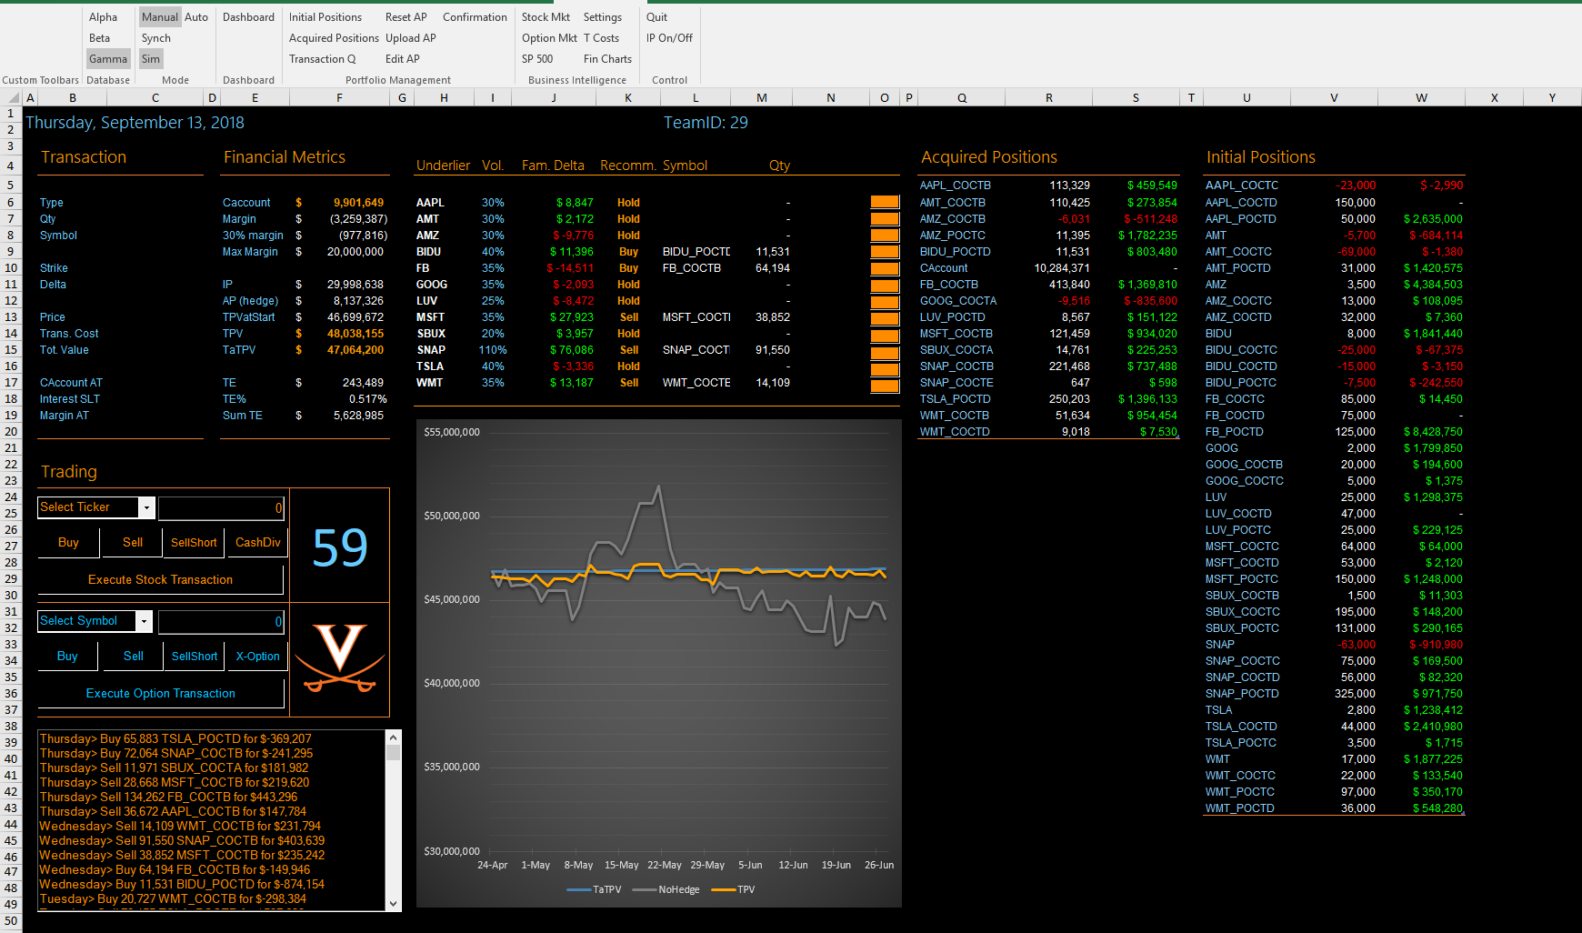

Slide 30
