Slide 1
Intro to the HT:
Stock and Options
Stefano Grazioli

Slide 2
Easy meter
We begin the Financial Engineering component of the course
We are regrading H11
H12 due Monday after Spring break
H13 due Tuesday after S.b.

Slide 3
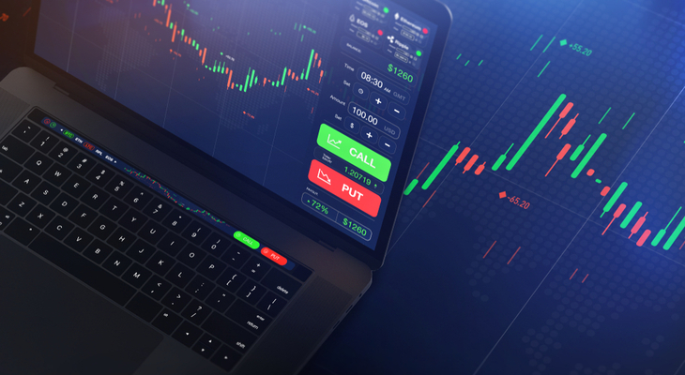
Learning objective
Define Stocks and Options
Understand how they work

Slide 4
Name, major…
Course objectives are clear?
Things you like about the class
Things that can be improved
Ask me one question about the Tournament

Slide 5
Homework
The first ‘Spartan Trader’

Slide 6
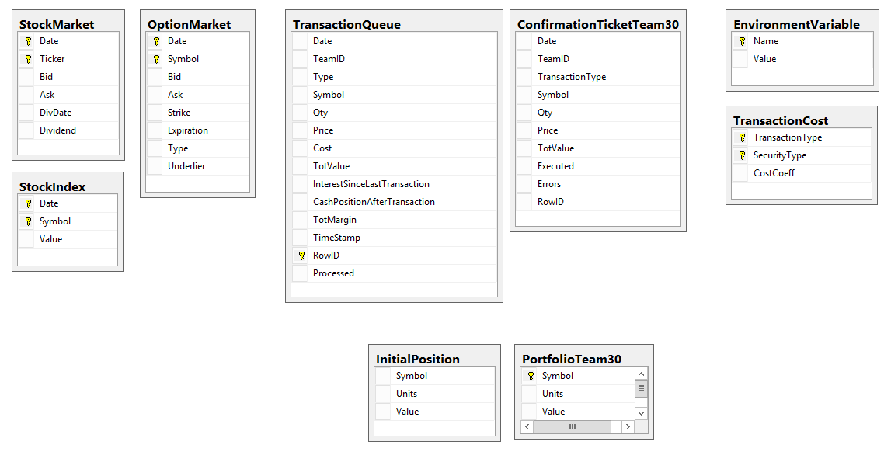
HT Datamodel
H13
Also called ‘Acquired Positions’

Slide 7
How do I check my work?
Oh no! It looks like table XYZ has no data! Is that right?
Easy to check. Use ADS or VS and look directly at table XYZ in the database. Some tables are empty.

Slide 8

Your portfolio
Cash (capital account)
IP and AP
  Shares
  Options on those shares
Long/short

Slide 9
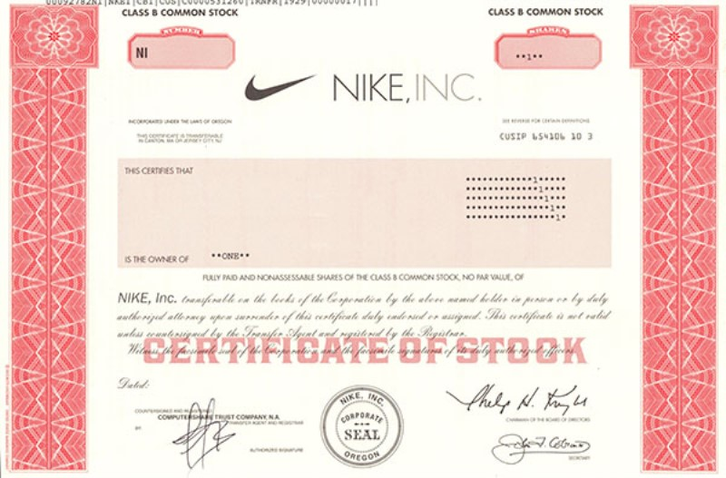
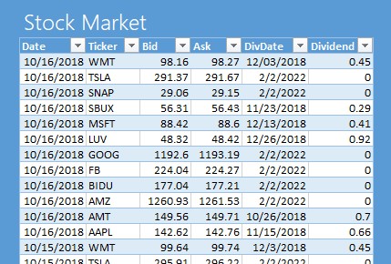
Stocks/Shares
A share of a corporation is a security that represents fractional ownership of the corporation.
Owners of shares - “Shareholders/Stockholders” - may receive dividends, proceeds from liquidation of assets, and may vote on important decisions affecting the corporation.
Shares are bought and sold on stock exchanges by market makers (also known as specialists). Bid / Ask
Notes:
M maker (e.g. NASDAQ) = firm that buys and sells on its own account. MMs compete among themselves. Electronic market.
Specialist (e.g. NYSE) = monopolist who runs an auction posting bids and asks from the market participants

Slide 10
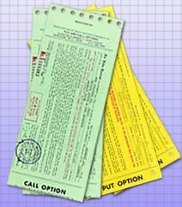
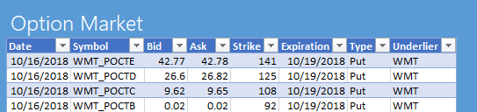
Options are derivatives
An option is a contract giving the buyer the right, but not the obligation, to either buy or sell an underlying asset (e.g., a stock) at a specific price on or before a specified date.
Once created, it may be sold and bought on the market. We do not write options. We buy/sell/sell short them.
Notes:
R. McDonald Fundamentals of Derivatives Markets – chpt 4
Why use derivatives: 1) to hedge; 2) speculate; 3) avoid trans. Costs 4) to arbitrage regulations

Slide 11
Nomenclature
underlier
Put Option
can sell 1 TESLA stock
@ $760.00
on 20 May 2024
Bid: $ 25.00
Ask: $ 25.50
TESLA Stock
Bid: $ 760.00
Ask: $ 760.50
Dividend: $ 0
strike price
expiration:
European vs. American

Slide 12
Example Scenario
You just inherited 1,000,000 Apple shares.
@ $180 -> $180,000,000.
You are pretty happy.
But you are also worried. What if the price drops to $160?
You need some kind of insurance against that.
Somebody is willing to commit to buying your Apple shares at $180
(if you want), two years from now.
But she wants $1 per share. Now.
You decide that it is a good deal. So, you buy 1,000,000 contracts that give you the right to sell your shares at $180 two years from now.
You have bought 1,000,000 put options.

Slide 13
Put Options
A put option gives to its holder the right to sell the underlying security at a given price on (or before) a given date.
Think “insurance”

Slide 15
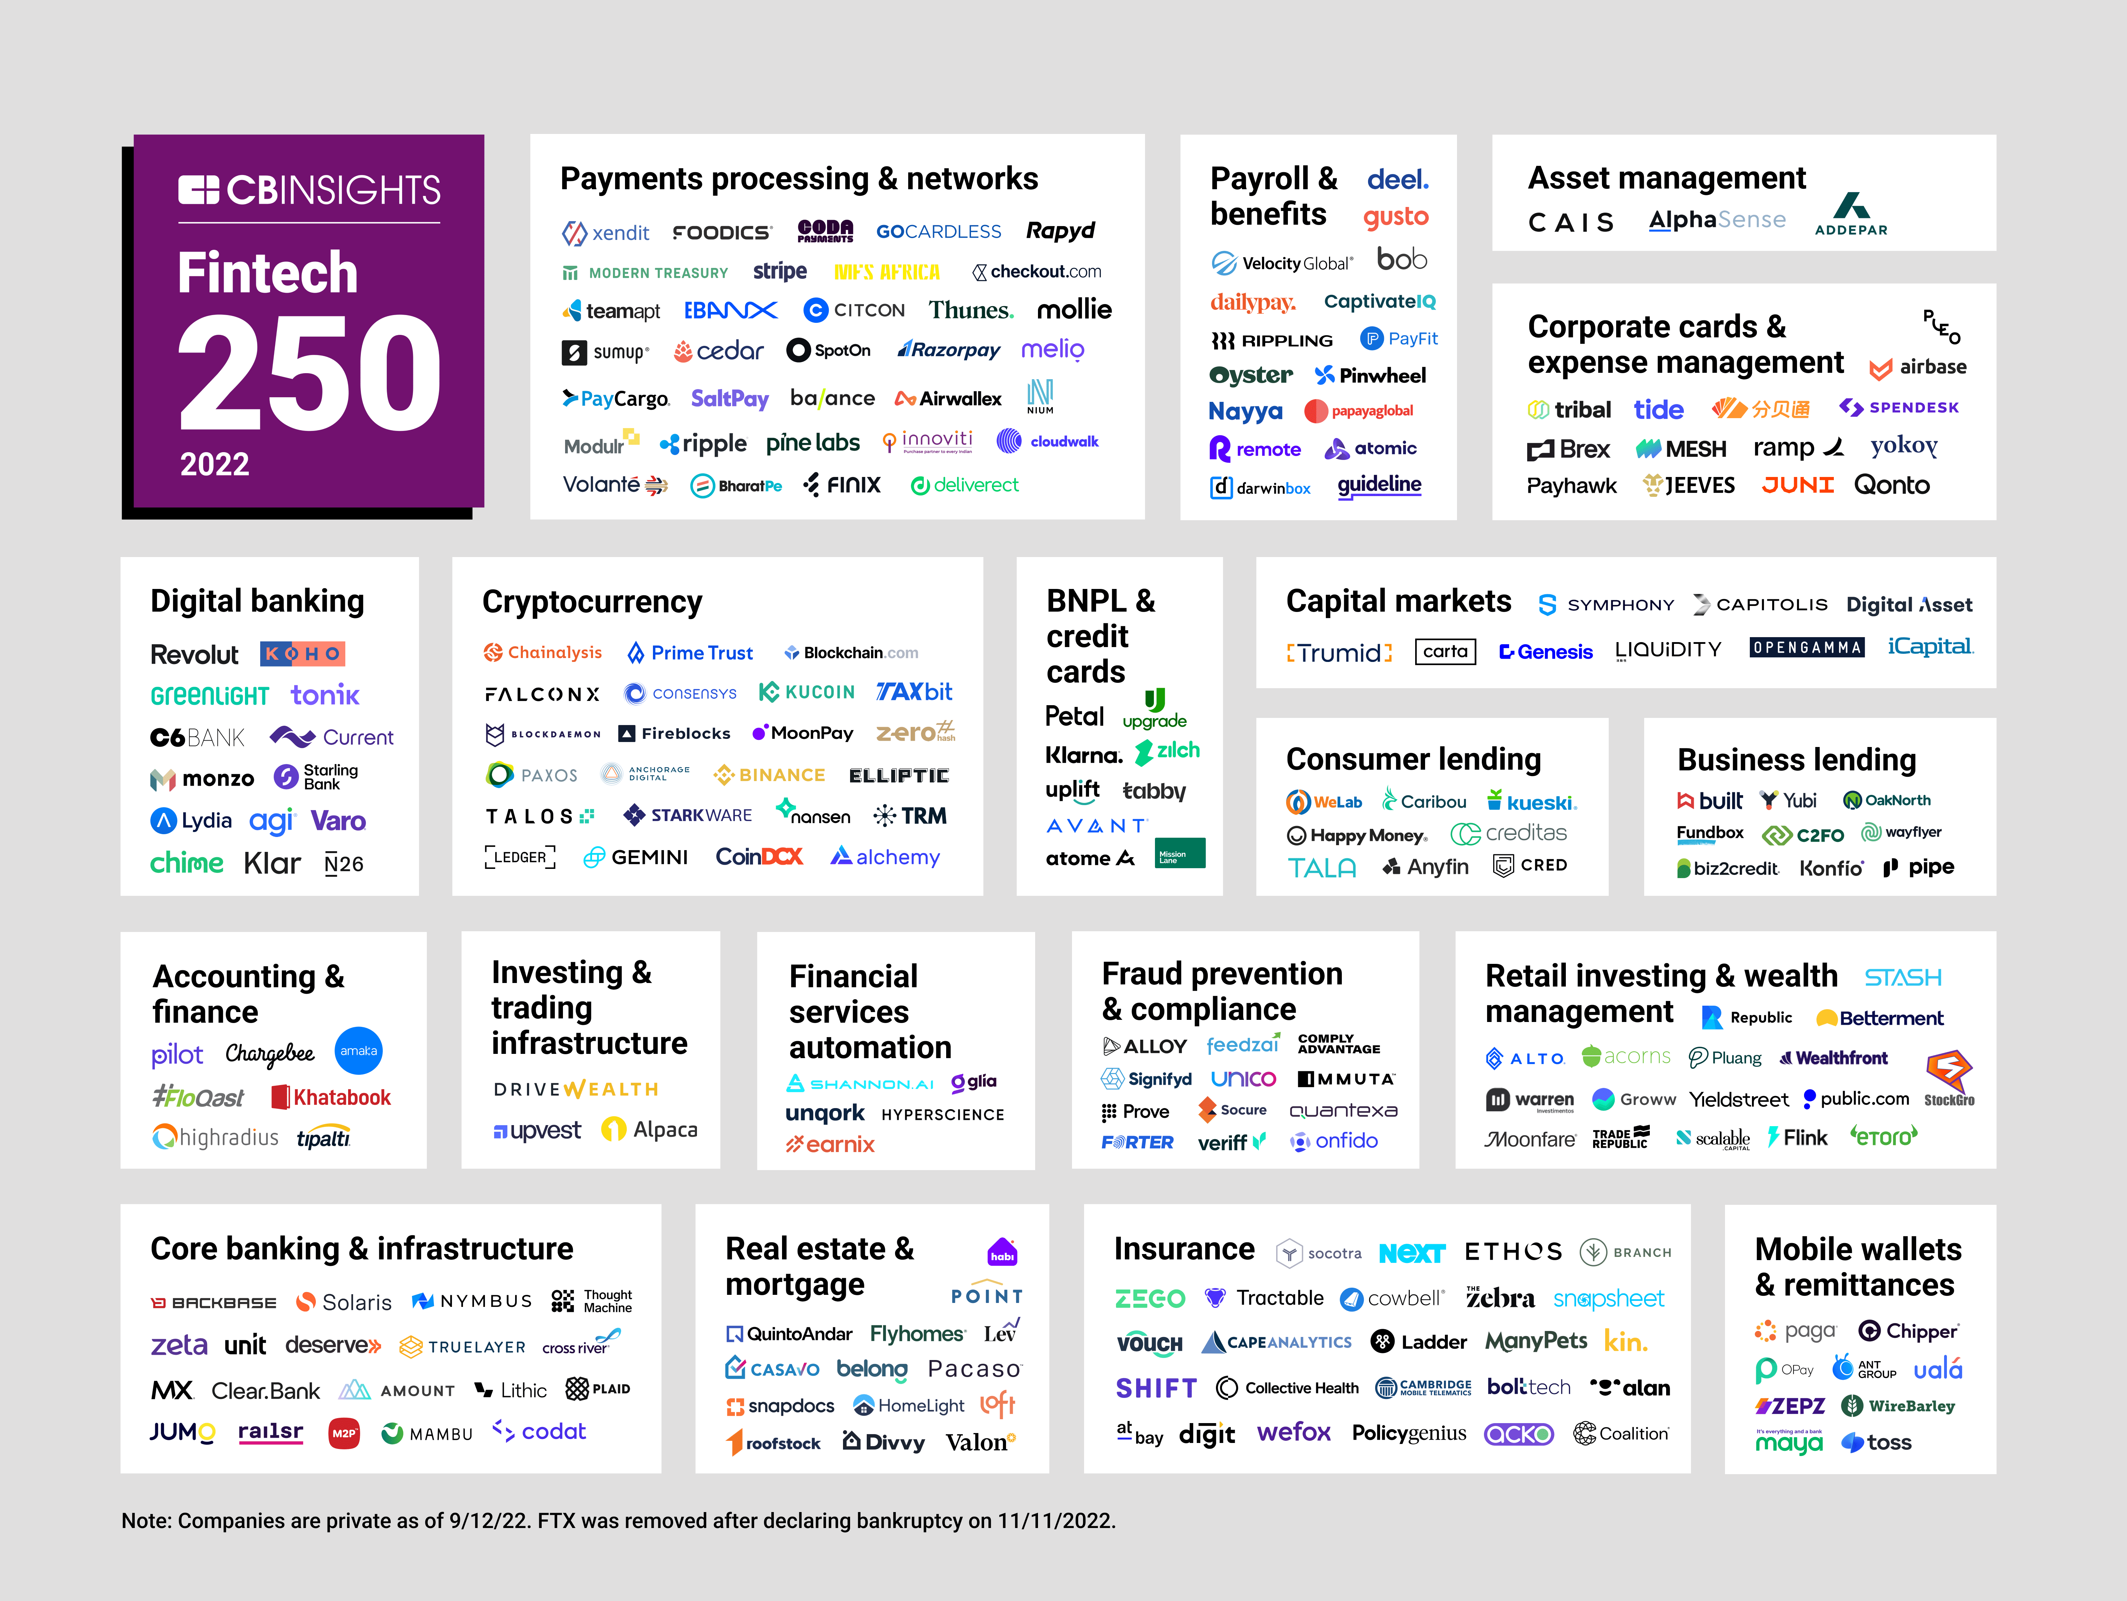
Pick one of these for the WINIT
https://thefinancialtechnologyreport.com/the-top-100-financial-technology-companies-of-2023/

Slide 16
Another Scenario
You are an executive at Netflix.
You make $1,000,000 a year.
You are pretty happy.
The Board wants to make sure that you will do your best to keep the price of the Netflix stock up.
Rather than giving you a well-deserved raise, they offer to you a deal. They promise that in three years they will give you the chance to buy 100,000 shares at $600 each.
Right now the share is valued at $600.
If the company does well, the share price could go as up as $700.
So you think: “In three years I could just get my 100,000 @ $600 and then immediately sell them back to the market for $700....”
You conclude that an extra $10,000,000 in your pocket is a good thing.
You have been given 100,000 call options.

Slide 17
Call Options
A call option gives to its holder the right to buy the underlying security at a given price on or by a given date
Think “deposit to buy at a fixed price"

Slide 18
Nomenclature
underlier
Call Option
can buy 1 TESLA stock
@ $750.00
on 20 May 2023
Bid: $ 20.00
Ask: $ 20.50
TESLA Stock
Bid: $ 760.00
Ask: $ 760.50
Dividend: $ 0
strike price
expiration:
European vs. American

Slide 19
American vs. European Options
In the HT we use European only. Why?
  Models and theory built on European options
  American always at least as expensive
  Not optimal to exercise early an American on a non-dividend paying stock (if assumptions hold)
  Always possible to trade a European option before expiration.
Source: R. McDonald – Fundamentals of derivative markets

