Slide 1
Trading
Stefano Grazioli

Slide 2
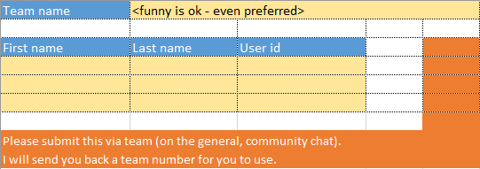
Easy meter
Companies
Teams
I will post a team formation form in MS Teams. Fill it and return it in the general chat. No teamId = no team.
How to submit as a team is described in the ‘grading policies’
No more ‘best’ solutions.

Slide 3
Today’s objectives
Understand and use software classes
Manual stock trading

Slide 4
Name, major…
Things you like about the class
Things that can be improved
Attitude towards the Tournament

Slide 5
Learning Retention Check
Orange words

Slide 6
Homework
Knowledge check and H16 Demo

Slide 7
Classes in Object-Oriented Programming
In object-oriented programming (OOP), a class is a blueprint or a template for creating specific instances of the class.
A class = properties (variables) + methods (subs and functions)
An object = a specific instance of a class
Class “button”
ShowStockBtn
QuitBtn
…

Slide 8
Building our own class: ‘Transaction’
A transaction is an operation that the trader asks the exchange to do.
Example: “Buy Stock”, “Sell Option”
Class “Transaction”
CurrentTransaction
LastValidTransaction
….

Slide 10
