Slide 1
How to do well in the Tournament
Performance improvement

Slide 2
Tournament is in seven days!
Software clinic is open – sign up sheets outside my door – TONS of office hours
HT runs available – check Teams
No class next Thursday (HT day)
No food/alcohol in the labs

Slide 3
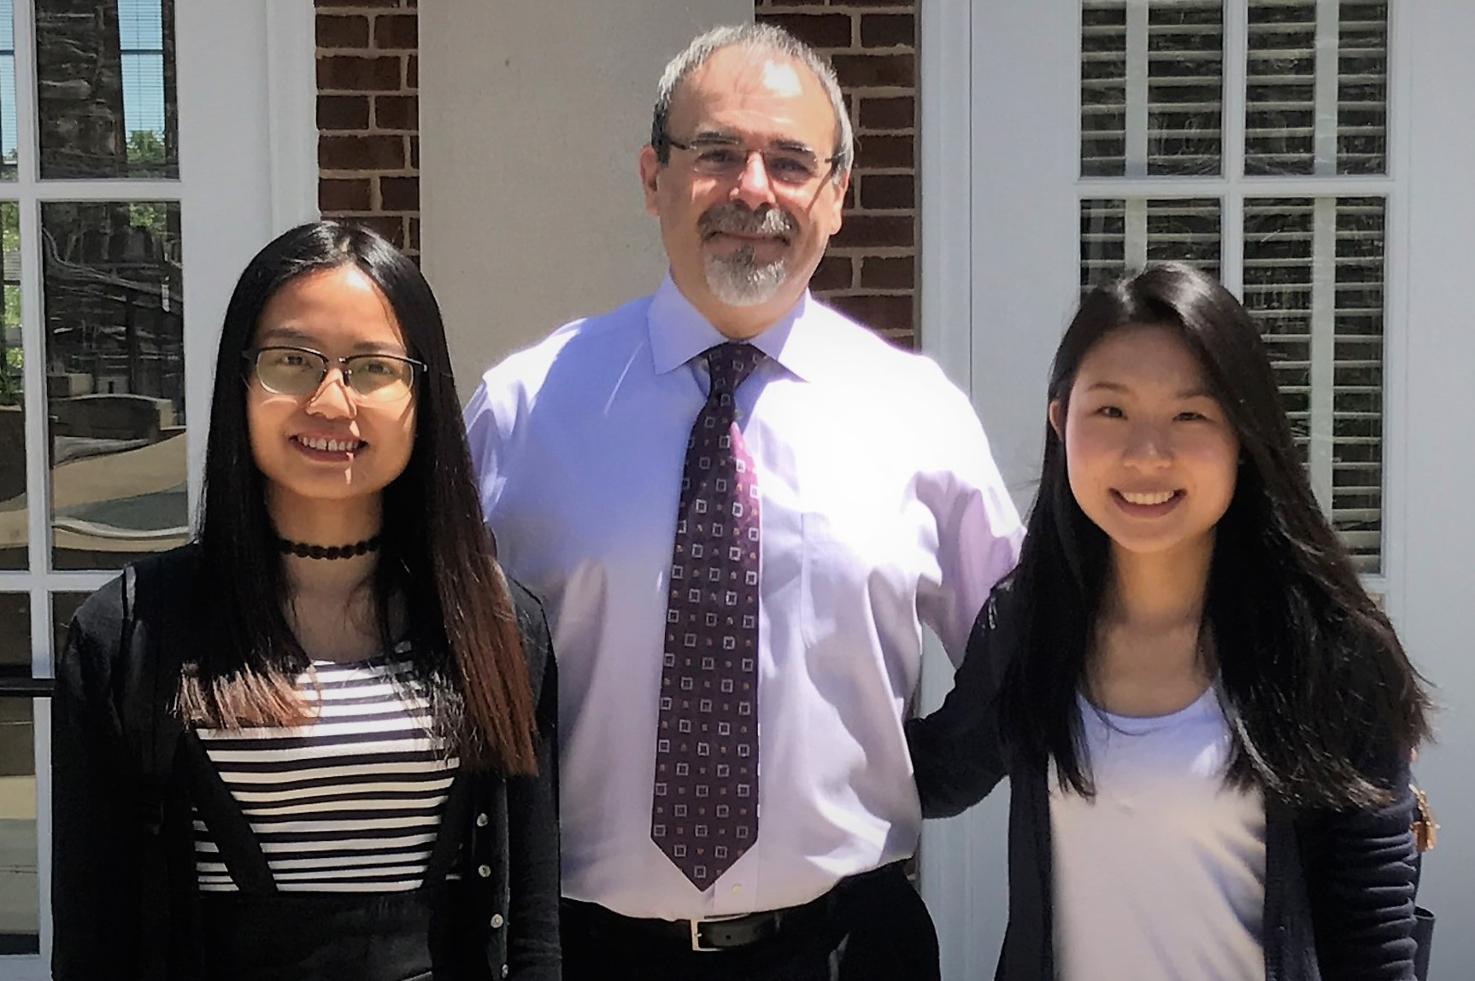
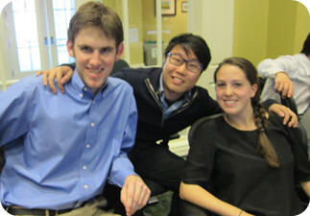
Most of the teams will tweak H24, some will do some optional mini projects, a few will try the dark horses.
OVERALL HT WINNERS 2017
OVERALL HT WINNERS 2013

Slide 4
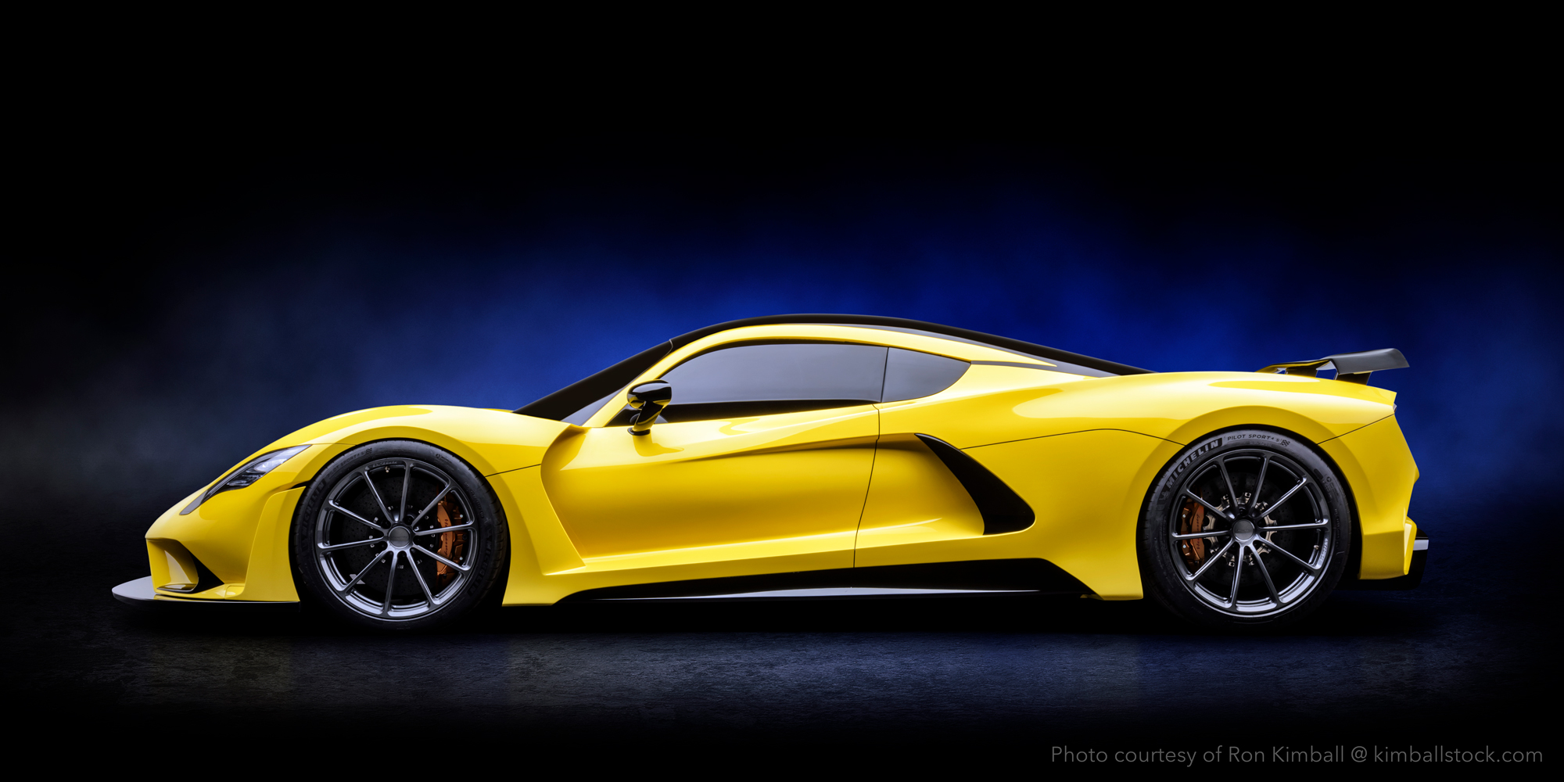
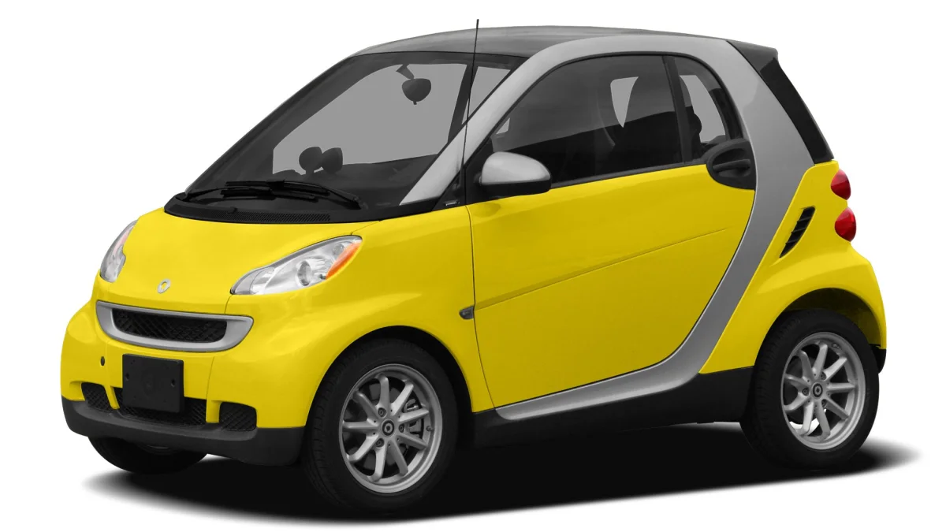
Optional performance improvements
at the top speed "the tires will only last for about fifteen minutes, but it's okay because the fuel runs out in twelve minutes.“*
Notes:
Hennessey venom F5 – fastest street car – 301 mph
$1.6mil
* About a Bugatti Veyron

Slide 5
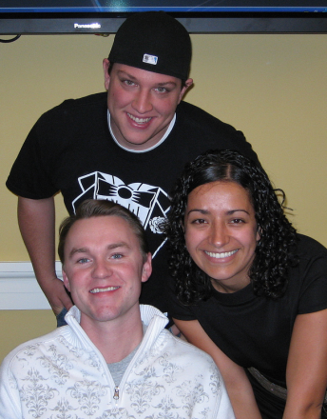
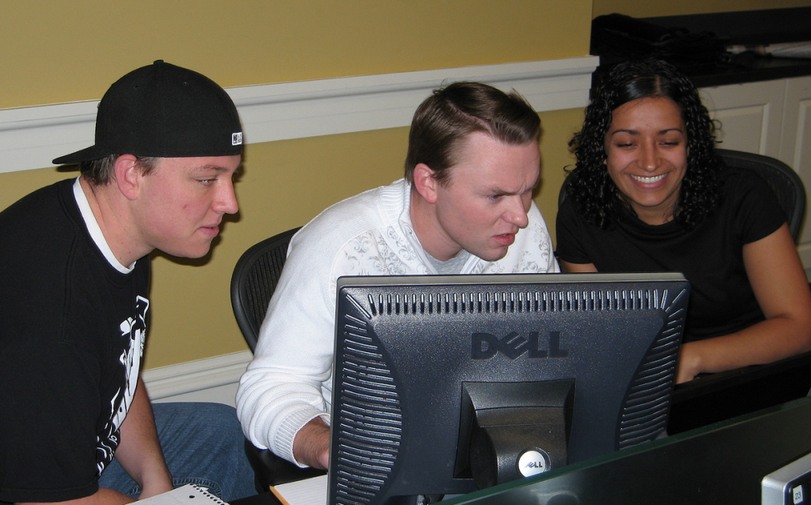
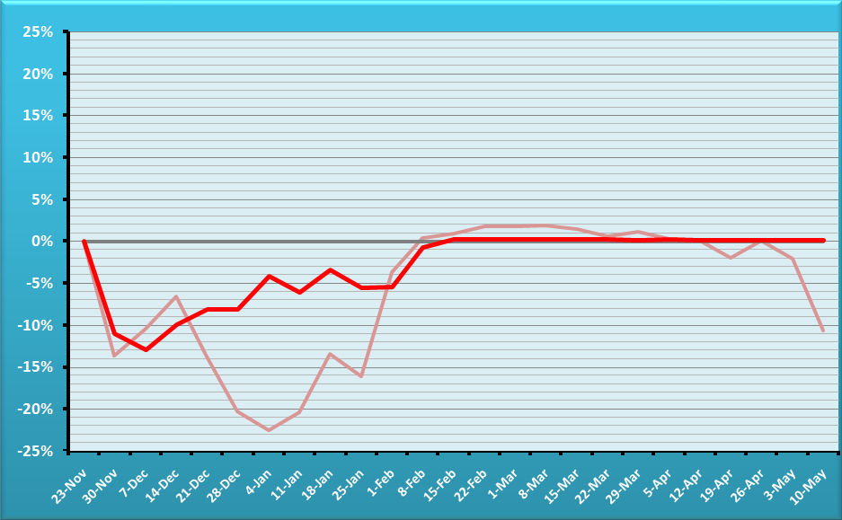
Fall 08 – The Fighters
BUG-FREE
Team
?
AUDITED PERCENT TRACKING ERROR.
Team is in red, reference portfolio semitransparent
OVERALL HT WINNER

Slide 6
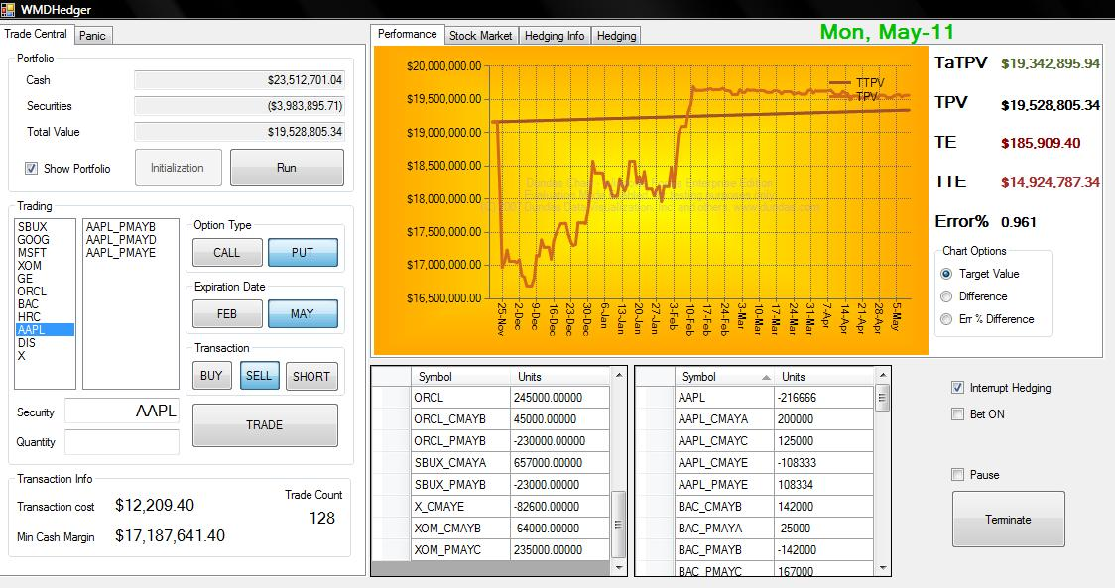

Slide 7
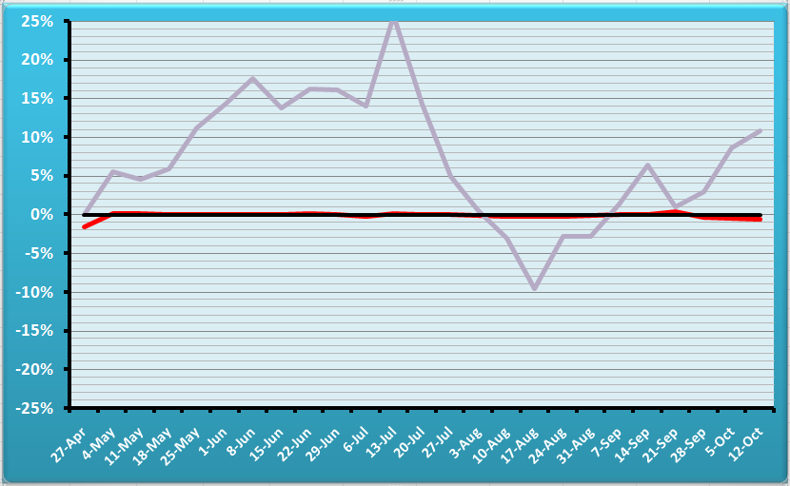
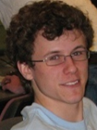
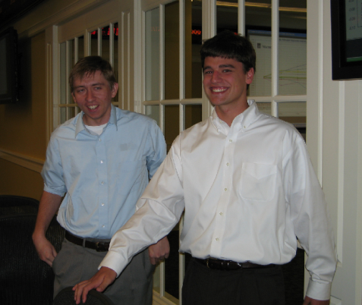
T3 – Gaming The System
PTL (Pardon The Loss)
Mark Paddrik,
Scott Tucker (Ghost) & Michael Ledwith
BUG-FREE
Team
AUDITED PERCENT TRACKING ERROR.
Team is in red, reference portfolio in gray
OVERALL
TOURNAMENT WINNERS

Slide 8
From the rulebook
You cannot trade twice the same ticker or symbol in the same day - i.e., no “money burning.” Both trades will be rejected.

Slide 9
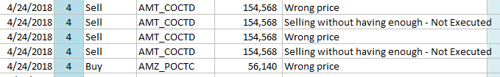
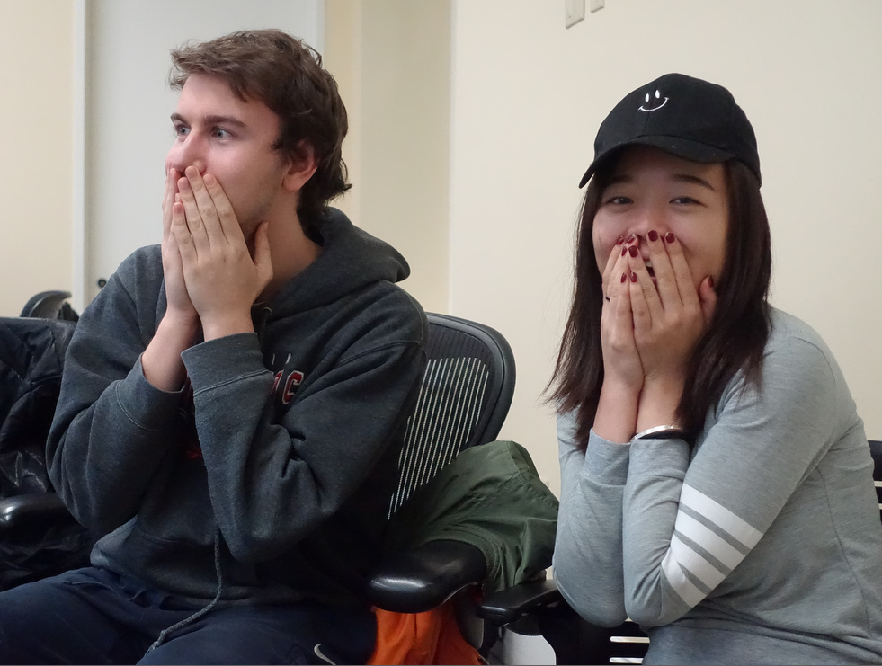
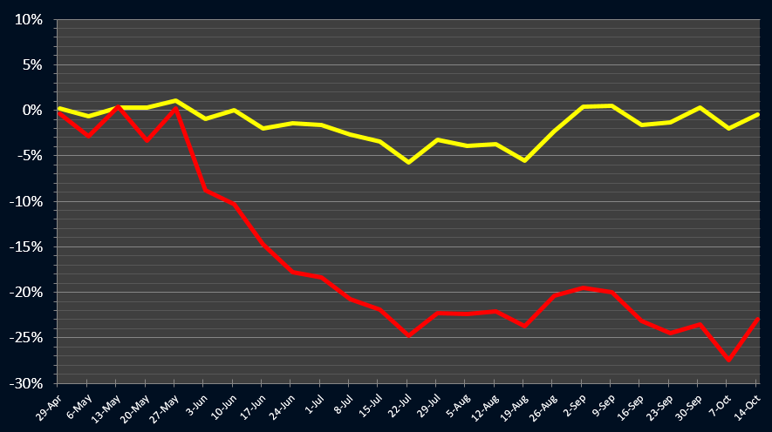

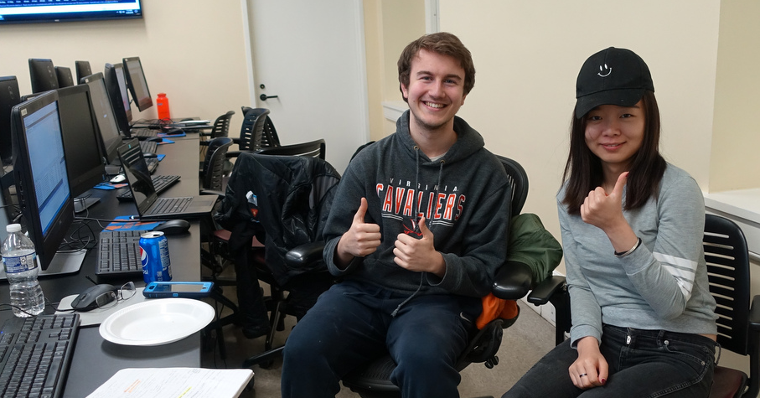
T4 spr18 – “Undecided”
The big scare
UNDERGRADUATE
RUNNER UP

Slide 10
From the rulebook
You may not sell short if you have a long position on the same security.
Example: you can not sellShort 250 GOOG if you hold a long position of 100 GOOG. First you sell the long position, then you go short. You must do so in two separate days.

Slide 11
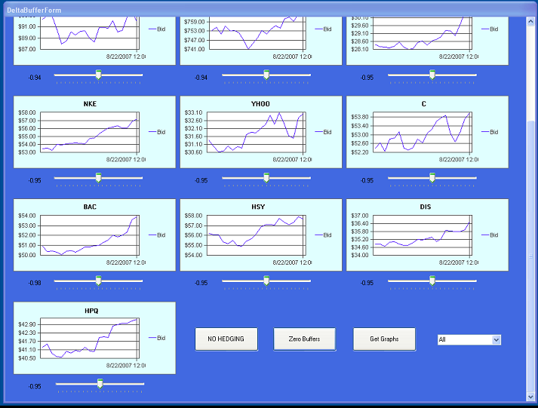
T 14/07
Idea: multiple delta targets

Slide 12
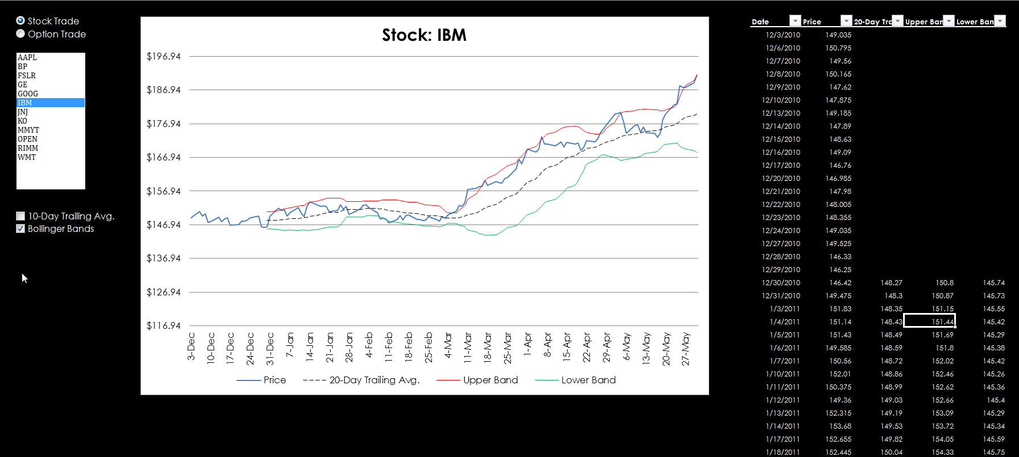

Slide 13
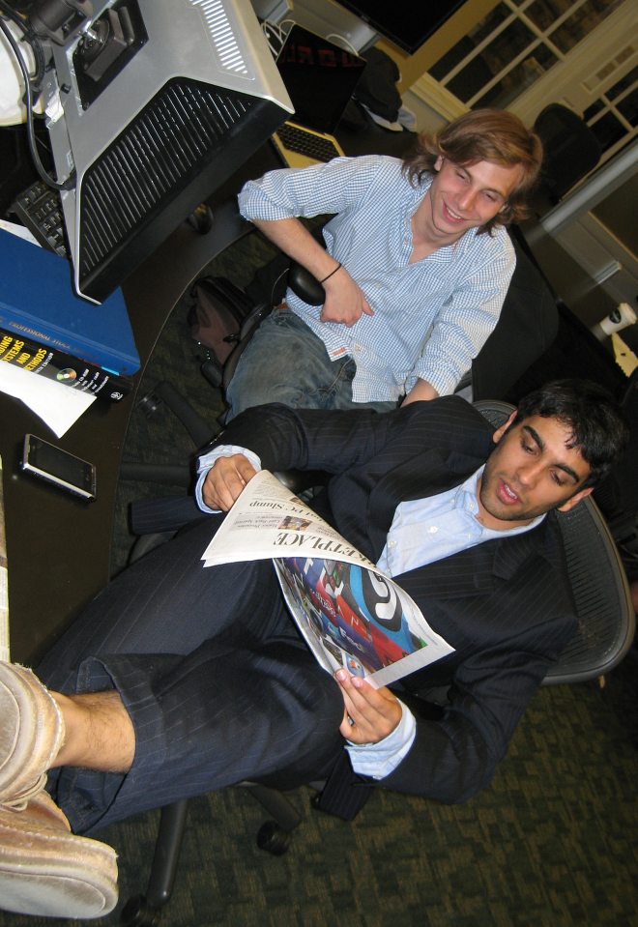
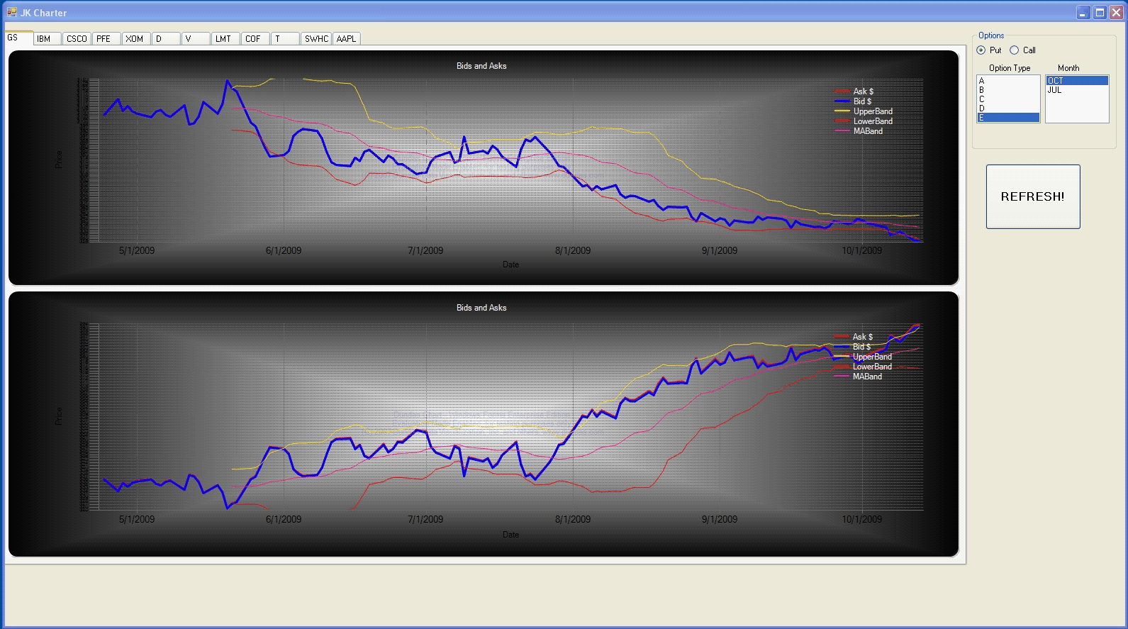
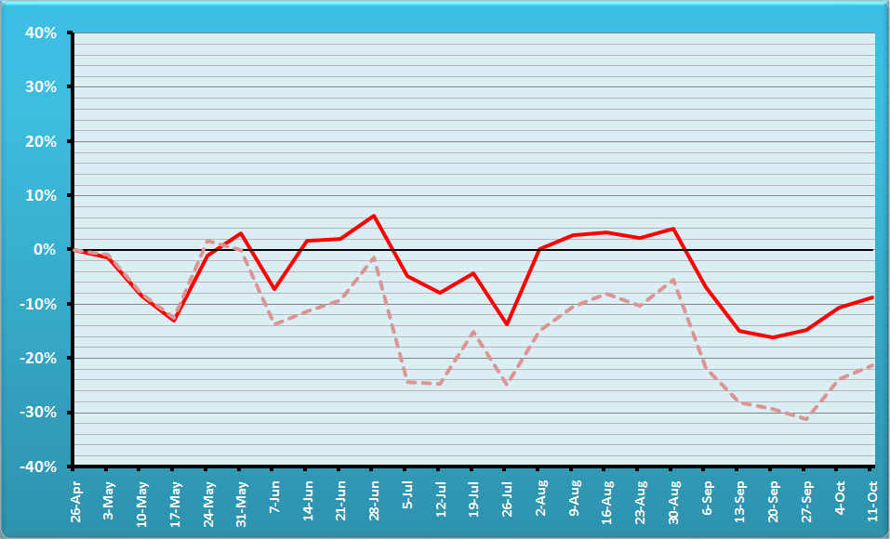
Team 5 – The “Moneymaker”
Jerome Kerviel
Fund Management
AUDITED PERCENT TRACKING ERROR.
Team is in red, reference portfolio semitransparent
Idea: explore new strategies
Notes:
Jérôme Kerviel is a French trader who was convicted in the 2008 Société Générale trading loss for breach of trust, forgery and unauthorized use of the bank's computers, resulting in losses valued at €4.9 billion. (wiki)

Slide 14
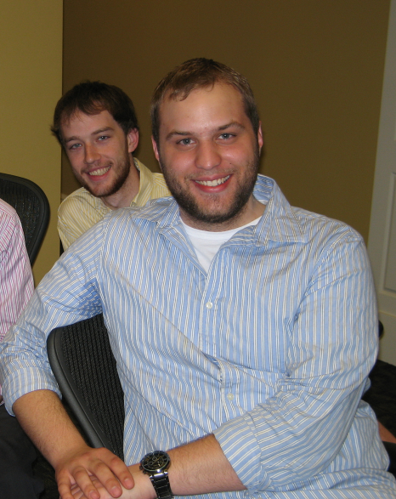
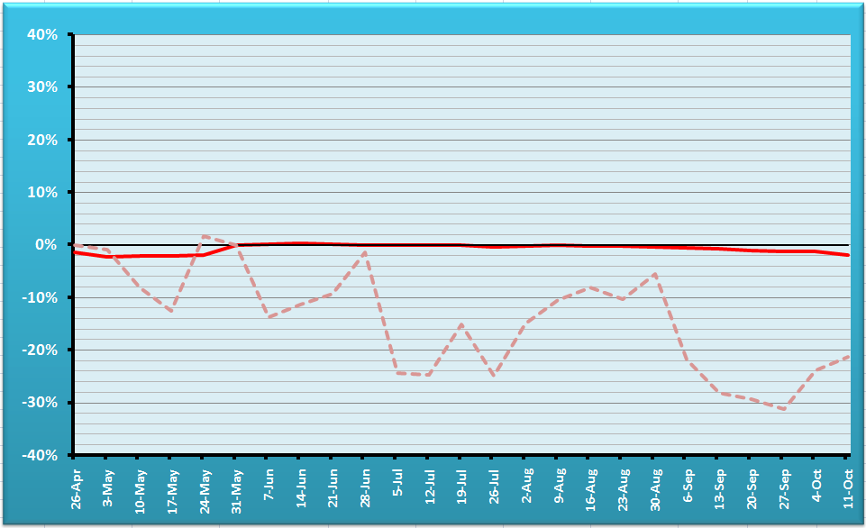
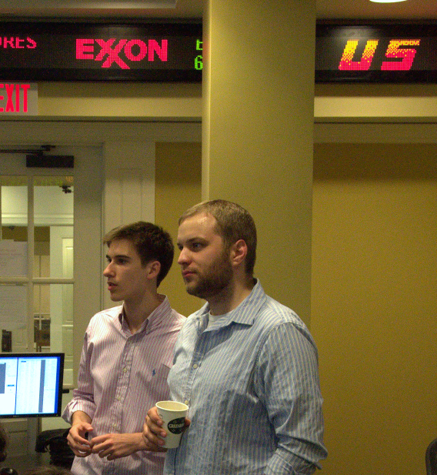
T8 - Delta & Gamma
OVERALL HT WINNERS
Bug-free
Team
AUDITED PERCENT TRACKING ERROR.
Team is in red, reference portfolio semitransparent

Slide 16
Main parameters to tweak
Frequency of hedging (HedgingToday)
Family Delta threshold (NeedToHedge)
Alternative actions scoring (CalcCandidateRecScores)
A-E options preferences (scoring rules)
Delta threshold (CalcQtyNeededToHedge)
Family delta target (CalcQtyNeededToHedge)
Available cash cushion (AvailableCashIsLow)
Max buy cushion (MaxPurchasePossible)
Max margin cushion (TooCloseToMaxMargins)
Max short cushion (MaxShortWithinConstraints)

Slide 17


Optional mini-projects
Automatic dividend cashing
Differential thresholds for hedging
Differential family delta targets
Intentional crashes
Edit portfolio on the fly
Bang for the buck
Auto/synch training
July options
Delta for dividend-paying securities
“Extra profits" button
Error viewer
Dark horses
- Gamma hedger

Slide 18

Three Dark Horses
Simultaneous Delta Gamma
Conditional Gamma
Synthetics

Slide 19
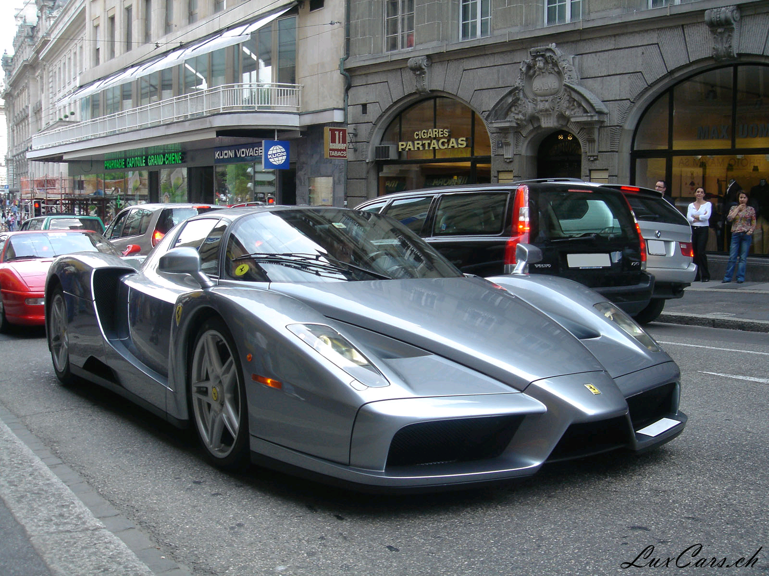
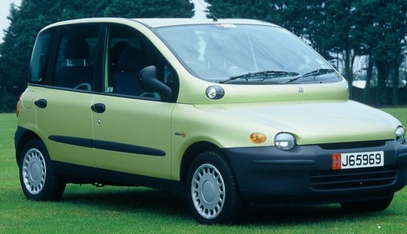
Family Gamma
Family Delta (Δ) measures the change in portfolio value
as the underlier’s price S changes (~speed).
Family Gamma (Γ) measures the rate of change in portfolio value as S changes (~acceleration).

Slide 20
Meaning of Gamma
If Gamma is small (abs.), small changes in S will not affect much Delta (and your portfolio value) ,
so
there is less need to take immediate rebalancing action.
If Gamma is large, small changes in S will affect Delta (and your portfolio value) significantly,
so
there is a stronger need to take immediate rebalancing action.

Slide 21
How to Calculate Gamma
Gamma = N’(d1)
Sσ√ t
N’(d1) = e ^{–(d1)2/2}
√ (2 π)
d1 as in Black Scholes
Gamma
Strike
Stock price S
Notes:
N’ is the prob density function for a standard normal distribution.

Slide 22
Gamma of a Portfolio of Related Securities
Γ_{family} = Σ qty_{i} * γ_{i}

Slide 23
Gamma of a portfolio
During small periods of time t₂-t₁
Δ _{portfolio} = ½ ∗ Γ_{portfolio} ∗ (S₂-S₁)²
Example:
If you do not rebalance, and the underlier price (e.g., GE) drops from $52 to $50, the change of value in a Delta-Neutral Portfolio is approximately
= ½ ∗ Γ ∗ (S₂-S₁)²
= 0.5 * (-10,000) * (52-50)²
= -$20,000
~

Slide 24
Gamma-Neutral Portfolio
More stable than a delta neutral-only.
Cannot use the stock to reach Gamma neutrality because the stock has Gamma = 0
1) Γ_{portfolio} <> 0
2) Γ_{portfolio} + Γ_{x} qty_{x} = 0
3) qty_{x} = -Γ_{portfolio} / Γ_{x}
Warning: Acquiring qty_{x} will disturb Delta neutrality. You will need to rebalance.

Slide 25

Delta Gamma Delta
It’s a financial strategy, not a sorority.
Find out what you need to achieve Delta neutrality.
Find out what you need to achieve Gamma neutrality.
Find out what you need to re-achieve Delta neutrality. Stock is ideal because it will not affect Gamma.

Slide 26
Simultaneous Delta Gamma
Δ_{portfolio} + δ_{x1} qty_{x1} + δ_{x2} qty_{x2} = 0
Γ_{portfolio} + γ_{x1} qty_{x1} + γ_{x2} qty_{x2} = 0
All known except qty x1 and qty x2
{

Slide 27
Conditional Delta Gamma
If below target -> delta only
else
Delta + Gamma

Slide 28
Offset the Position with a
Synthetic Security
Profit & Loss
Perfect hedge, but costly.
Synthetic Short position
Long position
to hedge
Stock price
Total Payoff

Slide 29
Put-Call Parity
For European Ps and Cs that have the same strike K, and expire by the same time t:
P + S = C + K e^{-rt}
We can solve for S, P, or C, effectively synthesizing a security with a combination of the other two and some interest-earning cash.
Example: S = C + Ke^{-rt} – P and
- S = - C - Ke^{-rt} + P

Slide 30
Theta, Vega, and Rho
Conceptually similar to Delta
Theta = change in portfolio value when time changes
Vega = change in portfolio value when the volatility changes
Rho = change in portfolio value when the rate of interest changes

Slide 32
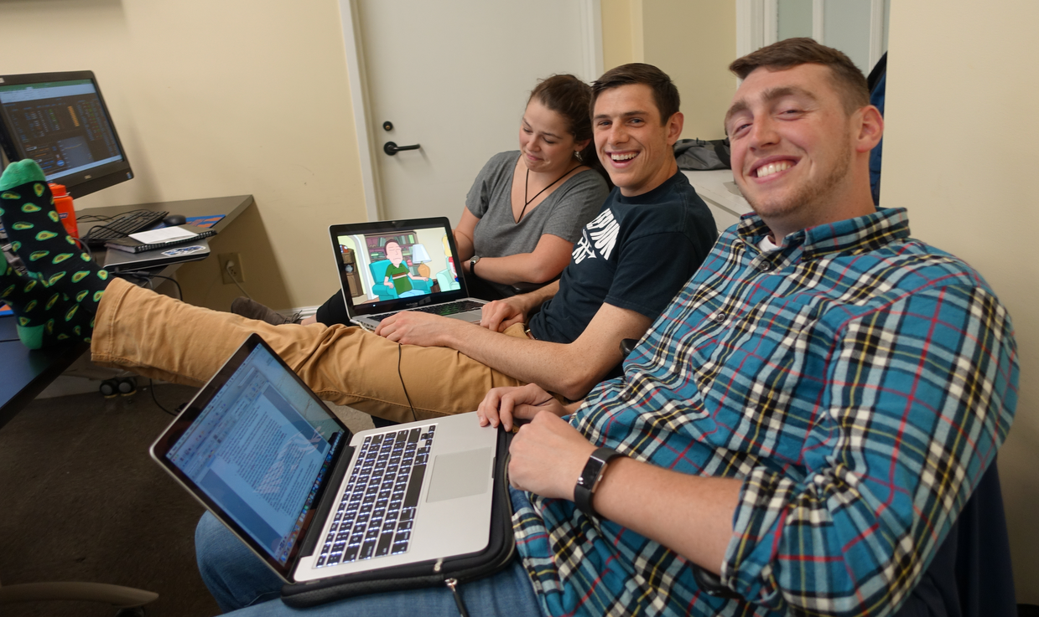
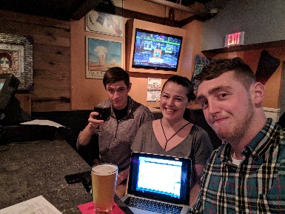
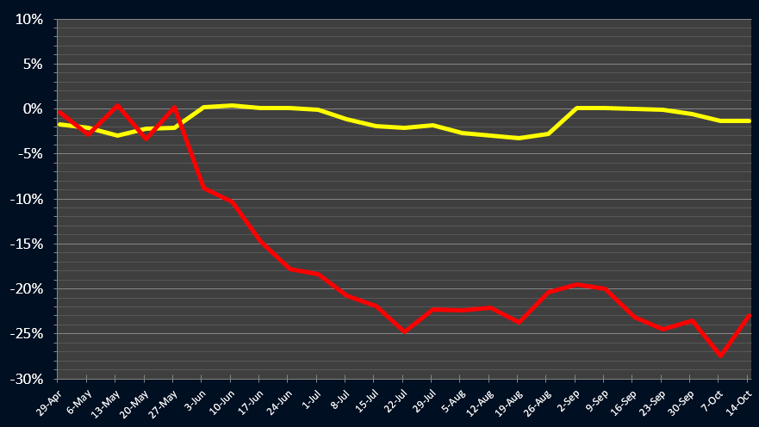

T6 spr18 – Dr. Scholes – Long live the spirit of the Tournament!
Where are the Dr. Scholes?
UNDERGRADUATEWINNER

