Slide 1
Privacy & Ethics
COMM 3220 - Database Management Systems and Business Intelligence
Jamie Specter Dattilo
https://www.linkedin.com/in/jamiespecter/

Slide 2
Purpose: Introduce Privacy and Ethics

Slide 3
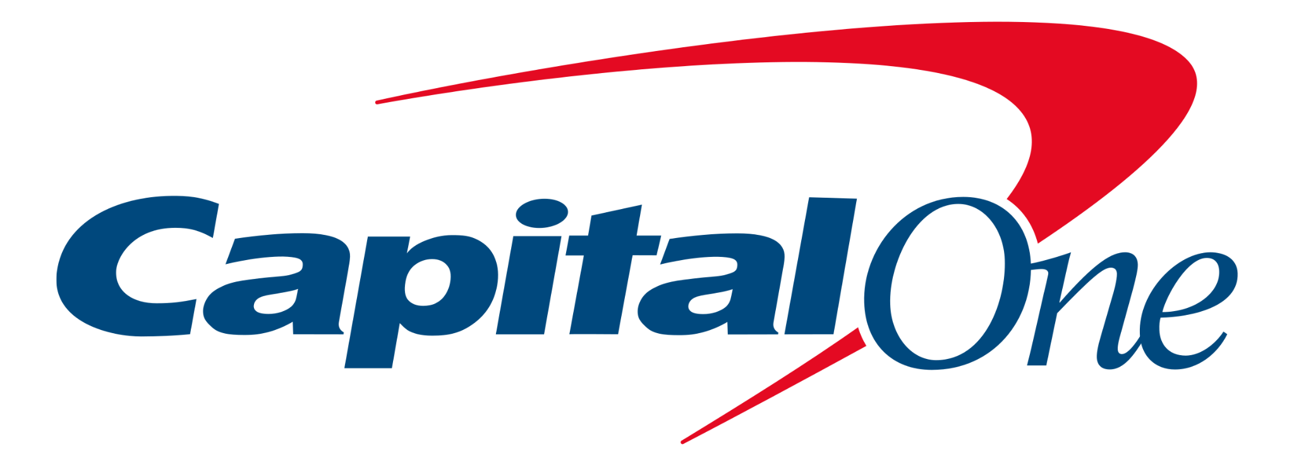
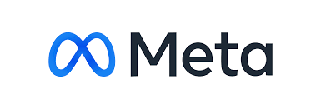
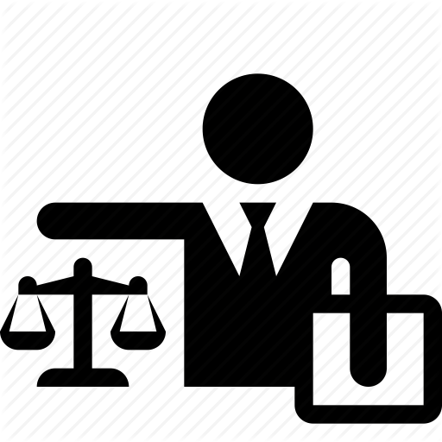
A Career in Data, Technology, and Privacy
Legal, IP and Commercial Litigation
Intellectual Property Litigation - Patent and Trademark
Complex Commercial Litigation
Legal, Law & Technology
Technology Business Counsel
Open Source Counsel
M&A Due Diligence & Integration
Information Governance and Retention
Data Transformation
Privacy & Data Policy
Data Protection and Data Sharing
2009
2015
2019
2012
2016
2021
Legal, Regulatory Advisory
Chief of Staff to Lead Executive of Legal Loss Mitigation team
Counsel for Bank and Home Loans
Third Party Assessment Team Counsel
Attorney, Law Firm
Defense counsel for complex construction and commercial litigation
Enterprise Digital, Data Ethics & Privacy
Create and execute privacy strategy through Program Operations and Governance, including policy generation
Data Management and Retention
Lead for Change Management (communications and training) and Stakeholder Engagement
Lead for Third Party Data Sharing
M.S., Management of IT
One-year Master’s program that provides a comprehensive understanding of technology and business skills needed to lead within a complex, IT-enabled business environment.

Slide 4
Cybersecurity and Privacy
Cybersecurity: art of protecting networks, devices, and data from unauthorized access, corruption, or theft throughout its entire lifecycle; the practice of ensuring confidentiality, integrity, and availability of data/information
Privacy: The right of individuals to control or influence:
what data or information related to them may be collected and stored and
by whom and to whom that information may be disclosed
Personal Information: Information that identifies, relates to, describes, is reasonably capable of being associated with, or could reasonably be linked directly or indirectly with a particular consumer.
(Source: Shipman and Watkins, An introduction to privacy information management)

Slide 5
How do you define Data Privacy?
1 Data privacy is how a person with a large amount of data decides to either hold or release that data.
2 Data privacy is the amount of protection regarding who can access, manipulate, and extract data from a source.
3 I think of data privacy as relating to the collection and the distribution of consumer/individual data by companies. Usually relating to personal companies.
4 Data privacy means confining the access of data to only those with the authority/need to access it. Generally, this is keeping personal information personal and not sharing it across many channels.
5 How data is protected from improper use, and the access limitations that exist.
6 Keeping data safe and secure, and away from people with ill intent
7 I think of data privacy is how protected and confidential if my personal information and data as well the data of others. Who as access to this data? What can be done with this data?
8 Data privacy is the user's ability to determine how their data is collected, used, or shared. Users should have control over how their data is used and removed. Additionally, privacy incorporates security aspects established by companies using our data such as protection from unauthorized access, data modification, and data authentication. This means it is confidential, secure, and able to be removed.
9 The knowledge that your data is not being used for things other than what you've directly consented to. Also, the knowledge that the data storing entity has the technological capacity to actually protect your data.
10 Data protection that ensures that sensitive data or confidential data is correctly protected
11 proper handling of sensitive data
12 data protection, the proper handling of sensitive data
13 The right for your data to not be known by others.
14 Data privacy is how much information is shared with the public (i.e., on the web).
15 information about how (and what) data is stored and shared
16 Data privacy is being able to choose what information gets shared and not. Additionally, its being able to completely delete data from apps such as Facebook.
17 Data should only be collected with the permission of the data provider and only certain people should be able to access that data once collected. It should not be easily shared with others.

Slide 6
A Brief Privacy History Lesson
1890: Two U.S. lawyers, Warren and Brandeis wrote “The Right to Privacy,” and article that argues the “right to be left alone,” using the phrase as a definition of privacy.
Traditionally, two schools of thought about privacy
Fair Information Practice Principles

Slide 7
Most data protection laws are built on a set of key principles, which establish the foundation for everything related to data privacy and the protection of personal data.
Here are seven data privacy principles that form the fundamental conditions that organizations must follow when processing personal data. Processing personal data in line with these key principles is essential for good data protection.
Source: PWC Data Privacy Handbook

Slide 8
Right to be informed
Right to access
​​One of the aims of data privacy laws is to empower individuals and give them control over their personal data.
Therefore, most data privacy laws introduce what are usually referred to as ‘data subject rights’ concerning the protection of individuals’ personal data.
Right to rectify
Right to Erase
Right to transfer data
Right to restrict processing in defined circumstances

Slide 9
Survey Results
I am aware of how my data is used and collected. 72% disagreed and 11% strongly disagreed; 16% agreed
How much control do I have over:
Preventing companies from collecting information from me? (1 = I don’t have any control) Average = 3.3/10
How much control do I have over:
Preventing companies from sharing my personal info with third parties? (1 = I don’t have any control) Average = 2.5/10
How much control do I have over:
Ensuring brands use my data for the purposes I initially agreed to? (1 = I don’t have any control) Average = 3.5/10
Notes:
According to the current model of notice-and-choice, it would be assumed that the very act of purchasing a social robot for home use provides our consent for unfettered data collection. Even if a consumer gives educated consent at the time of purchase based on knowledge of the robot’s functionality, how can the consumer remain educated about the robot’s functionality, as it is programmed to evolve and improve over time? In this framework the notice-and-choice model falls short in providing legal protection and relief.
Private citizens should be able to purchase and bring a machine connected to a social robot into their home, e.g. Alexa or other personal digital assistants, and enter into that relationship knowing that they are protected and would have legal relief when the implicit trust relationship is breached.

Slide 10
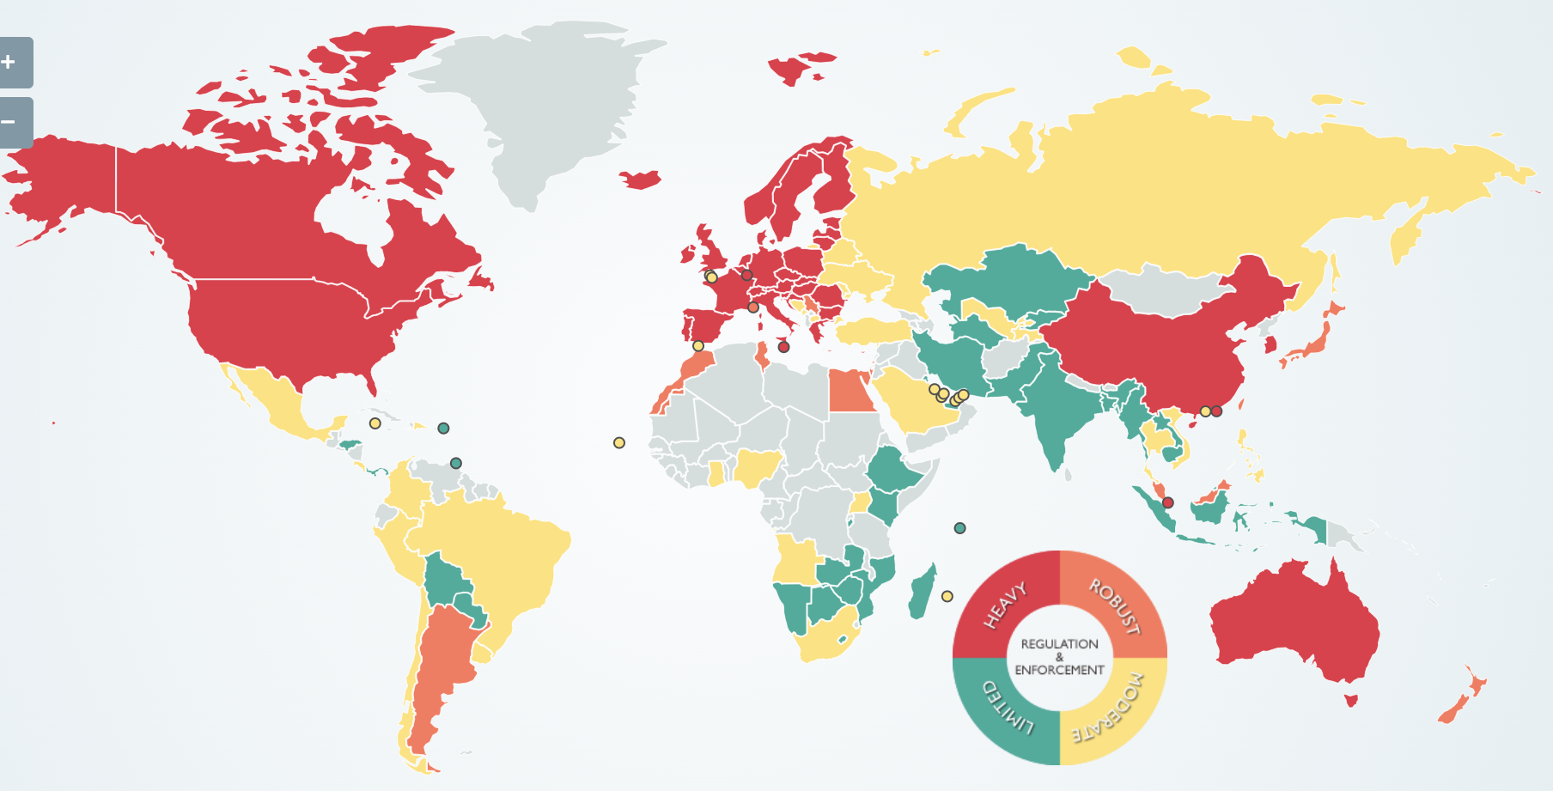
Privacy Legislation Around the World

Slide 11
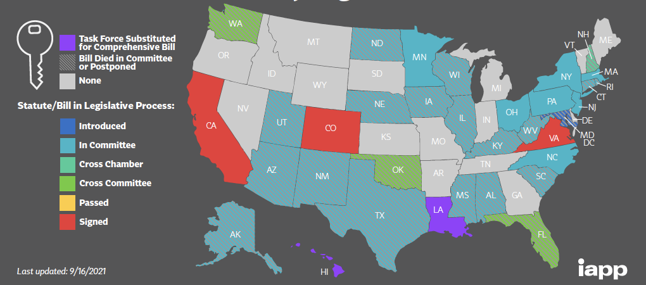
U.S. State Privacy Legislation

Slide 12
Impact on Business
The Challenge: Applying the world’s strictest data protection regulations puts unnecessary pressure on a business’s data supply; and ignoring the material distinctions between various regulations risks local noncompliance.
What’s at stake
Privacy, safety, and security of others
Significant monetary and operational penalties
Reputation of your company

Slide 13
Database Management Use Case
You are working in UVA’s accounting department and one of the databases you help manage includes information related to student aid awarded to individuals.
An econ professor wants to use the database for research she is conducting and has requested access to complete an empirical analysis of the data.
What are some next steps to consider?
Is privacy even an issue?
Is there sensitive data being collected?
Is this a permissible use based on what we told to the student?
Understand who to engage - What does the privacy program in my organization look like?
Keep in mind how contextual privacy is

Slide 14
Survey Results
Top 3:
35% = 7
23.5% = 3
18% = 8
Additional context provided:
Identity and payment info are what you want to protect
Level of concern comes from growing up in time where social media is a big part of life
Lack of trust
Benefits > Risks
Victims of data breaches
Mindful of what you share
Notes:
According to the current model of notice-and-choice, it would be assumed that the very act of purchasing a social robot for home use provides our consent for unfettered data collection. Even if a consumer gives educated consent at the time of purchase based on knowledge of the robot’s functionality, how can the consumer remain educated about the robot’s functionality, as it is programmed to evolve and improve over time? In this framework the notice-and-choice model falls short in providing legal protection and relief.
Private citizens should be able to purchase and bring a machine connected to a social robot into their home, e.g. Alexa or other personal digital assistants, and enter into that relationship knowing that they are protected and would have legal relief when the implicit trust relationship is breached.

Slide 15
Practical things to consider
Understanding the data with which you interact
Following internal processes
Complying with access controls
Only using internal tools for work purposes
Completing necessary training
Keeping in mind the key data privacy principles (e.g., data minimization)
Buy into a Privacy Culture
Notes:
According to the current model of notice-and-choice, it would be assumed that the very act of purchasing a social robot for home use provides our consent for unfettered data collection. Even if a consumer gives educated consent at the time of purchase based on knowledge of the robot’s functionality, how can the consumer remain educated about the robot’s functionality, as it is programmed to evolve and improve over time? In this framework the notice-and-choice model falls short in providing legal protection and relief.
Private citizens should be able to purchase and bring a machine connected to a social robot into their home, e.g. Alexa or other personal digital assistants, and enter into that relationship knowing that they are protected and would have legal relief when the implicit trust relationship is breached.

Slide 16
Data Ethics
“A branch of ethics that evaluates data practices with the potential to adversely impact people and society – in data collection, sharing and use”
-Open Data Institute
Technology shows us what we could possibly do with data.
Laws and regulations show us what we are allowed to do.
Ethics tells us what we should do.

Slide 17
How do you define Data Ethics?
1 Data ethics mandate that data is used for the purpose it was collected to be used for. Any alternate uses must be explicitly authorized by the individuals whose data is being used.
2 Data ethics is deciding what data should be confidential & what data should be released. & if this is right or wrong
3 Data ethics involves what uses of data are considered right versus wrong.
4 The right and/or wrong way of handling personal data. It usually has to do with how and what companies are giving and selling to third parties.
5 Data ethics deals with the moral dilemmas with how data is used. While data drives value for companies, it is important to consider whether they should be collecting and using certain data.
6 The ethically proper way to use data, not necessarily the legal way to use data.
7 Not using data for harm or ill intentions
8 I think of data ethics as asking- is our data being managed, collected, and analyzed ethically and up to corporate or government standards. Even more, are these standard ethical themselves or does society need to do more to protect personal data?
9 Starts with how data is viewed within the organization. Data Ethics are defined correct practices of data, specifically personal data use. Such as manipulation, collection, systemizing, defending, storing, and transferring consumer data. Implementation of data ethics can increase consumer trust with a company. It is important to have a code of conduct to reinforce ethical actions.
10 Taking full responsibility for the data you're storing, taking care to protect it and honor the source's wishes.
11 Moral obligations of using and gather data
12 evaluating data practices that have a potential to adversely impact people
13 moral obligations of gathering, protecting, and using personally identifiable information and how it affects individuals
14 Collection of private data based upon what is agreed upon by parties
15 Data ethics is how the data is used and whether it is morally correct.
16 the code of behavior behind how data is stored and collected
17 Data ethics refers to the practice in which data is gathered, shared, collected etc.
18 Data ethics to me is the use and collection of data that is conducted in a transparent way and with integrity.

Slide 18
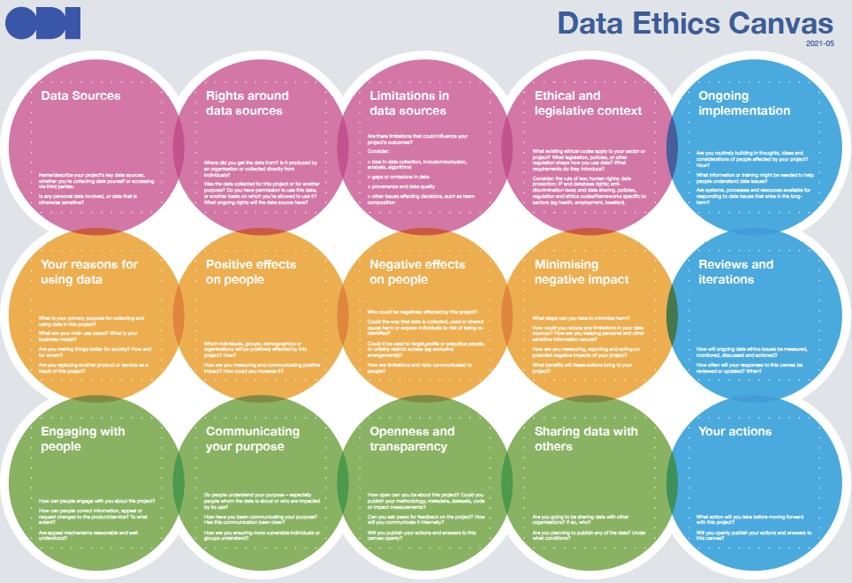
Link to canvas

Slide 19
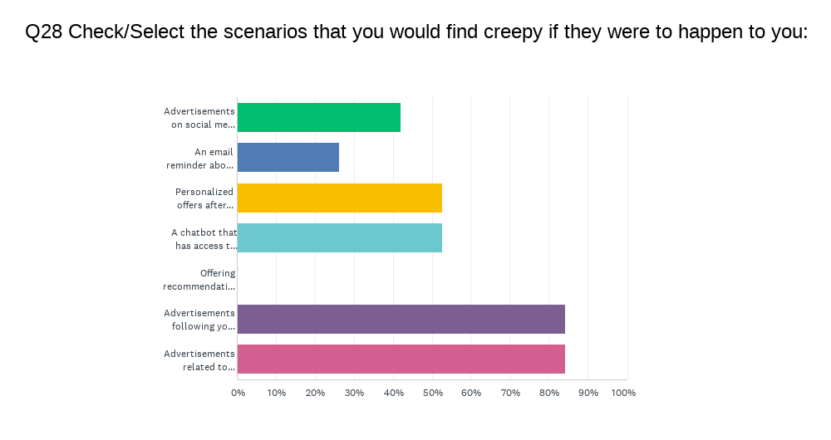
Survey Response
Advertisements on social media sites based on recent shopping experiences on other sites
42.11%
An email reminder about a product abandoned in an online shopping cart
26.32%
Personalized offers after staying on a brand's site for more than two minutes
52.63%
A chatbot that has access to past purchase history to help with online shopping
52.63%
Offering recommendations based on past purchases
Advertisements following you across devices
84.21%
Advertisements related to something they talked about near a smart device
84.21%

Slide 20
Appendix

Slide 21
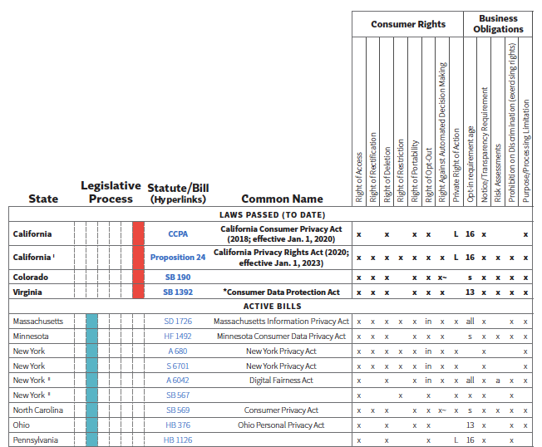
U.S. State Privacy Legislation Tracker
Bills introduced in 2021 - Passed and Active
Key

Slide 22
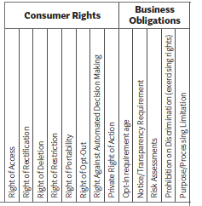
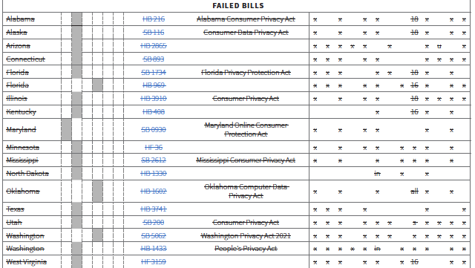
U.S. State Privacy Legislation Tracker
Bills introduced in 2021 - Failed Bills
Key

